Slide 1

A variationist study of the L2 production of Spanish trills
CASPSLaP 2014, March 16th, Georgetown University
Danielle Daidone
Sara Zahler

Slide 2
Introduction
Spanish has two rhotics, the tap /ɾ/ and the trill /r/
  pero [pé.ɾo] ‘but’ vs. perro [pé.ro] ‘dog’
  Prescriptively, /r/ is realized as a voiced alveolar trill with 2-3 occlusions (Hualde, 2005)
English-speaking learners of Spanish generally have difficulties producing the trill in a target-like manner (Face, 2006; Hurtado & Estrada, 2010; Major, 1986; Olsen, 2012; Reeder, 1998; Rose, 2010)
Target-like in these studies was solely considered the production of the voiced alveolar trill produced with multiple occlusions [r] (see Rose, 2010, and Hurtado and Estrada , 2010, for exceptions)
However, phonetic and sociolinguistic research on trill production shows that the realization of /r/ is variable in native-speaker productions (e.g. Díaz-Campos, 2008; Hammond, 1999, Widdison, 1998; Willis, 2006)
Notes:
The only position where the trill contrasts with the tap is in intervocalic position. In all other positions, the tap and the trill have a complementary distribution. The trill occurs in word-initial position, and in word-internal, syllable-initial position following a consonant.
Prescriptively /r/ is realized as a voiced alveolar trill with 2-3 occlusions.

Slide 3
Trill production by L2 learners of Spanish
American and British English have a single rhotic phoneme which is realized most often as a voiced alveolar approximant [ɹ] (Ladefoged & Johnson, 2010; Roach, 2004)
Beginning learners generally have very low accuracy in producing [r], accuracy increases with proficiency level, but even advanced speakers often fail to produce [r]
Not surprising since the alveolar trill is a difficult sound:
  requires precise control over the positioning of the articulators and the amount of air flow (Solé, 2002)
  among the last segments acquired by native speakers (Jiménez, 1987)

Slide 4
Trill production by L2 learners
Study | Learner groups | Trill
Reeder (1998) | 1st semester 3rd semester Upper Undergrad/ Graduate Faculty | 7% 13% 37% 83%
Face (2006) | 4th semester Advanced minors & majors | 5.1% 26.6%
Rose (2010) | 3rd semester students 5th semester students 8th semester students 1st year doctoral | 5% 27% 2% 67%
Olsen (2012) | Beginners | 7/48 learners
Major (1986) | Beginners | 2/4 learners

Slide 5
Trill production by Spanish native speakers
Previous studies have found that the production of the trill varies considerably across dialects:
  Velar variants in Puerto Rico (Lipski, 1990)
  Pre-breathy voiced variants in Dominican Republic (Willis, 2006, 2007)
  A range of variants from fricatives to approximants in Argentina (Colantoni, 2006)
  A tap realization in various dialects (e.g. Díaz-Campos, 2008; Willis, 2006)
  An assibilated variant throughout Latin America (e.g. Adams, 2002; Bradley, 1999, 2006; Matus-Mendoza, 2004)
Notes:
An assibilated variant has also been documented in the production of speakers from Bolivia (Bradley, 2006; Sessarego, 2011), Colombia (Bradley, 2006), Guatemala (Bradley, 2006), Honduras (Bradley, 2006), Mexico (Bradley, 2006; Rissel, 1989), Ecuador (Bradley, 1999, 2006), Costa Rica (Bradley, 2006; Quilis & Carril, 1971; Vásquez Carranza, 2006), Peru (Diez Canseco, 1997), Paraguay (Alvar, 1996b), and Chile (Hammond, 1999; Quilis & Carril, 1971).

Slide 6
Within dialects:
  Seven variants found in Santo Domingo Dominican Spanish (c.f. Willis, 2006, p. 124)
IPA | % | Description
[ɦ] | 9 | Voiced glottal fricative
[ʃ] | 10 | Voiceless alveo-palatal fricative
[ɦɾ] | 30 | Pre-breathy voice followed by a single tap
[ɦr] | 21 | Pre-breathy voice followed by multiple closures (trill)
[ɾ] | 9 | Single tap
[r] | 16 | Multiple closures without preceding breathy voice (trill)
Misc. | 4 | Post-tap frication (typically)

Slide 7
Within individuals:
  Out of the individual data presented for 10 speakers in Willis (2006), not a single speaker used exclusively one variant, i.e. all speakers presented variation
Speaker | [ɦ] | [ʃ] | [ɦɾ] | [ɦr] | [ɾ] | [r] | misc.
ME | 0 | 2 | 6 | 27 | 1 | 9 | 0
MG | 7 | 0 | 7 | 6 | 7 | 5 | 2
RC | 5 | 0 | 18 | 4 | 2 | 2 | 0
PB | 1 | 1 | 0 | 3 | 7 | 1 | 0
Examples taken from Willis (2006, p. 128)

Slide 8
Research shows that often the canonical trill is not the most frequent realization:
    “in normal Spanish discourse, the segment [r] simply does not occur in the speech of the vast majority of native Spanish speakers” (Hammond, 1999: 136)
Study | Region | % Trill
Díaz-Campos (2008) | Caracas, Venezuela | 36.2
Henriksen & Willis (2010) | Jerez, Spain | 29.8
Willis (2007) | Cibao, Dominican Republic | 4.2
Bradley (2006) | Bolivia, Colombia, Costa Rica, Ecuador | 16
Hammond (1999) | 35 dialects across Latin America, Spain, Canary Islands | 1

Slide 9
Previous sociolinguistic research
Trill variation in native speaker Spanish is constrained by:
Position with Word
Phonetic context
Number of syllables
Grammatical category
Syllable stress
Speech style
  Age
  Sex
  Social class
  Social network density
  Beliefs
  Urban vs. Rural
  Adams, 2002; Bradley, 2006; Bradley & Willis, 2012; Díaz-Campos, 2008; Diez Canseco, 1997; Henriksen & Willis, 2010; Lastra & Butragueño, 2006; Lewis, 2004; Rissel, 1989; Willis, 2006, 2007.
Notes:
Position within the word:

Slide 10
Trill production by Spanish native speakers: Summary
/r/ is highly variable in the Spanish of native speakers
  Several other variants of /r/ besides the canonical trill exist
  The trill is often not the most common variant
/r/ production is subject to a variety of linguistic and extralinguistic factors

Slide 11
What else do learners produce?
Both non-native and native-like variants:
  Major (1986):
    Learners produced English-like [ɹ], also taps
  Face (2006):
    Learners produced English-like [ɹ], also taps, voiced alveolar approximants, assibilation
  Rose (2010):
    Learners produced English-like [ɹ], also taps, and taps followed by frication

Slide 12
What conditions this variation?
Hurtado and Estrada (2010):
  Looked at what factors condition the pronunciation of Spanish r (both tap and trill contexts combined, all dialectal variants included)
Significant Factors | Produced more native-like variants when…
Rhotic (tap vs. trill) | attempting trill as opposed to tap
Phonological context | after vowels, velars, and bilabials
Position | syllable-initial position within a word
Type of discourse | reading individual words and in interviews
Recording time | later recording time
Focus of exercise | rhotics were the focus
Level of classes taken abroad | advanced classes

Slide 13
Trill production by L2 learners
Summary:
  Trill is not the most common variant produced by L2 learners until advanced levels of proficiency
  Learners often produce other variants, both non-native and native-like
  Still unknown what conditions trill variation within the trill context in the speech of L2 learners
  No direct comparison between learner variation and native speaker variation in terms of the trill production

Slide 14
Current Study
Purpose:
  Investigate the distribution of trill variants produced by L2 learners within solely the trill context and compare said production to that of native speakers performing the same tasks
  Expand the variables analyzed to include following phonological context, stress, number of syllables and speaker sex, which have been found to condition trill variation in native speakers
  Analyze what conditions the production of canonical trills (for both groups) and native-like variants (only for the L2 learners)
Research Questions:
  What linguistic and extralinguistic variables condition the use of the trilled variant in the speech of native speakers and L2 learners?
  What linguistic and extralinguistic variables condition the use of native-like variants in the speech of L2 learners?

Slide 15
Corpus
Spanish Learner Language Oral Corpora (SPLLOC) (Mitchell, Dominguez, Arche, Myles, & Marsden, 2008)
Contain oral productions from L1 British English L2 Spanish speakers and native Spanish speakers
L2 learners
  advanced speakers with a year abroad
  21-22 years old
  5 male, 5 female
Native speakers
  17-22 years old
  5 male, 12 female
Different tasks: narrative, discussion with other participants, photo description and interview, contextualized clitic production
All tokens of /r/ were extracted per speaker
Notes:
Due to various limitations of the online corpus (missing, mislabeled, or corrupt sound files), the native speaker control group consisted of many more female speakers than male speakers (3 males and 8 females) in order to achieve a comparable number of tokens to those extracted from the L2 learners’ productions.

Slide 16
Method
Tokens of /r/ were analyzed acoustically with Praat and classified as one of the following variants:
  voiced alveolar trill with 2-3 occlusions
  voiced alveolar trill with 4 or more occlusions
  voiced alveolar tap (1 occlusion)
  tap followed by approximant
  tap followed by frication
  tap followed by a partial occlusion
  approximant with a stable F3 and without audible r-coloring
  approximant with a lowered F3 and audible r-coloring
  assibilated rhotic (frication)
  voiced alveolar lateral approximant
  elision

Slide 17
Method
All tokens were coded according to the following variables:
  Preceding segment (manner)
  Preceding segment (place)
  Following segment
  Position within the word
  Stress
  Number of syllables
  Task
  Sex
Obstruent (stops, fricatives, affricates)
Sonorant consonants (nasal, lateral, rhotic)
High vowel
Mid vowel
Low vowel
Pause
Front vowel Bilabial Palatal
Central vowel Labiodental Velar
Back vowel Dental
Pause Alveolar
/a/ /e/
/i/ /o/
/u/
Word-initial
Word-internal
Stressed
Unstressed
Monosyllabic
2-3 syllables
4 or more syllables
Narratives
Discussion
Photo description and interview
Clitic production
-task type has been shown to condition variation in both NSs and learners (Ellis, 1985; Labov, 1970)
Female
Male

Slide 18
Method
Stepwise logistic regression analyses conducted using Rbrul (Johnson, 2009)
  Native speakers
    Trill versus other variants
  Learners
    Trill versus other variants
    Native-like variants versus other variants

Slide 19
Results
Native Speakers

Slide 20
Results
Notes:
Both groups have tap as most frequent variant, but NS produce more trills

Slide 21
Analysis of NS trill variation
Analysis of factors conditioning the production of trilled variants by native speakers
Trills with 2-3 occlusions and 4 or more occlusions were grouped together as application value vs. all other variants
8 tokens following a pause were excluded
1 token of a monosyllabic word was excluded

Slide 23
Results
Learners

Slide 24
Results

Slide 25
Analysis of L2 trill variation
Analysis of factors conditioning the production of the trilled variant by L2 learners
Trills with 2-3 occlusions and 4 or more occlusions were grouped together as application value vs. all other variants
Word-medial post /n/, /l/, or /s/ was excluded (7 tokens)
Notes:
proper nouns were grouped together with nouns since proper nouns were categorically realized with a non-trilled variant and nouns trended in the same direction.

Slide 27
Analysis of L2 native-nonnative variation
Analysis of factors conditioning the production of native variants by L2 learners
Native-like productions (trill, tap, assibilated variant, tap+frication, tap+partial occlusion, native-like approximant, elision) vs. English-like productions (approximant, lateral)

Slide 29
Results compared

Slide 30
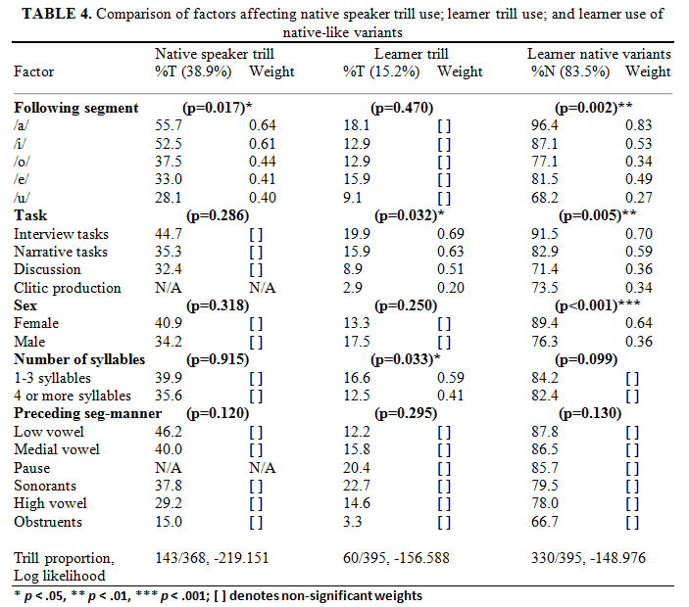

Slide 31
Discussion
Overall, L2 learners produced less canonical trills than native speakers (15.2% v. 37.8%) and exhibited non-native variants (16.5%)
  Most common variant for native speakers is trill (37.8%)
  Most common variant for learners is tap (42.3%)
The factors that conditioned the use of a trilled variant by the native speakers for these data were not the same factors that conditioned this production by L2 learners
  Following segment conditions trill variation for natives
  Task and number of syllables condition trill variation for learners
More similarities are seen between native speakers and learners when comparing the learners use of native variants versus non-native variants
Notes:
Andalusian Spanish more likely to be input to these British learners

Slide 32
Discussion
Following /a/ and /i/ favors the trill for natives and native-like variants for the learners. However, this factor is not significant for learners when looking at trill conditioning
  The same environment in which native speakers produce more trills is also the same environment in which L2 learners have less difficulty producing a native variant
  Though not significant, the distribution according to preceding segment-manner is identical for native trills and learner native variants but not for learner trills
L2 learners nearly categorically did not produce trills after an obstruent and produced more non-native variants after obstruents and high vowels
  Probably a reflection of the general articulatory difficulty of producing the trill after a consonant, which was also found in Lewis (2004), and after high vowels (Solé, 2002)

Slide 33
Discussion
Female L2 speakers favor more native-like variants than male L2 speakers and female native speakers favor more trilled variants than male native speakers
  Suggests female L2 speakers may be trying to trend towards more prestigious realizations (i.e. native-like productions) of the trill phoneme
In both analyses, the L2 learners’ production was conditioned by task type
Notes:
For the last bullet point, learners’ attentional resources aren’t elsewhere, but with the narrative, the paired discussion, and the clitic production, the task had a goal that wasn’t purely speech. They had to place their attentional resources elsewhere.

Slide 34
Conclusion
Overall, this study suggests that advanced L2 learners behave more similarly to native speakers in terms of trill production than found in previous L2 research, which tended to only focus on the realization of a trilled variant
They produce a high number of native-like variants (83.5%), particularly the tap (43.2%), but a low number of trills (15.2%)
  Spanish-speaking children at the age of 5 still have not completely acquired the trill (Jiménez, 1987)
Investigations in which more tokens are analyzed are needed
Additional factors, such as the effect of frequency or morphological status (i.e. re-), should be considered
Future research should consider L2 speech in light of variation in native speaker productions, not standard or normative forms

Slide 35
Thank you
Questions? Comments?
Danielle Daidone ddaidone@indiana.edu
Sara Zahler szahler@indiana.edu

Slide 36
References
Adams, C. (2002). Strong assibilation and prestige: a sociolinguistic study in the central valley of Costa Rica. (Doctoral dissertation), University of California, Davis.
Boersma, P., & Weenink, D. (2011). Praat: doing phonetics by computer (Version 5.3). Retrieved from www.praat.org
Bradley, T. G. (1999). Assibilation in Ecuadorian Spanish: A phonology-phonetics account. In B. E. Bullock, J.-M. Authier & L. A. Reed (Eds.), Formal Perspectives on Romance Linguistics (pp. 57-71). Amsterdam: John Benjamins.
Bradley, T. G. (2006). Phonetic realizations of /sr/ clusters in Latin American Spanish. In M. Díaz-Campos (Ed.), Selected Proceedings of the 2nd Conference on Laboratory Approaches to Spanish Phonetics and Phonology (pp. 1-13). Somerville, MA: Cascadilla Proceedings Project.
Bradley, T. G., & Willis, E. W. (2012). Rhotic variation and contrast in Veracruz Mexican Spanish. Estudios de fonética experimental, 21, 43-74. Colantoni, L. (2006). Increasing periodicity to reduce similarity: an account of deassibilation in rhotics. In M. Díaz-Campos (Ed.), Selected proceedings of the 2nd Conference on Laboratory Approaches to Spanish Phonetics and Phonology (pp. 22-34). Somerville, MA: Cascadilla Press.
Díaz-Campos, M. (2008). Variable production of the trill in spontaneous speech: sociolinguistic implications. In L. Colantoni & J. Steele (Eds.), Selected Proceedings of the 3rd Conference on Laboratory Approaches to Spanish Phonology (pp. 47-58). Somerville, MA: Cascadilla Press.
Diez Canseco, S. d. l. H. (1998). Language Variation: The Influence of Speakers' Attitudes and Gender on Sociolinguistic Variables in the Spanish of Cusco, Peru. Ph.D. Dissertation, University of Pittsburgh.
Ellis, R. (1985). Sources of variability in interlanguage. Applied linguistics, 6(2), 118-131.
Face, T. L. (2006). Intervocalic rhotic pronunciation by adult learners of Spanish as a second language. In C. A. Klee & T. L. Face (Eds.), Selected proceedings of the 7th Conference on the Acquisition of Spanish and Portuguese as First and Second Languages (pp. 47-58). Somerville, MA: Cascadilla Press.
Hammond, R. (1999). On the non-occurrence of the phone [r] in the Spanish sound system. In J. Gutierrez-Rexach & F. Martinez-Gil (Eds.), Advances in Hispanic Linguistics. Papers from the 2nd Hispanic Linguistics Symposium. (pp. 135-151). Somerville: Cascadilla Press.
Henriksen, N. C., & Willis, E. W. (2010). Acoustic characterization of phonemic trill production in Jerezano Andalusian Spanish. In M. Ortega-Llebaria (Ed.), Selected Proceedings of the Fourth Conference on Laboratory Approaches to Spanish Phonology (pp. 115-127). Somerville, MA: Cascadilla Proceedings Project.
Hurtado, L. M., & Estrada, C. (2010). Factors Influencing the Second Language Acquisition of Spanish Vibrants. The Modern Language Journal, 94(1), 74-86.
Hualde, J. I. (2005). The sounds of Spanish. New York: Cambridge University Press.
Jiménez, B. C. (1987). Acquisition of Spanish Consonants in Children Aged 3-5 Years, 7 Months. Language, Speech, and Hearing Services in Schools, 18(4), 357-363.
Labov, W. (1970). The study of language in its social context. Studium Generale, 23, 30-87.

Slide 37
References
Ladefoged, P., & Johnson, K. (2010). A course in phonetics (6th ed.). Boston, MA: Wadsworth Publishing Company.
Lastra, Y., & Butragueño, P. M. (2006). Un posible cambio en curso: el caso de las vibrantes en la ciudad de México. Estudios sociolingüísticos del español de España y América, 35-68.
Lewis, A. M. (2004). Coarticulatory effects on Spanish trill production. In A. Agwuele, W. Warren & S.-H. Park (Eds.), Proceedings of the 2003 Texas Linguistics Society Conference (pp. 116-127). Somerville, MA: Cascadilla Proceedings Project.
Lipski, J. (1990). Spanish taps and trills: Phonological structure of an isolated opposition. Folia linguistica, 24(3/4), 153-174.
Major, R. C. (1986). The ontogeny model: Evidence from L2 acquisition of Spanish r. Language Learning, 36(4), 453-504.
Matus-Mendoza, M. (2004). Assibilation of /-r/ and migration among Mexicans. Language Variation and Change, 16, 17-30.
Mitchell, R., Dominguez, L., Arche, M. J., Myles, F., & Marsden, E. (2008). SPLLOC: A new database for Spanish second language acquisition research. EuroSLA Yearbook, 8(1), 287-304.
Olsen, M. K. (2012). The L2 Acquisition of Spanish Rhotics by L1 English Speakers: The Effect of L1 Articulatory Routines and Phonetic Context for Allophonic Variation. Hispania, 95(1), 65-82.Reeder, J. T. (1998). English speakers’ acquisition of voiceless stops and trills in L2 Spanish. Texas Papers in Foreign Language Education, 3(3), 101-108.
Rissel, D. A. (1989). Sex, attitudes, and the assibilation of /r/ among young people in San Luis Potosí, Mexico. Language variation and change, 1(3), 269-283.
Roach, P. (2004). British English: Received Pronunciation. Journal of the International Phonetic Association, 34(2), 239-245.
Rose, M. (2010). Intervocalic tap and trill production in the acquisition of Spanish as a second language. Studies in Hispanic and Lusophone Linguistics, 3(2), 379-419.
Sankoff, D., Tagliamonte, S., & Smith, E. (2005). Goldvarb X: A variable rule application for Macintosh and Windows. Department of Linguistics, University of Toronto.
Solé, M.-J. (2002). Aerodynamic characteristics of trills and phonological patterning. Journal of Phonetics, 30(4), 655-688.
Widdison, K. A. (1998). Phonetic motivation for variation in Spanish trills. Orbis: Bulletin international de documentation linguistique, 40, 51-61.
Willis, E. W. (2006). Trill variation in Dominican Spanish: An acoustic examination and comparative analysis. Selected proceedings of the 9th Hispanic Linguistic Symposium, 121-131.
Willis, E. W. (2007). An acoustic study of the 'pre-aspirated trill' in narrative Cibaeño Dominican Spanish. Journal of the International Phonetic Association, 37(1), 33-49.

Slide 38
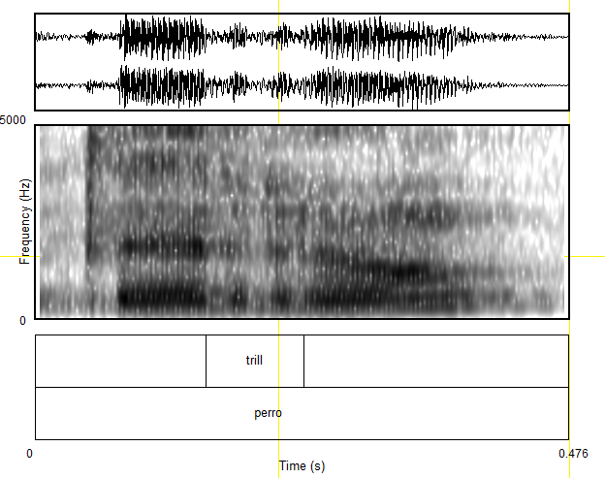

Slide 39
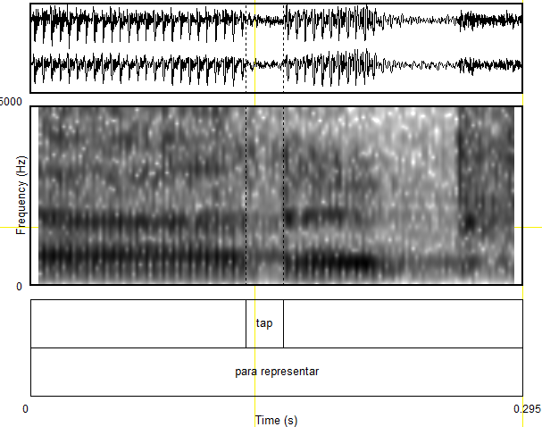
Notes:
Add spectographs and crosstabs as appendices

Slide 40
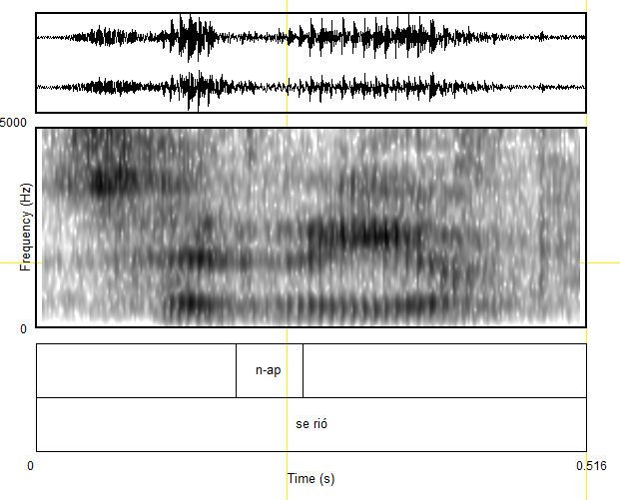

Slide 41
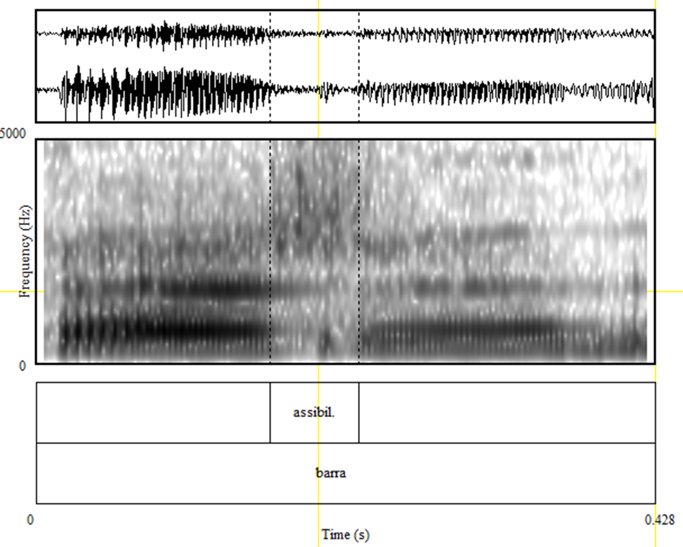

Slide 42
