Slide 1
The impact of study abroad on the acquisition of the Spanish copula contrast
Melissa Whatley, Sara Zahler, Kimberly Geeslin, and Manuel Díaz-Campos
Indiana University

Slide 2
Introduction
Goal: To examine the development of variable Spanish copula use in the context of intensive exposure during study abroad (SA).
[copula + adjective]
Ser vs. estar
Soy extrovertido ‘I am outgoing’
Estoy alegre ‘I am happy’
Notes:
While ser is the only copula choice for passive voice contexts, and estar the only copula choice for progressive contexts; ser and estar can both be used in preadjectival or locative contexts.

Slide 3
Research on native-speaker variable copula use

Slide 4
Accounts of variation
Permanency (ser) vs. temporariness (estar) (Bello & Cuervo, 1847: 1960)
Frame of reference (Falk, 1979)
Individual frame (estar) vs. class frame (ser)
Distinction in predicate type
Stage-level (estar) vs. individual-level (ser) (Diesing, 1992; Fernández Leborans, 1999; Lema, 1995; Leonetti, 1994)
Perfectivity (Bosque, 1990; Schmitt 1992, 2004)
Resultant state for estar
Connection/anchorage to another situation or location is presupposed or part of the discourse (Clements, 1988; Maeinborn, 2005)
Adjective class (Clements, 1988; Navas Ruiz, 1986; Vañó-Cerdá, 1982)
Notes:
Traditionally ser is associated with permanency and estar with temporary properties. However, this distinction is not a grammatical principle, but rather a tendency. Examples such as ella esta’ muerta demonstrate counterexamples to this tendency.
Thus, more recent analyses have tried to describe the difference between ser and estar in terms of different syntactic, semantic, discourse and pragmatic uses that can explain this tendency towards a temporariness-permanency distinction.
Although this list is not exhaustive, several main accounts are summarized here. Falk described the ser-estar distinction in terms of frame of reference: estar is used for individual frame reference, where a referent is compared to itself at another point in time; whereas ser is employed with class frame reference, in which a referent is compared to a group of similar objects.
Also discussed is a distinction of predicate type. A stage-level predicate is delimited temporally, whereas an individual-level predicate is not.
Similarly, perfectivity has been called on to explain the ser-estar distinction in the copula + adjective structure. Estar is used with adjectives describing a resultant state.
If the predicate is anchored to another event or location that is part of the discourse, estar is claimed to be used.
Lastly, adjective class has been oftentimes invoked as relevant to this distinction.

Slide 5
Factors affecting variation between ser and estar
Susceptibility to change
Adjective class/type
Semantic transparency
Subject animacy
Presence of an intensifier
Temporal adverbial
Predicate type
Copulas allowed
Resultant state
Frame of reference
Experience with the referent
e.g. Aguilar-Sánchez, 2009; Clements, 2005; Cortés-Torres, 2004; de Jonge, 1993; Díaz-Campos & Geeslin, 2011; Geeslin & Guijarro-Fuentes, 2008; Guijarro-Fuentes & Geeslin, 2006; Gutiérrez, 1992, 1994; Ortíz-López, 2000; Salazar, 2007; Silva-Corvalán, 1986.
Notes:
Several syntactic, pragmatic and discursive factors related to or directly applied from these accounts of variation have been shown to influence ser-estar use. These factors are semantic, syntactic, and pragmatic. The two that are of interest to us in this study are frame of reference and experience with the referent.

Slide 6
Examples
Frame of reference:
Britney Spears es rubia.
Antes, Britney Spears tenía pelo rubio, pero ahora está calva.
Experience with the referent:
Mi hermana es muy delgada.
En esta foto mi hermana está muy delgada.

Slide 7
The SLA of copula choice

Slide 8
Early work
Error analysis → Stages of acquisition (Briscoe, 1995; Gunterman, 1995; Ryan & Lafford, 1992; VanPatten, 1985, 1987)
Included all functions
Notes:
The earliest research on copula choice was often characterized by predetermined error analysis of ser and estar use to arrive at said stages of acquisition.
Several studies have determined that copula choice in L2 learners is determined by

Slide 9
Variationist work
Exclusively focused on the [copula + adjective] structure
Has found that:
Learners use a range of forms: ser, estar, parecer, sentir
Learners begin with a low rate of estar, which increases with proficiency and can surpass the rate of estar use of native speakers
Learners are sensitive to the semantic, pragmatic and discursive features of Spanish copula use
This sensitivity can develop over time
Semantic factors are significant at lower levels, whereas pragmatic factors are significant at higher levels
Advanced learners generally approximate native speaker norms in terms of significant predictors and their direction of effect.
e.g. Cheng, Lu & Giannakouros, 2008; Geeslin, 2000, 2001, 2003, 2005; Geeslin & Gudmestad, 2008, 2010; Geeslin & Guijarro-Fuentes, 2004, 2005, 2006a,b, 2007

Slide 10
Woolsey (2008)
2 tasks (examined together)
Picture description task
16-item WCT with pictures manipulating the variables: frame of reference and immediate experience with the referent (similar to the task used in the current study)
111 university-level participants from four levels representing 2nd-4th year Spanish.
Notes:
One study in particular has examined the effect of two pragmatic factors on the ser-estar contrast in Spanish, specifically the variables grame of reference and immediate experience with the referent. This study has found that even advanced (4th year) learners do not pattern in the expected direction.

Slide 11
Woolsey (2008)
Results (regression analyses):
Task emerges as most significant predictor variable in a regression analysis
Immediate experience with referent ([+/- immediate experience])
Chi-square
Significant for levels 1 & 2 not in the expected direction -- estar more frequent in [-immediate experience] contexts
Significant for level 4 in the expected direction -- estar more frequent in [+immediate experience] contexts
Frame of reference ([+/- comparison])
Chi-square
Significant for levels 3 & 4 not in the expected direction -- estar more frequent in [-comparison] contexts
Need for native speaker comparison group

Slide 12
Connecting Woolsey to other SLA research
Advanced learners generally approximate native speaker norms
Specifically, two pragmatic features (experience with the referent and frame of reference) have been shown to constrain learner variation, though not always as expected
The development of copula use with respect to these two pragmatic features has not been investigated in a SA context and compared to NSs
Notes:
So tying this in with the other previous research that we just synthesized, it has been shown that generally advanced learners approximate the native speaker norms. Woolsey, who examined two pragmatic factors, found that the learners did not pattern in the expected direction, above all for frame of reference. However, the development of copula use with respect to these two pragmatic features has not been investigated in a SA context and compared to NSs.
With increased input, we may expect more development as far as pragmatic features are concerned in a SA context

Slide 13
The study abroad context

Slide 14
Study Abroad
Effects of SA on L2 development are not always uniform
Grammatical structure/ability studied
Characteristics of the non-native speaker (NNS)
Type of SA program
Contact hours
DeKeyser 1986, 1991; Díaz-Campos 2004; Freed, Segalowitz, & Dewey 2004; Hernández 2010; Knight & Schmidt-Rinehart 2010; Lafford 1995, 2004; Segalowitz & Freed 2004; Segalowitz et al. 2004; Vande Berg, Connor-Linton & Paige 2009
Notes:
While overall results reveal that learners improve their L2 skills even with short stays in the target environment, effects of SA on L2 development are not always uniform and is often mediated by various factors. For example, areas such as oral and written fluency, lexical knowledge and sociolinguistic awareness often show improvement. However, there are mixed results for grammatical precision and pronunciation.
Characteristics of the non-native speaker and the type of SA abroad program have also been found to influence gains after a SA experience.
Importantly, contact hours with NSs have been shown to influence learner gains, and consequently need to be considered.

Slide 15
Study Abroad
Lafford and Collentine (2006) in their review of the SA literature, note several gaps in prior research, among which this study will focus on:
Information about the SA program
Fine-grained test instruments
Notes:
Lafford and Collentine (2006) highlight in their overview of research on SA and at-home (AH) contexts that one reason current research presents mixed results may be a reflection of the research methodology employed. Specifically, current research into the SA learning context lacks information about the SA program, a robust number of participants, AH comparison groups, and fine-grained test instruments. This study attempts to address these four gaps in previous studies by examining the effects of SA on the acquisition of subject expression variation in L2 Spanish in comparison with AH data.

Slide 16
Study Abroad
Scarcity of research on SA and the acquisition of morphosyntactic variation in Spanish
Object pronouns (Geeslin, Garcia-Amaya, Hasler, Henrikson, & Killam, 2010; Salgado-Robles, 2011)
Past temporal reference (Geeslin, Garcia-Amaya, Hasler, Henrikson, & Killam, 2012; Geeslin, Fafulas, & Kanwit, 2013; Whatley, 2013)
Future temporal reference (Kanwit & Solon 2013)
Demonstrates changes in frequency and predictors of use even during relatively short but intensive SA experiences

Slide 17
Study Abroad and copula choice
Previous research on L2 copula during short term SA has focused on stages of acquisition (Guntermann, 1995; Ryan & Lafford, 1992)
Approach based on error analysis
Not limited to the [copula + adjective] context
Copula use has not been studied within a variation framework

Slide 18
The current study

Slide 19
The Current Study
Goal: Examine the development of copula contrast in pre-adjectival contexts by English-speakers learning Spanish with a focus on the effect of two pragmatic predictors: experience with referent [+/- immediate experience] and frame of reference [+/- comparison]
Participants
26 High school students studying abroad in Valencia, Spain
6 Native speakers from the Valencian Community
Notes:
Results inform our knowledge of L2 acquisition of variation in general

Slide 20
The Learning Context
Highly competitive immersion program
Host families
Structured daily activities
4 academic courses
Grammar, Communication, Culture, Linguistics
Obligatory afternoon activities
Optional afternoon and weekend activities
3 Obligatory weekend excursions
Students sign contract to speak only Spanish for the entire 6-week-long program

Slide 21
Elicitation tasks and timeline
Pre-study abroad questionnaire administered in English at orientation about a month before leaving the United States
Computerized Questionnaire Task (CQT) administered the second week in Valencia (Time 1)
CQT administered again 1 month later; 3 days before leaving Valencia (Time 2)
Proficiency test (2 times)
25 discrete-point grammatical items
Post-study abroad questionnaire administered via e-mail after students had returned to the United States (4 learners did not complete) (details later)
Estimate the amount of contact hours they had with Spanish while abroad (adapted from Freed et al., 2004)

Slide 22
Linguistic Task
Administered using PowerPoint
Response choice: ser or estar
Manipulated variables
Pragmatic
Frame of reference (comparison context or not)
Experience with referent (there was a photo [+experience] or not [-experience] of the referent)
All other variables controlled

Slide 23
Britney Spears Profesión: Cantante, Madre Edad: 29 años
Describe a Britney Spears físicamente
Britney es rubia.
Britney está rubia.
Notes:
No comparison; text experience only, no immediate experience

Slide 24
Britney Spears
En el 2006 Britney le pidió el divorcio a Kevin Federline, dejó de cantar, tuvo problemas sicológicos y subió de peso. En el 2011 Britney retomó su carrera, bajó de peso y tiene éxito.
En el 2011 Britney es delgada.
En el 2011 Britney está delgada.
Notes:
Comparison, text experience, no immediate experience

Slide 25
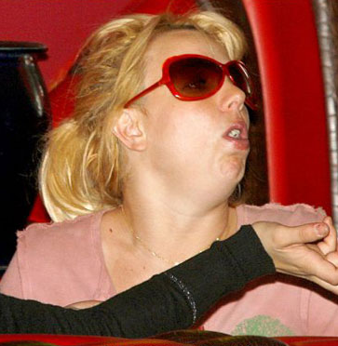
Britney Spears
Observa la foto y describe a Britney.
Britney es gorda.
Britney está gorda.
Notes:
No comparison, photo experience

Slide 26
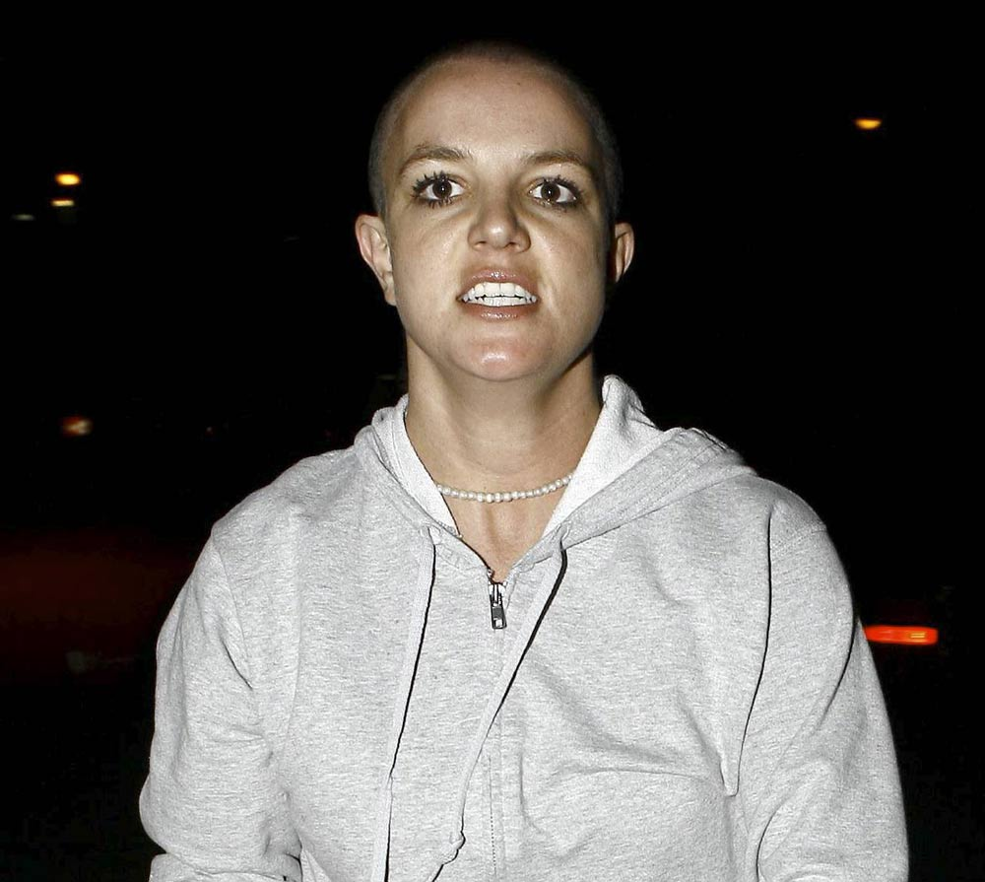
Britney Spears
Mira las dos fotos y describe la foto 2.
Britney es calva.
Britney está calva.
Foto 1
Foto 2:
Notes:
Comparison, photo experience

Slide 27
Timeline
Pre-study abroad questionnaire administered in English at orientation about a month before leaving the United States
CQT administered the second week in Valencia (Time 1)
CQT administered again 1 month later; 3 days before leaving Valencia (Time 2)
Post-study abroad questionnaire administered via e-mail after students had returned to the United States (4 learners did not complete) (details later)

Slide 28
Results

Slide 29
Results: Distribution (whole group)
Time | % ser | % estar
Before study abroad | 64.8% (324) | 35.2% (176)
After study abroad | 65.6% (328) | 34.4% (172)
NSs from Valencia | 31.7% (38) | 68.3% (82)

Slide 30
Results: Regression (whole group)
Time | Frame of reference (comparison or not) | Experience with referent ([+/- experience]) | % Explained
Before SA | X*** | X*** | 64.4%
After SA | X*** | X*** | 64.6%
NS from Valencia | X*** | X*** | 83.3%
Note. * = p < .05, ** = p < .01, *** = p < .001

Slide 31
Contact with Spanish
What kinds of interactions did students have while abroad? What were their social networks like?
This summer, outside of class, I spoke Spanish to:
3d. strangers whom I thought could speak Spanish
Typically, how many days per week?
□0 □1 □2 □3 □4 □5 □6 □7
On those days, typically how many hours per day?
□0–1 □1–2 □2–3 □3–4 □4–5 □more than 5
Written and oral, active and passive
Hours/day calculated for each learner via a points system
Low contact: 0 – 48 points
High contact: 49 – 62 points
105 possible points

Slide 32
Results: Distribution (contact hours)
Time | % ser | % estar
Low Bef. SA | 67.9% (163/240) | 32.1% (77/240)
Low After SA | 70.0% (154/220) | 30.0% (66/220)
High Bef. SA | 63.3% (114/180) | 36.7% (66/180)
High After SA | 65.0% (130/200) | 35.0% (70/200)
NSs from Valencia | 31.7% (38/120) | 68.3% (82/120)

Slide 33
Results: Regression (contact hours)
Level/Group | Frame of reference ([+/-comparison]) | Experience with referent ([+/- experience]) | % Explained
Low Bef. SA | X*** | X** | 67.9%
Low After SA | X* | X* | 70.0%
High Bef. SA |  | X** | 63.3%
High After SA | X* | X*** | 65.0%
NS from Valencia | X*** | X*** | 83.3%
Note. * = p < .05, ** = p < .01, *** = p < .001

Slide 34
Frame of reference
Time 1 Time 2 Time 1 Time 2 NSs
Low Contact High Contact
Notes:
Distribution of ser/estar in the native like direction for all groups at all times; all groups overuse ser

Slide 35
Experience with referent
Time 1 Time 2 Time 1 Time 2 NSs
Low Contact High Contact
Exp = experience
Notes:
All groups in native-like direction; difference becomes more apparent at time 2 for high contact learners

Slide 36
Summary of Results
Learners continue to overuse ser (overall rates did not change over course of SA)
Regression
Low contact group: Less native-like over the course of SA
High contact group: More native-like over the course of SA
Direction of effects mostly native-like at Time 1 and Time 2
Frame of reference
Very little change over time
Experience with referent
Very little change over time
High contact group at Time 2 differentiates more clearly between [+/- experience] contexts

Slide 37
Discussion
Frame of reference:
Woolsey (2008): Even at Level 4, significant but effect in opposite direction
Current study: Little change over time for High and Low contact groups (but direction of effect in the native-like direction)
Experience with referent:
Woolsey (2008): Levels 1 & 2, significant but effect in opposite direction; Level 3 not significant; Level 4 significant and in native-like direction
Current study: Becomes significant for high contact group; direction of effect more apparent at Time 2 for this group

Slide 38
Conclusion
Benefits of SA are not automatic, but rather mediated by additional factors, such as contact hours
These two pragmatic constraints on copula variation, [+/- experience with the referent] and [+/- comparison], are late acquired, even with SA experience
“All told, pragmatic competence seems to develop quite slowly in the SA context” (Collentine, 2009: 226)
May be a classroom effect
Learners are introduced to ser early on
Ser is likely to be more frequent in input due to the nature of classroom activities
Need for more native-like variable input from the beginning stages of acquisition
Future studies:
Classroom input
Naturalistic learners
Highly advanced learners
Notes:
MW: Weren’t we going to cite studies about pragmatics being late acquired here?
SZ: In his review on of the SA literature, Collentine examines the relevant research on pragmatics in SA contexts and concludes: “All told, pragmatic competence seems to develop quit slowly in the SA context”
Is this okay?

Slide 39
Thank you!
Special thanks to Stephanie Goetz, Managing director of the IU Honors Program in Foreign Languages, students of S614 and S712 for their initial work on task design, and Bret Linford for his assistance with statistical analysis. All remaining errors are our own.
Melissa Whatley melwhatl@indiana.edu
Sara Zahler szahler@indiana.edu
Kimberly Geeslin kgeeslin@indiana.edu
Manuel Díaz-Campos mdiazcam@indiana.edu

Slide 40
References
Aguilar-Sánchez, J. (2009). Syntactic variation: The case of copula choice in Limón, Costa Rica (Unpublished doctoral dissertation). Indiana University, Bloomington, IN.
Andrade, M. J. (1919). The distinction between ser and estar. Hispania, 2, 19-23.
Bello & Cuervo 1911, 1916 find where I cited it!
Briscoe, G. (1995). The acquisition of ser and estar by non-native speakers of Spanish. Doctoral dissertation. University of Pennsylvania, Philadelphia, PA.
Clements, J. C. (2005). ‘Ser’ and ‘estar’ in the predicate adjective construction. In J. C. Clements & J. Yoon (Eds.), Functional approaches to Spanish syntax: Lexical semantics, discourse, and transitivity (pp. 161–202). London: Palgrave-Macmillan.
Collentine, J. 2009. Study abroad research: Findings, implications, and future directions. In M. Long & C. Doughty (Eds.), The Handbook of Language Teaching (pp. 218-234). Wiley-Blackwell Press: Oxford, UK.
Cortés-Torres, M. (2004). ¿Ser o Estar? La variación lingüística y social de estar más adjetivo en el español de Cuernavaca, Mexico. Hispania, 87, 788-795.
De Jonge, B. (1993). (Dis)continuity in language change: Ser and estar + age in Latin American Spanish. In F. Drijkoningen & K. Hengeveld (Eds.), Linguistics in the Netherlands (pp. 69-80). Amsterdam: John Benjamins.
DeKeyser, R. (1986). From Learning to Acquisition? Foreign Language Development in a U.S. Classroom and During a Semester Abroad. Doctoral dissertation. Stanford University, Stanford, CA.
DeKeyser, R. (1991). Foreign language development during a semester abroad. In B. F. Freed (Ed.), Foreign Language Acquisition Research and the Classroom (pp. 104-119). Lexington, MA: D.C. Heath.

Slide 41
References
Díaz-Campos, M. (2004). Context of learning in the acquisition of Spanish second language phonology. Studies in Second Language Acquisition 26, 249-274.
Diaz-Campos, M. & Geeslin, K. (2011). Copula Use in the Spanish of Venezuela: Social and Linguistic Sources of Variation Spanish. Spanish in Context, 8, 73-94.
Freed, B., Segalowitz, N., & Dewey, D. (2004). Context of learning and second language fluency in French: Comparing regular classroom, study abroad, and intensive domestic immersion programs. Studies in Second Language Acquisition 26, 275-301.
Geeslin, K. (2000). A new approach to the second language acquisition of copula choice in Spanish. In R. Leow & C. Sanz (Eds.), Spanish Applied Linguistics at the Turn of the Millennium: Papers from the 1999 Conference on the L1 & L2 Acquisition of Spanish and Portuguese (pp. 50-66). Somerville, MA: Cascadilla Press.
Geeslin, K. (2001). Changing norms, moving targets and the SLA of copula choice. Spanish Applied Linguistics, 5, 29-55.
Geeslin, K. (2003). A comparison of copula choice in advanced and native Spanish. Language Learning, 53, 703-764.
Geeslin, K., & Guijarro-Fuentes, P. (2006). A longitudinal study of copula choice: Following development in variable structures. In N. Sagarra & A. J. Toribio (Eds.), Selected Proceedings of the 9th Hispanic Linguistics Symposium (pp. 144-156). Somerville, MA: Cascadilla Proceedings Project.
Geeslin, K., & Guijarro-Fuentes, P. (2008). Variation in contemporary Spanish: Linguistic predictors of estar in four cases of language contact. Bilingualism: Language and Cognition, 11, 365-380.

Slide 42
References
Geeslin, K., Garcia-Amaya, L., Hasler, M., Henrikson, N., & Killam, J. (2010). The SLA of direct object pronouns in an immersion environment where use is variable. In C. Borgonovo, M. Español-Echevarría & P. Prévost, (Eds.), Selected Proceedings from the 12th Hispanic Linguistics Symposium (pp. 246-259). Somerville, MA: Cascadilla Press.
Geeslin, K., Garcia-Amaya, L., Hasler, M., Henrikson, N., & Killam, J. (2012). A study of the second language acquisition of the present perfect in an immersion context. In K. Geeslin & M. Díaz-Campos (Eds.), Selected Proceedings for the Hispanic Linguistics Symposium (pp. 197-215). Somerville, MA: Cascadilla Press.
Guijarro-Fuentes, P., & Geeslin, K. (2006). Copula choice in the Spanish of Galicia: The effects of bilingualism on language use. Spanish in Context, 3, 63-83.
Guntermann, G. (1995). The Peace Corps experience: Language learning in training and in the field. In B. Freed (Ed.). Second Language Acquisition in a Study Abroad Context (pp. 149-170). Amsterdam/Philadelphia: John Benjamins.
Gutiérrez, M. (1992). The Extension of estar: A linguistic change in progress in the Spanish of Morelia, Mexico. Hispanic Linguistics, 5, 109-141.
Gutiérrez, M. (1994). Simplification, transfer and convergence in Chicano Spanish. Bilingual Review/La Revista Bilingüe, 19, 111 – 121.
Hernández, T. (2010). The Relationship Among Motivation, Interaction, and the Development of Second Language Oral Proficiency in a Study-Abroad Context. The Modern Language Journal 94, 600–617.
Kanwit, M. & Solon, M. (2013). Acquiring variation in future-time expression abroad in Valencia, Spain and Mérida, Mexico. In J. Aaron, J. Cabrelli Amaro, G. Lord, & A. de Prada Pérez (Eds.) Selected Proceedings of the 16th Hispanic Linguistics Symposium (pp. 206 – 221). Somerville, MA: Cascadilla Proceedings Project.
Knight, S., & Schmidt-Rinehart, B. (2010). Exploring conditions to enhance student/host family interaction abroad. Foreign Language Annals 43, 64-79.
Lafford, B. (1995). Getting into, through and out of a survival situation: A comparison of communicative strategies used by students studying Spanish abroad and “at home.” In B. Freed (Ed.), Second Language Acquisition in a Study Abroad Context (pp. 97-121). Philadelphia: John Benjamins.
Lafford, B. (2004). The effect of the context of learning on the use of communication strategies by learners of Spanish as a second language. Studies in Second Language Acquisition 26, 201-226.

Slide 43
References
Lafford, B. & Collentine, J. (2006). The effects of study abroad and classroom contexts on the acquisition of Spanish as a second language: From research to application. In B. Lafford & R. Salaberry (Eds.), Spanish Second Language Acquisition: From Research Findings to Teaching Applications (pp. 103-126). Washington, DC: Georgetown University Press.
Morley, S. G. (1925). Modern uses of ser and estar. Publications of the Modern Language Association, 40, 450-489.
Ortiz López, L. (2000). La extensión de estar en contextos de ser en el español de Puerto Rico: ¿Evolución interna o contacto de lenguas? Boletín de la Académia Puertorriqueña de la Lengua Española, 98-118.
Salazar, M. L. (2007). Está muy diferente a como era antes: Ser and estar + adjective in New Mexico Spanish. In K. Potowski & R. Cameon (Eds.), Spanish in Contact: Policy, Social and Linguistic Inquiries (pp. 345-355). Amsterdam: John Benjamins Publishing Company.
Salgado-Robles, F. (2011). The Acquisition of Sociolinguistic Variation by Learners of Spanish in a Study Abroad Context. PhD Dissertation, University of Florida. Gainesville, FL.
Segalowitz, N., & Freed, B. (2004). Context, contact and cognition in oral fluency acquisition: Learning Spanish in At Home and Study Abroad contexts. Studies in Second Language Acquisition 26, 173-199.
Segalowitz, N., Freed, B., Collentine, J., Lafford, B., Lazar, N., & Díaz-Campos, M. (2004). A comparison of Spanish second language acquisition in two different learning contexts: study abroad and the domestic classroom. Frontiers 10, 21-38.
Silva-Corvalan, C. (1986) Language contact and change: The extension of estar in Los Angeles Spanish. Language 62, 583-608.
Regan, V., Howard, M., & Lemée, I. (2009). The Acquisition of Sociolinguistic Competence in a Study Abroad Context. Tonawanda, NY: Multilingual Matters.
Ryan, J., & Lafford, B. (1992). The acquisition of lexical meaning in a study abroad environment: Ser and estar and the Granada experience. Hispania, 75, 714–722.

Slide 44
References
Vande Berg, M., Connor-Linton, J., & Michael Paige, R. (2009). The Georgetown Consortium Study: Intervening in student learning abroad. Frontiers 18, 1-75.
VanPatten, B. (1985). The acquisition of ser and estar by adult learners of Spanish: A preliminary investigation of transitional stages of competence. Hispania, 68, 399-406.
VanPatten, B. (1987). Classroom learners’ acquisition of ser and estar: Accounting for development patterns. In B. VanPatten, T. R. Dvorak, & J. F. Lee (Eds.), Foreign Language Learning (pp. 19-32). Rowley: Newbury.
Whatley, M. (2013). The acquisition of past tense variation by L2 learners of Spanish in an abroad context. In J. Cabrelli Amaro, G. Lord, A. de Prada Pérez, & J. E. Aaron (Eds.), Selected Proceedings of the 16th Hispanic Linguistics Symposium (pp. 190-205). Somerville, MA: Cascadilla Proceedings Project.
Woolsey, D. (2008). From theory to research: Contextual predictors of “estar + adjective” and the study of the SLA of Spanish copula choice. Bilingualism: Language and Cognition, 11, 277-295.

