Slide 1
Speech strategy variation in Mexico City Spanish and London English in online personal advertisements
Sara Zahler
Indiana University

Slide 2
Introduction

Slide 3
Language as identity
Speakers use language to participate in various sociocultural groups by displaying behavior that is often associated with a group identity (Elliot, 2010; Reid & Giles, 2005).
Primary means for constructing sociocultural identities (Bucholtz & Hall, 2004).
Ideologies
Discursive practices
Deviation from the norm
Ebonics or Spanglish (Harwood & Abhik, 2005)
Notes:
Speakers often use language to participate in various sociocultural groups by displaying behavior that is often associated with a group identity (Elliot, 2010; Reid & Giles, 2005).

Slide 4
Online personal advertisements
Excellent forum for the creation of such lingusitic practices.
Speakers use specific linguistic practices in:
Partner selection strategies (e.g. Cicerello & Sheeham, 1995; Hatala & Prehodka, 1996; Sato, 2008).
Demonstrating and authenticating membership in specific gender or sexual groups (Del-Teso-Craviotto, 2008).
These norms are often established by members of specific online dating communities (Groom & Pennebaker, 2005; Gudelanas, 2005; Hardey, 2004; Smith and Stillman, 2002; Yurchisin, Watchravesringkan, & McCabe, 2005).
Notes:
Del-Taso-Craviotto writes that “the authentication of the participants’ gender and sexual identity is a performative act acheived through different linguistic strategies” (256). Well, as we’ve seen, looking at gender as a performative act seems like a good idea, and now it looks like we’re going to get a how to.
Self-describing announcement by individuals seeking socio-sexual relationships with an ideal partner

Slide 5
Research goals
To explain variation in speech strategy sequencing in electronic personal ads in terms of social variables such as gender, and sexual orientation by examining variation in the description of one’s desired partner.
The second goal is to compare said sociolinguistic patterning between Spanish personal ads from Mexico City and English personal ads from London.

Slide 6
DF.HBM.17
Hola (Greeting)
Hi
soy un hombre de 32 años solo (Auto-description)
I am a single 32 year old man
que quiero conoser una linda damita de df o de estado de mexico (Description of desired other)
That wants to meet a pretty woman from the DF or the state of Mexico.
con quien salin a tomar un cafesi9n , bailar , solo platicar , salir a tomar (Description of desired relationship)
To go out with to have a coffee, dance, just chat and drink with.

Slide 7
DF.MBH.17
Busco noviazgo, relación seria (Description of desired relationship)
I’m looking to date, a serious relationship
de preferencia hombre de 28-35 años, profesionista, divertido y tierno que guste de pasar tiempo conmigo (Description of partner)
Preferably a man between 28-35 years old, professional, fun and affectionate who would like to spend time with me
yo tengo 29, profesionista, 1.57, morena, llenita (Auto-description)
I’m 29, a profesional, 1.57, dark-haired, chubby
mandame una foto y contacta conmigo! (Reference)
Send me a photo and contact me!

Slide 8
Outline
Personal advertisements
Previous research
Method
Results
Discussion and Conclusion

Slide 9
Personal advertisements
Solicit online and/or face-to-face interactions from an unknown audience for expected socio-sexual relationships (Holden & Tsuruki, 2003; Vlčková, 1996).
No limit to length
Asynchronous CMD system (Kiesler, Siegel & McGuire, 1984)
One-way transmission (Cherny, 1999)
Likelihood of eventual face-to-face interaction is inherent (Ellison, Keino & Gibbs, 2006).
Notes:
Online personals differ from their antecedents, newspaper or print personals, in that there is no limit to their potential length. As such, speakers hypothetically are able to construct self-narratives and describe their ideal partner more freely as well as include other elements (Hardy, 2004; Yurchisin et al., 2005; van Compernolle, 2008b), thus making online personal advertisements particularly amenable to pragmatic analysis as well as to CMDA.
Additionally, online personals allow site members or viewers to contact each other directly upon reading an advertisement, generally either through online chats or through emails. With regard to synchronicity of participation (Kiesler, Siegel & McGuire, 1984), personal ads are a type of asynchronous CMD system since they do not require that users log on at the same time in order to send and receive messages. Furthermore, personals can be characterized as a one-way transmission (Cherny, 1999) in that readers do not know that the original ad is being addressed to them as potential viewers until it is transmitted in its entirety.

Slide 10
Personal advertisements
Typically have three main components:
Self-image or description
Description of the partner(s) the author seeks
Overview of the intended collaborative relationship
(Coupland, 1996; Marley, 2002; Montini & Ovrebro, 1990; Shalom, 1997; Thorne & Coupland, 1998)
“X seeks Y for Z; where X is the desiring subject, Y the desired object, and Z the desired relationship.” (Shalom, 1997)

Slide 11
Coupland (1996: 192-194)
ADVERTISER (gender, age, location, personality/behavior traits, interests, career/solvency/status, generational/marital status, ethnicity)
seeks (WLTM/would like to meet; looking for; is missing; Are you a tall intelligent professional man?, etc.)
TARGET (gender; age; personality/behavior traits; appearance; career/solvency/status; interests; ethnicity; location)
GOALS (for friendship, possibly romance; to bring sparkle into life; for fun nights in, no ties relationship; for companionship, visits and holidays; future husband, etc.)
(COMMENT) (“a fleeting opportunity in the written mode to deconventionalize the advert” (p. 194): for example, ‘call you might be surprised; let’s see how it goes’)
REFERENCE (“the means of moving from this initial event into a next event (suggesting a target write or leave a telephone message in the voicelink box)” (ibid.))
Notes:
In addition to the three main speech parts just described, there are two additional:
Deconventionalizations
Reference

Slide 12
Previous research

Slide 13
van Compernolle (2008)
Online personal advertisements in Quebec French
Five main parts:
Greeting
Purpose (type of relationship and justification)
Self-promotion
Partner’s description
Invitation to contact
Looked at rates of occurrence of each component across sex (male and female), and ages (18-25; 36-45)

Slide 14
van Compernolle (2008: 3)
Gender | Greeting | Purpose | Self-promotion | Partner’s description | Invitation to contact
Men | 36% | 37% | 92% | 39% | 65%
Women | 55% | 56% | 92% | 18% | 60%
Total | 45.5% | 46.5% | 92% | 28.5% | 62.5%
Age | Greeting | Purpose | Self-promotion | Partner’s description | Invitation to contact
18-25 | 53% | 37% | 92% | 29% | 69%
36-45 | 38% | 56% | 92% | 28% | 54%
Total | 45.5% | 46.5% | 92% | 28.5% | 62.5%
Notes:
Found that self-promotion is by far most common component (92% for both sexes and both age groups).
Invitation to contact > Greeting/Purpose > Partner’s description.
Men were more likely to describe their partner than women (39% vs. 18%)
Women were more likely to include a greeting (55% vs. 36%) and a purpose (56% vs. 37%).
Younger advertisers more likely to use Greetings and invitations to contact, while older advertisers were more likely to include a purpose.

Slide 15
Motivation for this study
This study aims to expand on van Compernolle’s (2008) research by looking at the occurrence of the different speech strategies across sexual orientation/sex groups.
Will also examine the sequencing of these speech strategies across the sex/orientation groups.
Looks at similarities and differences across languages.

Slide 16
Method

Slide 17
Data source
Personal ads from London, UK, taken from the website www.vivastreet.co.uk
Personal ads from Mexico City, Mexico, taken from the website www.vivastreet.com.mx
London, political and financial capital of UK, population a little over 8 million
Mexico City, political and financial capital of Mexico, population of 8.84 million
Medium specific characteristics are nearly identical between the two websites.

Slide 18
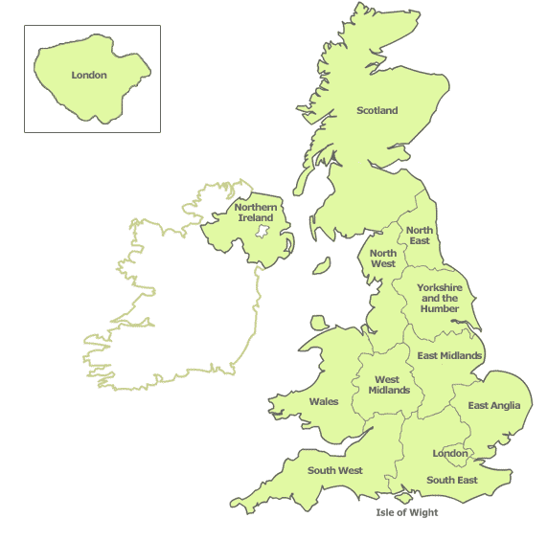
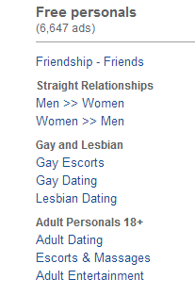
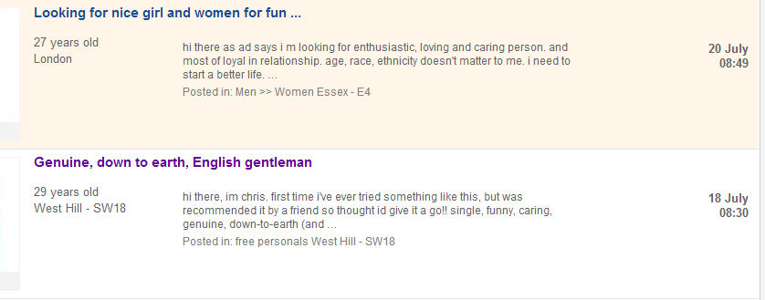

Slide 19
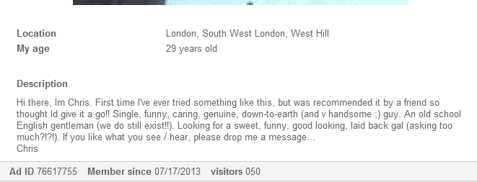
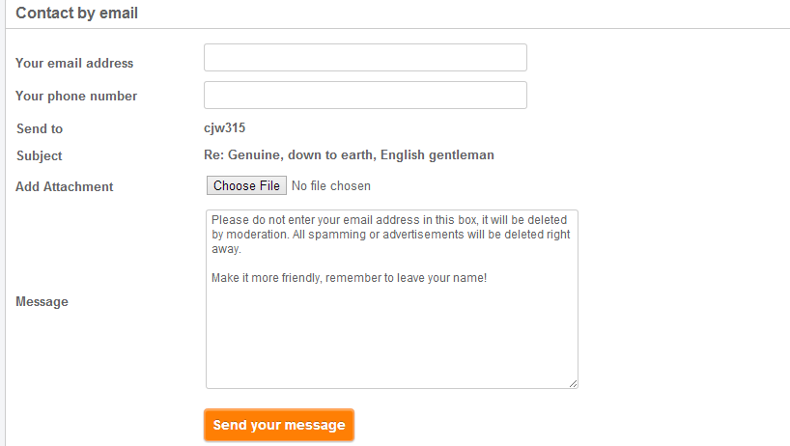
Notes:
category of the personal ad; postcode (region and city name in the Mexican version); ad title; description (where the main body of the personal ad is written); age; a link to post a photo (optional); email (which remains private in the classified ad); a password; and an optional phone number, which would be displayed if it is provided. It is on the individual ad’s page that the reader can view the full description that the advertiser posted. If he/she is interested then the reader has the option to click on a button titled Send a message. This link will lead the reader to a webpage in which he/she enters his/her email address, phone number, an optional attachment and a message before clicking send. This message is then sent to the advertiser who has the option to contact the reader. Additionally, if the original advertiser entered his/her phone number, the reader has the option to click on a link that will reveal the number and he/she can consequently directly contact the advertiser. Thus, the two websites are essentially identical, which makes it possible to allocate differences between the two languages to the two languages and not to medium-specific characteristics or requirements, adhering to the main principles of Computer-Mediated Discourse Analysis and contrastive pragmatics.

Slide 20
Object of study
The types and sequencing of speech strategies
Dependent variable: The whole speech event (the personal ad)
Variants: The different sequences of subcomponents (speech strategies) within the personal ad
Smooth swimmer seeks adventurous lady for Tenerife holiday (LN.HBM.1)
Auto-description → Description of partner → Purpose
If you are nice and friendly Female, who is interested in friendship and quality time together then please feel free to email or txt/call me. I love making friend, traveling, watching movie and i can be romantic and able make me smile & laugh. (LN.HBM.20)
Description of partner → Purpose → Reference → Auto-description
Only the sequencing of the speech strategies that form part of the schema “X seeks Y for Z” (Shalom, 1997) will be examined.

Slide 21
Speech strategies
Speech act reconceptualized for the purpose of this study → redefined as content-rich speech strategy.
Responding to rudeness (Beebe & Waring, 2005).
Giving someone embarrassing information (Beebe & Yakashi, 1989)
Nagging (Boxer, 2002).
Affect-rich domain of study which merits investigation across speech acts
I.e. rudeness can occur across requests, refusals, complaints, compliments, etc.
Both the description of the desired relationship and and the desired partner are two different speech strategies but the same speech act, an implicit request.
Speech acts: request, apology, refusal, complaint, compliment, suggestion, etc. (Searle, 1976)
Content-rich speech strategy: auto-description, description of partner, description of relationship, etc.

Slide 22
Coding of speech strategies
Combining the results of previous studies, there are eight main speech strategies (Coupland, 1996; Marley, 2002; Montini & Ovrebro 1990; Shalom, 1997; Thorne & Coupland, 1998; van Compernolle, 2008).
Auto-description
Description of the partner
Purpose
Deconventionalization
Reference
Greetings/farewells
Justification
Requests for particular groups of people not to contact the poster, henceforth called exclusions

Slide 23
Independent Variables
Sex and orientation
Male looking for male
Male looking for female
Female looking for female
Female looking for male

Slide 24
Data collection & analysis
Exclusions
Repetitions
Other types of ads
One ad seeking a partner for an alien
Collected in March 2013
Coded for dependent and independent variables and analyzed for the distribution of speech strategies and speech strategy sequences using SPSS across gender/orientation groups.

Slide 25
Totals
 | Mexico City Spanish | London English | Total
Men seeking men | 98 | 100 | 198
Men seeking women | 98 | 98 | 196
Women seeking men | 54 | 20 | 74
Women seeking women | 70 | 100 | 170
Total | 320 | 318 | 638

Slide 26
Results
Mexico City Data

Slide 27
Speech strategy occurrence: Mexico City
 | Auto-description | Partner description | Purpose | Deconventiona-lization | Reference | Greetings/ farewells | Justification | Exclusion
Men → Men | 90 91.8% | 89 90.8% | 87 88.8% | 25 25.5% | 38 38.8% | 46 46.9% | 6 6.1% | 11 11.2%
Men → Women | 81 82.7% | 82 83.7% | 92 93.9% | 25 25.5% | 41 41.8% | 49 50.0% | 6 6.1% | 5 5.1%
Women → Men | 41 75.9% | 49 90.7% | 50 92.6% | 7 13.0% | 17 31.5% | 18 33.3% | 1 1.9% | 13 24.1%
Women → Women | 60 85.7% | 63 91.3% | 67 95.7% | 14 20.0% | 27 38.6% | 33 47.1% | 5 7.1% | 19 27.1%
Total | 85.0% | 88.7% | 92.5% | 22.2% | 38.4% | 45.6% | 5.6% | 15.0%

Slide 28
Exclusions
“Tampoco busco encuentros sexuales casuales, ni mucho menos mantener a un hombre.” (DF.MBH.26)
I am not looking for casual sexual encounters, nor am I looking to support a man.
“Atencion NO ofrezco prostitución” (DF.MBH.3)
Attention, I am not offering prostitution.
“NO BUSCO ENCUENTROS SEXUALES CASUALES” (DF.MBH.27)
I am not looking for casual sexual encounters.
Hombres abstenerse (DF.MBM.6)
Men, please abstain.

Slide 29
Speech strategy sequence: Mexico City
 | XYZ | YZX | ZXY | ZYX | Other | Total
Men → Men (4) | 19 19.4% | 16 16.3% | 14 14.3% | 11 11.2% | 38 38.8% | 98 100%
Men → Women (3) | 24 24.5% | 9 9.2% | 6 6.1% | 14 14.3% | 45 45.9% | 98 100%
Women → Men (2) | 13 24.1% | 4 7.4% | 4 7.4% | 9 16.7% | 24 44.4% | 54 100%
Women → Women (1) | 13 18.6% | 7 10.0% | 12 17.1% | 9 12.9% | 29 41.4% | 70 100%
Total | 69 21.6% | 36 11.2% | 36 11.2% | 43 13.4% | 136 42.5% | 320 100%
Pearson Chi-Square: p<0.001

Slide 30
Summary of Mexico City results
Across sexual orientations and genders:
The rate of occurrence of the different speech strategies appears to be fairly consistent, with little significant distribution.
Women seeking women and men seeking men have significantly more exclusions.
While the distribution is not significant, men seeking men and women seeking women use less of the canonical “X seeks Y for Z” and more of other sequences.

Slide 31
Results
London data

Slide 32
Speech strategy occurrence
 | Auto-description | Partner description | Purpose | Deconventiona-lization | Reference | Greetings/ farewells | Justification | Exclusion
Men → Men | 76 76.0% | 83 83.0% | 94 94.0% | 12 12.0% | 60 60.0% | 20 20.0% | 3 3.0% | 19 19.0%
Men → Women | 90 91.8% | 82 83.7% | 90 91.8% | 24 24.5% | 49 50.0% | 57 58.2% | 12 12.2% | 5 5.1%
Women → Men | 20 100.0% | 19 95.0% | 17 85.0% | 4 20.0% | 8 40.0% | 8 40.0% | 4 20.0% | 8 40.0%
Women → Women | 89 89.0% | 74 74.0% | 92 92.0% | 31 31.0% | 58 58.0% | 48 48.0% | 11 11.0% | 48 48.0%
Total | 86.5% | 81.1% | 92.5% | 22.3% | 55.0% | 41.8% | 9.4% | 25.2%

Slide 33
Exclusions
“ABSOLUTELY NO MALES WANTED.” (LN.MBM.1)
“NO MEN AND IF YOU ARE A COUPLE. PLEASE DO NOT CONTACT ME. AND NO TIME WASTERS. :)” (LN.MBM.7)
“Genuine replies only thanks from single ( only ) men, no cheating husbands, wackos or young men as I have NO interest.” (LN.MBH.11)
“If you spend more time in front of the mirror than me then don't reply.” (LN.MBH.12)

Slide 34
Why less self-descriptions?
“Are there any young lads out there who would like to meet for fun and bj in my car if you cannot accommodate? Im in South East london but i cannot accommodate but willing to travel a reasonable distance for a genuine meet with a genuine slim young guy. Text only please as im very rarely by a computer.” (LN.HBH.82)
Men seeking men
87% of personal ads were looking for sex
Women seeking women
80% of personal ads were looking for sex
Men seeking women
64.3% for relationship/dating
Women seeking men
80% for relationship/dating
This was not observed for the Mexico City data. Type of relationship desired was consistent across gender/orientation groups:
Relationship, dating, friend

Slide 35
Speech strategy sequence
 | XYZ | YZX | XZY | Other | Total
Men → Men (4) | 26 26.0% | 5 5.0% | 20 20.0% | 49 49.0% | 100 100%
Men → Women (3) | 48 49.0% | 6 6.1% | 8 8.2% | 36 36.7% | 98 100%
Women → Men (2) | 8 40.0% | 5 25.0% | 1 5.0% | 6 30.0% | 20 100%
Women → Women (1) | 25 25.0% | 8 8.0% | 18 18.0% | 49 49.0% | 100 100%
Total | 107 33.6% | 24 7.5% | 36 11.2% | 136 42.5% | 318 100%
Pearson Chi-Square: p<0.001
Notes:
Finish

Slide 36
Summary of London results
Across sexual orientations and genders:
The rate of occurrence of the various speech strategies differs more across groups than in the Mexico City data.
Men seeking men and women seeking women focus somewhat more on the type of relationship they seek as opposed to describing themselves.
Women seeking women and men seeking men have significantly more exclusions, similar to the Mexico City data.
Significant distribution of speech strategy sequences
Men seeking men and women seeking women use less of the canonical “X seeks Y for Z” (Shalom, 1997).

Slide 37
Results
Both varieties

Slide 38
Speech strategy occurrence: both languages
 | Auto-description | Partner description | Purpose | Deconventiona-lization | Reference | Greetings/ farewells | Justification | Exclusion
Mexico City | 85.0% | 88.7% | 92.5% | 22.2% | 38.4% | 45.6% | 5.6% | 15.0%
London | 86.5% | 81.1% | 92.5% | 22.3% | 55.0% | 41.8% | 9.4% | 25.2%

Slide 39
Speech strategy sequencing: both languages
 | XYZ | Other | Total
London | 107 33.6% | 211 66.4% | 318 100.0%
Mexico City | 69 21.6% | 251 78.4% | 320 100.0%
Total | 176 27.5% | 463 72.5% | 638 100.0%
Overall, Mexico City uses less of the canonical format “X seeks Y for Z.”
Pearson Chi-Square: p<0.001

Slide 40
Summary of results
Similarity between both languages in terms of:
Overall distribution of strategies in online personal ads.
Women seeking women and women seeking men both employ more exclusions.
Women seeking women and men seeking men use less of the canonical “X seeks Y for Z” schema than opposite sex personals.
However, XYZ is the most common strategy for all gender/orientation groups for both languages.
Differences between both languages:
Speech strategies
In London, other than XYZ, YZX, and XZY were the most common strategies.
In Mexico City, other than XYZ, YZX, ZXY and ZYX were the most common strategies.
Overall lesser rate of XYZ in Mexico City than in London.
Notes:
The 3 most frequent speech events: the self-description, the description of the partner and the overview of the relationship

Slide 41
Discussion and Conclusion

Slide 42
Comparison with previous work
Van Compernolle (2008)
Much less partner description (28.5%)
Much less purpose (46.5%)
Men more likely to describe partner while women more likely to describe relationship.
No significant difference between any of the gender/orientation groups in terms of these two speech strategies in either language.
Likely due to format of the website
Advertisers respond to questions about themselves on Netclub.com then give a free response.

Slide 43
What does this all mean?
These online personal ads are highly conventionalized, despite no length limits.
Fairly similar distribution of speech strategies.
XYZ is most common sequence, though it does not constitute the majority of the data.
However, while the options are the same between the two languages, speaker choices are different.
Similar sociolinguistic patterning across social groups in both languages.
The important question to ask is why are women seeking women and men seeking men the two groups that diverge from the conventional XYZ sequence more than the other groups?
Notes:
Sensitivity for the importance of contextual variables

Slide 44
Discussion
Stigma with personal ads (Shalom, 1997)
Conventionalized format → distance from speech event
Personal intimate speech event
Perceived failure to find a partner through conventional means
The same sex groups are often marginalized
Already considered “non-conventional”
Ebonics and Spanglish (Harwood & Abhik, 2005)
Difference in function of personal ads for London data
Typically, personal advertisements were used to find partners, LTRs, and for dating.
Using online personals for hookups or sexual relationships (often very explicit requests) is also a non-conventional use.

Slide 45
Conclusion
Use of speech strategies and other linguistic features to create an in-group identity.
Deviation from the norm.
Demonstrating and authenticating membership in specific gender or sexual groups (Del-Teso-Craviotto, 2008).
Future research
Change in personal ads over time
Across ages
Print versus online
More research on other cultural contexts and languages (van Compernolle, 2008)

Slide 46
References
Beebe, L., & Waring, H. (2005). Pragmatic development in responding to rudeness. In J. Frodesen, & C. Holten (Eds.), The power of context in language teaching and learning (pp. 67-80). Boston, MA: Heinle & Heinle/Thomson Learning.
Beebe, L., & Yakashi, T. (1989). Do you have a bag?: Social status and pattern variation in second language acquisition. In S. Gass, C. Madden, D. Preston, & L. Selinker (Eds.), Variation in second language acquisition: Discourse, pragmatics, and communication. (pp. 103-125). Clevedon, UK: Multilingual Matters.
Boxer, D. (2002). Nagging: the familial conflict area. Journal of Pragmatics(34), 49-61.
Buscholtz, M., & Hall, K. (2004). Theorizing identity in language and sexuality research. Language in Society 33, 469-515.
Cherny, L. (1999). Conversation and Community: Chat in a Virtual World. Stanford, CA: Center for the Study of Language and Information.
Cicerello, A. & Sheehan, E. P. (1995). Personal advertisements: A content analysis. Journal of Social Behavior and Personality, 10, 751-756.
Coupland, J. (1996). Dating advertisements: Discourses of the commodified self. Discourse and Society, 7(2), 187-207.
Del-Teso-Craviotto, M. (2008). Gender and sexual identity authentication in language use: The case of chat rooms. Discourse Studies 10, 251-270.

Slide 47
Elliot, L. (2010). Predicting Someone’s True Identity: Linguistic Norms and Cues in Online Personal Advertisements. Master’s Thesis, The Rochester Institute of Technology.
Ellison, N., Heino, R., & Gibbs, J. (2006). Managing imipressions online: self-presentation processes in the online dating environment. Journal of Computer-Mediated Communication, 11(2). Retrieved March 05, 2013, from http://jcmc.indiana.edu/vol11/issue2/
Groom, C. J., & Pennebaker, J. W. (2005). The language of love: sex, sexual orientation, and language use in online personal advertisements. Sex roles, 52, 447-461.
Gudelunas, D. (2005). Online personal ads: community and sex, virtually. Journal of Homosexuality, 49, 1-33.
Hardey, M. (2004). Mediated relationships: authenticity and the possibility of romance. Information, Communication and Society, 7, 207-222.
Harwood, J., & Abhik, R. (Eds.) (2005). Social Identity Theory and Mass Communication Research. USA: Peter Lang Publishing.
Hatala, M., & Prehodka, J. (1996). Content analysis of gay male and lesbian personal advertisements. Psychological Reports, 78, 371-374.
Holden, T., & Tsuruki, T. (2003). Deai-kei: Japan's new culture of encounter. In N. Gottlieb, & M. McLelland (Eds.), Japanese cybercultures (pp. 34-49). New York, NY: Routledge.

Slide 48
Kiesler, S., Siegel, J., & McGuire, T. (1984). Social psychological aspects of computer-mediated communication. American Psychologist, 39, 1123-1134.
Marley, C. (2002). Popping the question: questions and modality in written dating advertisements. Discourse Studies, 4(1), 75-98.
Montini, T., & Ovrebro, B. (1990). Personal relationship ads: An informal balancing act. Sociological Perspectives, 33, 327-339.
Reid, S. A., & Giles, H. (2005). Intergroup relations: Its linguistic and communicative parameters. Group Processes and Intergroup Relations 8, 211-214.
Sato, T. (2008). Social Asymmetries in Online Personal Ads in Japanese: Discursive Construction of Desirable Personae, Bodies, and Practices. Doctoral Dissertation, University of Arizona.
Searle, J. (1976). A classification of illocutionary acts. Language in Society, 5(1), 1-23.
Shalom, C. (1997). That great supermarket of desire: attributes of the desired other in personal advertisements. In K. Harvey, & C. Shalom (Eds.), Language and desire: Encoding sex, romance and intimacy (pp. 186-203). New York: Routledge.

Slide 49
Smith, C. A., & Stillman, S. (2002). What do women want? The effects of gender and sexual orientation on the desirability of physical attributes of personal ads of women. Sex Roles, 46, 337-342.
Thorne, A., & Coupland, J. (1998). Articulations of same sex desire: lesbian and gay male dating advertisements. Journal of Sociolinguistics, 2(2), 233-257.
van Compernolle, R. (2008). Sociopragmatics norms in Québécois online personal advertisements. In M. Koop (Ed.), Le Québec à l'aube du nouveau millénaire: entre tradition et modernité (pp. 1-8). Québec: Presses de l'Université du Québec.
Vlčková, J. (1996). Text typology of personal advertising (Attract. 35 yo. M, profess., with GSOH, WLTM sim.F 4 f/ship.Ldn). BRNO Studies in English, 22, 89-96.
Yurchisin, J., Watchravesringkan, K., & McCabe, D. (2005). An exploration of identity re-creation in the context of Internet dating. Social Behavior and Personality, 33, 735-750.

Slide 50
¡Thanks!
Thank you to Dr. Félix-Brasdefer for his input on this project. Thank you to Monica Mills for feedback. All mistakes are my own.
szahler@indiana.edu

