Slide 1
THE ROLE OF COGNITIVE CONSTRAINTS IN LANGUAGE VARIATION: THE RELATIONSHIP BETWEEN WORKING MEMORY AND SUBJECT EXPRESSION VARIATION IN SPANISH
Sara Zahler
NWAV 47
October 21, 2018

Slide 2
Recent research suggests that it is important to distinguish between three types of constraints (e.g. Tamminga et al., 2016)
Social/stylistic
Linguistic
Psychophysiological
Physiological
Articulatory constraints
Carro v. irritar
Psychological/Cognitive
Priming
Production planning
Automatic imitation
Working memory

Slide 3
Working memory
Limited capacity attentional resource
Temporarily stores and manipulates information available for processing during complex tasks
Information is subject to decay over time
Inverse relationship between storage and processing
Limit on working memory capacity is generally considered 7 items across individuals
(e.g. Baddeley, 2000; Baddeley, 2007; Baddeley & Hitch, 1974; Miller, 1956)

Slide 4
Working memory and language
Working memory abilities have been shown to correlate with:
Grammatical complexity
Semantic richness
Resolution of and sensitivity to syntactic ambiguity
Sentence interpretation
(e.g. Blackwell & Bates, 1995; Hyon Kim & Christianson, 2013, 2017; Kemper & Sumner, 2001; McDonald, 2008; Montgomery, 2000; Saito & Baddeley, 2001)

Slide 5
How can working memory affect linguistic variation?
Give rise to linguistic constraints on variation related to…
Distance between elements in discourse
Number of elements in the discourse
Complexity of discourse
Ambiguity in discourse

Slide 6
Examples
Effect of distance between subject and verb on auxiliary contraction in English
The professor’s smart
The professor who teaches the French course is smart
Effect of subject complexity/length on subject doubling in French
Le professeur (ø) est intelligent
Le professeur qui enseigne le course de français il est intelligent
Adjacency effects in subjunctive v. indicative variation in Spanish
Quizás vaya al supermercado
Quizás, si tengo tiempo, voy al supermercado
Auger & Villeneuve, 2010; Barth, 2011; Bresnan & Spencer, 2013; Campion, 1984; Finanger, 2011; Frank & Jaeger, 2008; García, 2011; King et al., 2008; Nagy, 2003; Roberts, 2014; Waltermire, 2017; Zahler, 2014

Slide 7
If working memory is a universal (speaker-absolute) constraint of human cognition, how can we test whether it affects or interacts with linguistic constraints on variation?

Slide 8
Goal of the current study
Examine the patterns of variation in speakers who differ according to working memory to determine any differences in…
Constraints on variation
Directions of effect of these constraints
If constraints on variation differ between and high and low working memory speakers, these constraints may be, at least partially, attributable to working memory limits

Slide 9
Subject expression in Spanish
Martín/el médico → Lexical noun phrase (NP)
Él → Overt subject pronoun
Ø → Null subject
Subject to discursive linguistic constraints found repeatedly across varieties of Spanish and research studies
Distance
Switch in reference
Tense-mood-aspect (TMA) ambiguity
(e.g. Alfaraz, 2015; Erker & Guy, 2012; Flores Ferrán, 2004; Holmquist, 2012; Shin & Erker, 2015; Shin & Otheguy, 2009)

Slide 10
Switch reference
Yo pienso que (María/ella/ø) es buena amiga → Switch from prior subject
I think that Maria is a great friend
Yo hablaba con María mientras (María/ella/ø) patinaba → Same as prior object
I spoke with Maria while she was skating
Yo pienso que (yo/ø) soy buena amiga → Same as prior subject
I think that I am a good friend
Overt subjects most frequent with:
Switch from prior subject > Same as prior object > Same as prior subject
(e.g. Alfaraz, 2015; Erker & Guy, 2012; Flores Ferrán, 2004; Holmquist, 2012; Shin & Erker, 2015; Shin & Otheguy, 2009)
Notes:
Speakers have to maintain multiple elements in short-term memory. There could be differences in effect between high and low WM speakers. High WM speakers may be able to maintain multiple subject referents in short-term memory better which may affect switch reference patterns. For example, when there are competing subject referents (i.e. in a switch or partial reference context) they may be more likely to disambiguate via overt subjects. They may be more able to “notice” ambiguity given research that indicates that higher WM native speakers are more sensitive to syntactic ambiguity in processing

Slide 11
Tense-mood-aspect ambiguity
Él/yo/ø hablaba con Pablo → Ambiguous verb tense
He/I was speaking with Pablo
Él/ø habló con Pablo → Unambiguous verb tense
He spoke with Pablo
(Yo/ø) hablé contigo → Unambiguous verb tense
I spoke with Pablo
Overt subjects most frequent with:
Ambiguous verb tenses > Unambiguous verb tenses
(e.g. Bayley et al., 2012; Castellano Alemán, 2002; Holmquist, 2012; Hurtado, 2005; Prada Perez, 2009; Travis, 2007)
Notes:
Speakers with higher WM may be better at ¨dealing with¨ or noticing verbal ambiguity in language production. That is, they may be more likely to disambiguate between competing subject referents by disambiguating

Slide 12
Distance
Yo pienso que (yo/ø) soy buena amiga → 1-clause distance from previous mention of the same subject
Mi mejor amiga es María. Siempre la llamo cuando necesito consejos o si tengo algún problema. Por eso, yo pienso que (María/ella/ ø) es buena amiga porque siempre me escucha → 3-clause distance from previous mention of the same subject
Overt subjects most frequent with:
First mention of referent > longer to shorter distances
(e.g. Cameron, 1992; Holmquist, 2012; Hurtado, 2001; Martínez-Sanz; Prada Perez, 2009)
Notes:
If information in working memory erodes with time, we would expect a gradual increase in overt subjects as distance increases. For higher working speakers, we would expect this increase to occur at further distances than for lower working memory speakers.

Slide 13
Method

Slide 14
Linguistic tasks
Oral response prompt task
PowerPoint with 10 prompts for an oral response
All prompts used a command
15-20 minutes
Range of topics
Memories
Future plans
Descriptions
Cuéntame tus planes para este fin de semana
“Tell me about your plans for this weekend”

Slide 15
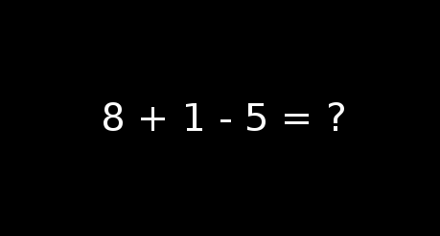
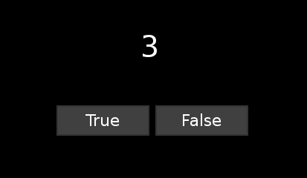
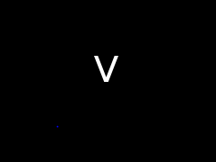
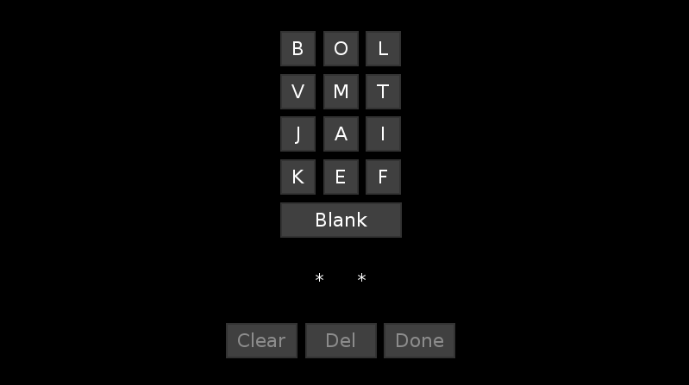
Measure of WM
Operation span task
Chosen over reading span task to avoid confluence with verbal abilities
Native speakers of Spanish and English can perform the same task
Psychology Experiment Building Language (PEBL) (Meuller & Piper, 2014)
Sequences of 3, 4, 5, 6, and 7
Practice phase
Scoring on the letter recall
Test requires 85% processing accuracy

Slide 16
Coding
All tokens of finite (conjugated) verbs were extracted from the transcriptions for all 30 recordings
Exclusions
 | Native speakers
Total tokens | 6702
Exclusions Command Corrected Cut off Gustar Subject relative Repeat Impersonal Fixed phrases First token | 1208 39 49 55 241 371 128 223 102 29
Final tokens coded | 5465

Slide 17
Dependent variable: Subject type
Subject form | Example | Subject Type
Null subject pronoun | Ø [No subject] | 74.8% (N = 4111)
Lexical noun phrase | Mi hermana ‘My sister’ | 15.3% (N = 842)
Overt subject pronoun | Yo ‘I’ | 6.9% (N = 381)
Indefinite pronoun | Alguien ‘Somebody’ | 0.6% (N = 34)
Interrogative pronoun | Quién ‘Who’ | 0.2% (N = 11)
Demonstrative pronoun | Esa ‘That (one)’ | 2.1% (N = 115)
Final total = 5305

Slide 18
Independent variables
Switch in reference*
TMA ambiguity
Distance*
Subject type of prior clause
Switch in TMA
Grammatical Person
Verb Class
Clause Type
*Run separately
Constraint | Subcategories
Switch in reference | Switch Same as object Same as subject
TMA ambiguity | Ambiguous TMA Unambiguous TMA
Distance | First mention 1-3 clauses 4-5 clauses 6-7 clauses 8-10 clauses More than 10 clauses

Slide 19
Participants
30 native speakers of Spanish residing in the U.S.
All are second language speakers of English
Graduate students and instructors of Spanish
Speaker characteristics | Group demographics
Average years in United States | 8.21 (SD = 6.68; Range = 4 months to 26 years)
Sex | M = 17, F =13
Average Age | 35.77 (SD = 8.34; Range = 24 to 56)
Region of origin | Spain = 12 Colombia = 5 Argentina = 3 Mexico = 2 Puerto Rico = 2 Chile = 2 Cuba = 1 Bolivia = 1 Venezuela = 1 Peru = 1
Average reported English use | 5.14 (SD = 3.46; out of 16; Range = 0 to 13)
Average reported Spanish use | 12.79 (SD = 2.47; out of 16; Range = 6 to 16)

Slide 20
WM Groups
 | Working memory | Weighted IQ | Grammar proficiency | Vocabulary proficiency | Age
Working memory | 1 | .154 | -.024 | -.127 | -.135
Weighted IQ | .154 | 1 | .310 | -.153 | -.136
DELE proficiency | -.024 | .310 | 1 | .675** | .035
Vocabulary proficiency | -.127 | -.153 | .675** | 1 | .155
Age | -.135 | -.136 | .035 | .155 | 1
Group | WM score
All participants (N=30) | 48.27 (SD = 14.56)
High working memory (N=11) | 63.63 (SD = 4.68)
Middle working memory (N=9) | 47.56 (SD = 4.82)
Low working memory (N=10) | 32.00 (SD = 7.42)
Notes:
Participants were divided into high, middle and low working memory groups. Before dividing them, their working memory scores were correlated with a range of other individual differences to ascertain that there was no relationship for this participant group b/t working memory and other IQ, grammar proficiency, vocabulary proficiency and age. WM was not correlated with any of these other IDs and so participants were divided into approximately equal thirds according to their WM scores.

Slide 21
Native speaker participants
Speaker characteristics | High working memory | Low working memory
Average years in United States | 9.45 | 8.12
Sex | M = 8, F = 3 | M = 3, F = 7
Average Age | 35.27 | 36.9
Region of origin | Spain = 5 Argentina = 2 Colombia = 2 Mexico = 1 Bolivia = 1 | Spain = 4 Argentina = 1 Colombia = 1 Mexico = 1 Puerto Rico = 1 Venezuela = 1
Average reported English use | 6.09 | 5
Average reported Spanish use | 12.18 | 12.67

Slide 22
Statistical analysis
Generalized Linear Mixed Model (GLMM) multinomial regression analysis in SPSS
Three regressions
All native speakers (N = 30)
High working memory speakers (N=11)
Low working memory speakers (N = 10)
Dependent variable
Null subject as reference value
Indicates the likelihood of selecting an overt pronoun OR lexical NP over a null subject
Fixed effects
Switch in reference*
TMA ambiguity
Distance*
Subject type of prior clause
Switch in TMA
Grammatical Person
Verb Type
Clause Type
Random effects
Individual participant

Slide 23
Results

Slide 24
Rate of subject type
Constraint | All native speakers | High working memory | Low working memory
Null subjects | 76.8% | 76.4% | 76.3%
Lexical NPs | 16.0% | 15.9% | 16.9%
Overt pronouns | 7.2% | 7.7% | 6.8%
Total # of contexts | 5305 | 2051 | 1611
These differences across WM groups are not statistically significantly different according to a Pearson Chi-square analysis (χ2 [4, N = 5305] = 3.278, p = .512)

Slide 25
Regression analyses
Constraint | All native speakers | High working memory | Low working memory
Switch in Reference | *** | *** | ***
TMA Ambiguity | *** | *** | **
Distance | *** | ** | ***
*p<.05 **p<.01 ***p.001

Slide 28
***
**

Slide 29
***
**

Slide 30
Discussion

Slide 31
Differences in constraints on variation?
No
The same factors constrain variation
Switch in reference
Distance from last mention
TMA Ambiguity

Slide 32
Differences in effects of these constraints?
Yes
Higher working memory speakers
More overt subjects with switch reference and same as object contexts
Larger effect of TMA ambiguity
Later effect of distance
Lower working memory speakers
More overt subjects with switch reference, not with same as object contexts
Smaller effect of TMA ambiguity
Earlier effect of distance

Slide 33
What does this mean?
Higher working memory speakers demonstrate stronger patterns of disambiguation
Use more overt subjects when there are multiple competing referents
Switch reference AND same as object contexts
TMA ambiguity
Coincides with previous research that native speakers are more sensitive to syntactic and referential ambiguity
Boudewyn, Long et al., 2015; Hyon Kim & Christianson, 2017; Nieuwland & Berkum, 2006

Slide 34
What does this mean?
Lower working memory speakers are more susceptible to distance dependencies
Faster increase in overt subject use as distance increased between mentions of the subject, particularly lexical NP
→ Lower storage capacity/processing capacity, subject referent is retained for less time

Slide 35
Role of working memory
Interacts with linguistic constraints on variation (Tamminga et al., 2016)
WM as an independent variable was not significant for any participant group
However, when participant groups are divided according to WM group, the patterns of variation are different
May explain the tendency to find distance and complexity effects across morphosyntactic structures and languages

Slide 36
Relationship to language change
In the same way that…
Articulatory constraints give rise to phonetic innovation and variation
Co-articulation
Articulatory difficulties
Carro v. irritar
Memory constraints may give rise to morphosyntactic innovation and variation
Are new variants introduced in contexts where working memory is taxed?
Complex discourse
Longer distances

Slide 37
Relationship to language change
Can we test this?
Diachronic analysis of subjunctive in Spanish/French
Subject doubling in different varieties of French
Would expect stronger effects of subject complexity and length constraints in varieties with less advanced subject doubling
Stronger effects of pragmatic, semantic and social factors in varieties with more advanced subject doubling

Slide 38
Thank you!
szahler@albany.edu
www.szahler.com

