Slide 1
Spanish in context: stop-tap clusters in a contact zone in Colorado
Sara Zahler and Vanessa Elias
szahler@Indiana.edu; mavelias@indiana.edu
Indiana University

Slide 2
Intro
Cr (stop-tap) clusters are highly similar between Spanish and English in terms of:
Orthography
Identical graphemes
Phonology
Both occur word-initially and –medially in syllable initial position
Similar distinctive functions
/tr/ v. /dr/

Slide 3
Intro
These segments differ between Spanish and English in terms of:
Phonetics
Differences in VOT and stop voicing (Guitart, 2004; Lamy, 2012; Lisker & Abramson, 1964; Stockwell & Bowen, 1965)
Rhotic manner (Colantoni & Steele, 2006)
Co-articulation of the stop and rhotic (Navarro Tomás, 1918)
Epenthesis v. co-articulation with affrication
These clusters could present an area of phonology that would lend itself to convergence in heritage or bilingual Spanish.
English-speaking learners of Spanish show English influence in their L2 production of stop-tap clusters (Colantoni & Steele, 2006)
Notes:
In English, the difference between t and d for instance is due to a difference between long lag and short lag, whereas in Spanish, it is short lag versus. Prevoicing.
In English, the r is realized as an approximant. In voiceless clusters, it is affricated, particularly following t. In Spanish, it is realized as the tap or flap, similar to the English intervocalic /t in butter.
In English, clusters are realized as phonetically uninterrupted sequences, whereas in Spanish, they are generally discrupted or broken up by a short epenthetic vowel with a mean length of 31-40 ms.

Slide 4
Spanish stop-tap Cr clusters
Generally produced as a sequence of two stops: a stop consonant and a tap
Frequently disrupted by a short epenthetic vowel (EV) with an average length of 31-40 ms (Colantoni & Steele, 2006; Gili Gaya, 1921; Malmberg, 1965; Navarro Tomás, 1918; Quilis, 1970)
Occurs as a function of formality (Blecua & Machuca, 2000; Gili Gaya, 1921)
Can vary with co-articulated variants (such as affrication, or stop-approximant clusters) in numerous varieties of Latin American Spanish (Argüello, 1978; Bobadilla & Bobadilla, 1980; Flores, 2012; Lipski, 2009)
Variable rates of epenthetic vowel occurrence
95% (Gili Gaya, 1921)
45-85% according to dialect (Schmeiser, 2006)
75% (Ramirez, 2014)

Slide 5
What conditions this variation?
Voicing of the first consonant (C1):
More EV after voiced consonants (Blecua, 2001; Ramirez, 2006)
Longer EV after voiced consonants (Colantoni & Steele, 2005; Ramirez, 2006; Schmeiser, 2006)
Place of articulation of C1:
Higher rate of EV after dentals than labials/velar (Ramirez, 2006)
No effect (Ramirez, 2014)
Manner of articulation of C1:
Longer EV after dorsal, then coronals, then labials (Schmeiser, 2006)
No effect (Colantoni & Steele, 2005)

Slide 6
What conditions this variation?
Following nuclear vowel
Shorter EV with [o] nuclear vowel than with [u] (Ramirez, 2002)
Longer duration of EV in following order: u>a>e>o>i (Ramirez, 2014)
Word position
Longer EV in word initial (Bradley & Schmeiser, 2003)
Longer EV in word medial (Colantoni & Steele, 2005; Schmeiser, 2006)
Stress
Longer EV in stressed syllable (Bradley & Schmeiser, 2003)
The rate of occurrence of EV is lesser in stressed syllables (Ramirez, 2014)
Order constriction
Back to front lead to longer EV (Bradley & Schmeiser, 2003; Schmeiser, 2006)

Slide 7
Summary on research
The appearance of the EV is variable in numerous varieties of Spanish
Almost always represents a majority of productions
The rate of EV appearance is affected by:
Voicing of C1
Point of articulation of C1
Stress
The duration of the EV is affected by:
Voicing of C1
Manner of articulation of C1
Nuclear vowel
Word position
Stress
Order of constriction

Slide 8
Current study
Given the previous research, our questions are two-fold:
What are the factors affecting the production of canonical epenthesis in the Spanish of a group of heritage speakers in Antonito, Colorado?
Does this group show convergence with English by demonstrating less production of the canonical variant in words that are cognates with English?
An effect of cognates is expected to occur due to research demonstrating that similarities between a bilingual’s two languages in particular words can lead to more convergence/effect of one language on the other in those words than in other less similar words (Brown & Harper, 2009).

Slide 9
Method
7 sociolinguistic interviews
4 male, 3 female between 40-65 years old
Lasted 45 minutes – 1 hour
Collected in Antonito, Colorado
Small town of approximately 800 people. Many of the residents have been residing here for 7 generations or more
614 tokens extracted of /pr/, /tr/, /kr/, /br/, /dr/, /gr/
All tokens of words with syllable-initial Cr clusters were extracted
Up to five occurrences of each lemma (i.e. nosotr-) for each speaker
5 excluded due to dropping of C1
1 excluded due to metathesis of segments
608 tokens used in final analysis

Slide 10
Coding
Dependent variable
Canonical epenthesis
Affrication
Stop + English-like approximant
Independent variables
Individual C1
Preceding phonological segment
Following nuclear vowel
Word stress
Position within the word
Cognate

Slide 11
Analysis
Multivariate regression analysis using Rbrul (Johnson, 2009)
Canonical epenthesis v. all others
Affrication v. all others
Stop-approximant v. all others

Slide 12
Results

Slide 13
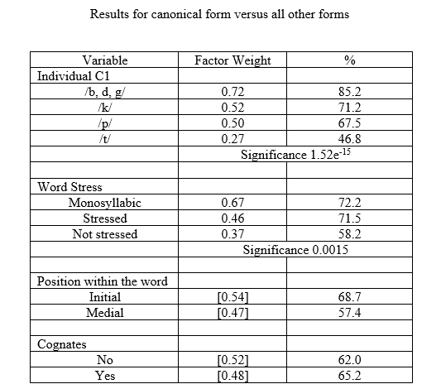
Results

Slide 14
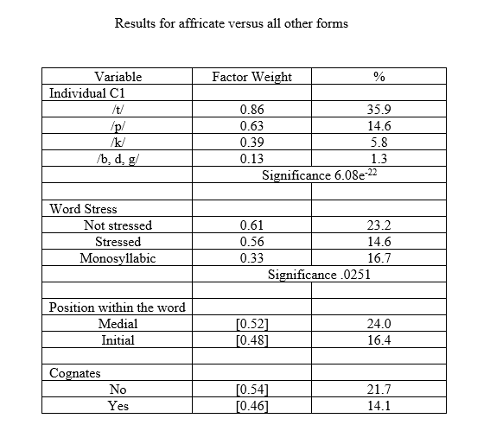
Results

Slide 15
Results
We did a regression analysis of the stop-approximant realization v. all others.
No significant factors!
Stop-approximant clusters do not seem to have a role in the variation between canonical epenthesis and affrication.

Slide 16
Discussion
More canonical epenthesis with voiced C1 than with unvoiced
(Blecua, 2001; Colantoni & Steele, 2005; Ramirez, 2006; Schmeiser, 2006)
Particularly, we see more affrication with /t,p/
Could be an English influence since /tr/ and /pr/ are more commonly affricated in English
Also could be frequency effect
Primero/prima
Trabajar/otro/nosotros
Less canonical epenthesis in non-stressed multisyllabic words
Contradictory to Ramirez (2014)
However, not surprising given that in stressed syllables, acoustic information is preserved and therefore less overlapping of segments is expected. Where you would expecting overlapping or co-articulation is in unstressed syllables (Bradley & Schmeiser, 2003).

Slide 17
Discussion
Position in the word not significant
Contrasts with previous literature
Longer EV in word initial (Bradley & Schmeiser, 2003)
Longer EV in word medial (Colantoni & Steele, 2005; Schmeiser, 2006)
Phonological context
Not significant in first runs, so was eliminated due to various statistical interactions.
Following nuclear vowel
Shorter EV with [o] nuclear vowel than with [u] (Ramirez, 2002)
Longer duration of EV in following order: u>a>e>o>i (Ramirez, 2014)

Slide 18
Discussion
Cognates
Not significant
Affrication occurs in monolingual varieties, specifically Latin American Spanish, and in particular, Andean Spanish (Argüello, 1978; Bobadilla & Bobadilla, 1980; Flores, 2012; Lipski, 2009)
No evidence that it is an effect of English, since it’s present in monolingual varieties and is not favored by Spanish-English cognates
So what is pushing this variation?
Articulatory constraints
Frequency: repetition leads to stronger representation leading to less need for perceptual saliency and frequency leads to reduction (Bybee, 2002).
Five very frequent words: primo/a, primero, trabajar, otro/a/s, nosotro/a/s
Even in terms of syllable cluster frequency, /tr/ is most frequent, followed by /pr/, then the rest.
/tr/ - 46.7% of data; /pr/ - 20.2% of data; voiced all together 24.5%

Slide 19
Conclusions
It seems from the results that this is an internal change driven by:
Frequency
Perceptual saliency (i.e. word stress)
Directions for future studies
Code for frequency
Code for individual word
Code duration of epenthetic vowel
Include a controlled task
If we were to revisit this community, we would need to employ the comparative variationist methodology (Poplack & Tagliamonte, 2001; Meyerhoff, 2009; Poplack & Levey, 2010; Lamy 2012), and therefore collect data from:
Monolingual Spanish speakers from the community
Monolingual English speakers from the community
Bilingual speakers in English and Spanish

Slide 20
References
Argüello, F. 1978. The Žeísta Dialect of Spanish Spoken in Ecuador: A phonetic and phonological study. PhD dissertation, The Pennsylvania State University.
Blecua, Beatriz. (2001). Las vibrantes del español: manifestaciones acústicas y procesos fonéticos. Doctoral Dissertation. Universitat Autònoma de Barcelona.
Blecua, F. B., & Machuca, M. (2000). Los grupo consonánticos en español: manifestaciones acústicas en dos estilos de habla. In M. D. Muñoz, A.I. Fernández, & V. Benítez (Eds.), IV Congreso de Lingüística General. Cádiz, 3-6, abril 2000. Volumen II: Comunicaciones. Cádiz-Alcalá de Henares: Servicio de publicaciones de la universidad de Cádiz, pp. 283-295.
Bobadilla, F. & Bobadilla, G. (1980). El estudio de tres variables sociolingüísticas en Rancagua: problemas preliminaries. Boletín de Filología, XXXI, 721-741.
Bradley, Travis G. and Benjamin Schmeiser. (2003). On the Phonetic Reality of /r/ in Spanish Complex Onsets. Selected Proceedings of The Sixth Hispanic Linguistics Symposium ed. by Paula M. Kempchinsky, Judith Liskin-Gasparro and Carlos-Eduardo Piñeros. Somerville, MA: Cascadilla Press.
Brown, E., & Harper, D. (2009). Phonological evidence of interlingual exemplar connections. Studies in Hispanic and Lusophone Linguistics, 2(2), 257-274.
Bybee, Joan. 2002. Word frequency and context of use in the lexical diffusion of phonetically conditioned sound change. Language Variation and Change 14: 261-290.
Colantoni, Laura. Steele Jeffrey. (2005). Liquid Assymetries in French and Spanish. In Fregeni Chiara, Hirayama, Manami, and Mackenzie, Sarah (Eds.). Toronto Working Papers in Linguistics. Special Issue on Similarity in Phonology. Toronto. University of Toronto.
Colantini, L., & Steele, J. (2006). Native-like attainment in the L2 acquisition of Spanish stop-liquid clusters. In C. A. Klee & T. L. Face (Eds.), Selected proceedings of the 7th Conference on the Acquisition of Spanish and Portuguese as First and Second Languages, pp. 59-73. Somerville, MA: Cascadilla Proceedings Project.

Slide 21
References
Flores, T. (2012). Variation of the /tr/ cluster in Chilean public speech. Paper presented at the 41st New Ways of Analyzing Variation (NWAV41), Bloomington, IN.
Gili Gaya, S. (1921). La r simple en la pronunciación española. Revista de Filología Española, 8, pp. 271-280.
Guitart, Jorge M. (2004). Sonido y sentido. Washington D.C.: Georgetown University Press.
Johnson, D. E. (2009). Getting off the GoldVarb standard: Introducing Rbrul for mixed effects variable rule analysis. Language and Linguistics Compass, 3, 359-383.
Lamy, D.S. (2012). A variationist account of voice onset time among Bilingual West Indians in Panamá. PhD Dissertation, University of Florida, Gainesville, FL.
Lipski, J. 1994. Latin American Spanish. London: Longman Group.
Lisker, Leigh, & Arthur Abramson. (1964). A cross-language study of voicing in initial stops: Acoustical measurements. In R.J. Baken & R.G. Daniloff (eds.), Readings in the clinical spectrography of speech, pp. 384-422. San Diego, CA: Singular Publishing Group, Inc.
Malmberg, B. (1965). Estudios de fonética hispánica. Madrid: Consejo Superior de Investigaciones Científicas.
Meyerhoff, Miriam. (2009). Replication, transfer and calquing: Using variation as a tool in the study of language contact. Language Variation and Change. 21:1-21.

Slide 22
References
Navarro Tomás, T. (1918 [1991]). Manual de pronunciación española. 25th edition. Madrid: Consejo Superior de Investigaciones Científicas.
Poplack, Shana, & Stephen Levey. (2010). Contact-induced grammatical change. In Peter Auer & Jürgen Erich Schmidt (eds.), Language and Space – An international handbook of linguistic variation: Volume 1 – Theories and methods, Berlin: Mouton de Gruyter.
Poplack, Shana, & Sali Tagliamonte. (2001). African American English in the diaspora. Oxford: Blackwell.
Quilis, A. (1970). El elemento esvarabáticos en los grupos [pr,br,tr]. Phonetique et Linguistique Romaines: Melanges offerts a M. Georges Straka, pp. 99-104.
Ramirez, C. J. (2002). Characterization of the epenthetic vowel between the clusters formed by stops/fricatives + flap in Spanish. Toronto Working Paper in Linguistics, 19, 67-74.
Ramírez Vera, Carlos Julio. (2006). Acoustic and Perceptual Characterization of the Epenthetic Vowel Between the Clusters Formed by Stop + Flap in Spanish” In Díaz-Campos M. (Ed.), Selected Proceedings of the 2nd Laboratory Approaches to Spanish Phonetics and Phonology. September 17-19. 48-61. Indiana University, Bloomington. In.
Ramirez, C. J. (2014). Production and perception of the epenthetic vowel in obstruent + liquid clusters in Spanish: An analysis of the prosodic and phonetic cues used by L1 and L2 speakers. PhD Dissertation. University of Toronto.
Schmeiser, B. S. (2006). On the durational variability of svarabhakti vowels in spanish consonant clusters. PhD Dissertation. University of California Davis.
Stockwell, Robert P., & Jean Donald Bowen. (1965). The sounds of English and Spanish. Chicago: University of Chicago Press.

Slide 23
Questions?
Sara Zahler: szahler@Indiana.edu
Vanessa Elias: mavelias@Indiana.edu

