Slide 1
A CMDA and contrastive pragmatics approach to the study of personal ads from Mexico City and London
Sara Zahler, Indiana University, szahler@indiana.edu1
Presentation at LASSO XLII

Slide 2
Outline
Research goals & object of the study
Theoretical approximations
Personal ads & previous research
Method
Results
Conclusions

Slide 3
Research goals
To explain variation in electronic personal ads at the actional level of pragmatic analysis in terms of social variables such as gender, sexual orientation, and age by examining variation in the description of one’s desired partner.
The second goal is to compare said sociolinguistic patterning between Spanish personal ads from Mexico City and English personal ads from London.

Slide 4
Object of the study
The different manners in which the speaker declares her/his desired attributes in a potential partner.
Busco cadete (hombre) del Heroico Colegio Militar para amistad y fines de noviazgo.
‘I’m looking for a cadet from the Heroic Military School for friendship and relationship purposes.’ (DF.MBH.4)
Deseo conocer hombre profesionista soltero y/o divorciado (NO SEPARADOS) de 40-42.
‘I want to meet a single or divorced professional man (NOT SEPARATED) from 40-42 years-old.’

Slide 5
Object of the study
Directive speech act (Searle, 1976).
Implicit request: understood as part of the discursive or situational context or shared knowledge between the interlocutors.
Non-conventional: understood via implicature
Pragmalinguistic variable
Notes:
This type of speech act is a directive (Searle, 1976), which can be defined as when the speaker expects the listener to do something as a response. Examples of directive speech acts include asking a question (6a), making a request (6b), issuing an invitation (6c) (Searle, 1976; Qadir and Riloff, 2011); or the variable under study (6d), a description of what one desires in a partner, which can be considered an implicit request. Implicit requests are those that do not directly ask the hearer to perform a task, yet the request is understood as part of the discursive or situational context or shared knowledge between the interlocutors (Searle, 1976). Since personal ads are directed to a potential reader who has the characteristics outlined by the speaker, there is an implicit request for the hearer to contact the speaker if he/she possesses these attributes. This request can be characteristized as non-conventional since it is understood via implicature (Grice, 1975).
The analysis of the variation in these verbal constructions constitutes a pragmalinguistic variable, which is defined as the different linguistic realizations used to express the same speech act.

Slide 6
Theoretical Approximations

Slide 7
Computer Mediated Discourse Analysis
Computer-Mediated Discourse: human interaction via networked computers
“Technical determinism” (Androutsopoulos, 2006) → speaker characteristics
Computer-Mediated Discourse Analysis (CMDA)
Meaning level: semantics, utterances or speech acts.
Notes:
the communication produced when humans interact with one another by transmitting messages via networked computers.
At first, the analysis of CMD sought technological explanations to account for linguistic differences evidenced in the virtual world, resulting in a type of “technical determinism” (Androutsopoulos, 2006).
The second wave of CMD research can be characterized as an intermediary step in which social and situational factors start to be considered as possible explanatory constraints on electronic communicative practices.
Finally, the third stage of CMD analysis emphasizes linguistic heterogeneity and variation in electronic discourse.
As such, current investigations on CMD have evolved from focusing on the specific medium of communication (texts vs. blogs vs. emails) as the potential cause of linguistic patterns to highlighting factors based on the speaker (gender, orientation, age, etc.) in order to explain variation (Locher, 2010).
structure, meaning, interaction, and social behavior. At the meaning level, semantics, utterances or speech acts as well as larger functional units such as macrosegments are analyzed.
Computer-Mediated Discourse Analysis (CMDA), the main methodological approach to investigating CMD, can be broadly defined as empirically-grounded textual observations of online verbal interaction (Herring, 2004). There are two major theoretical assumptions to CMDA: first, that discourse exhibits recurrent patterns and secondly, that discourse involves speaker choices. As such, the core objective of CMDA is to analyze options that a speaker has, or rather, the variation that he/she exhibits and how this variation patterns among different groups of speakers.

Slide 8
Contrastive Pragmatics
Compares pragmatic variation across two languages and cultures (Blum-Kulka, House & Kasper, 1989).
Speech communities tend to develop culturally distinct interactional styles.
Actional level: speech act or speech event
Requests, apologies, etc. or advertisements
Notes:
Numerous previous studies in these two fields have revealed culture-specific features of discourse, lending support to the claim that speech communities tend to develop culturally distinct interactional styles (see Blum-Kulka et al., 1989 for an overview of such studies). One particularly salient theme is the difference between communities with regard to directness in speech act realization (Levenston, 1968; Blum-Kulka, 1982, 1983; Tannen, 1981, etc.).
the formal level, the actional level, the interactional level, the topic level and the organizational level

Slide 9
Personal ads and previous research

Slide 10
Personal advertisements
Solicit online and/or face-to-face interactions from an unknown audience for expected socio-sexual relationships (Vlčková, 1996; Holden & Tsuruki, 2003).
No limit to length
Asynchronous CMD system (Kiesler, Siegel & McGuire, 1984)
One-way transmission (Cherny, 1999)
Likelihood of eventual face-to-face interaction is inherent (Ellison, Keino & Gibbs, 2006).
Notes:
Online personals differ from their antecedents, newspaper or print personals, in that there is no limit to their potential length. As such, speakers hypothetically are able to construct self-narratives and describe their ideal partner more freely as well as include other elements (Hardy, 2004; Yurchisin et al., 2005; van Compernolle, 2008b), thus making online personal advertisements particularly amenable to pragmatic analysis as well as to CMDA.
Additionally, online personals allow site members or viewers to contact each other directly upon reading an advertisement, generally either through online chats or through emails. With regard to synchronicity of participation (Kiesler, Siegel & McGuire, 1984), personal ads are a type of asynchronous CMD system since they do not require that users log on at the same time in order to send and receive messages. Furthermore, personals can be characterized as a one-way transmission (Cherny, 1999) in that readers do not know that the original ad is being addressed to them as potential viewers until it is transmitted in its entirety.

Slide 11
Personal advertisements
Typically have three main components:
Self-image or description
Description of the partner(s) the author seeks
Overview of the intended collaborative relationship
“X seeks Y for Z; where X is the desiring subject, Y the desired object, and Z the desired relationship” (Shalom, 1997)

Slide 12
Previous research
Most previous studies are oriented toward the topic level (Cicerello & Sheeham, 1995; Hatala & Prehodka, 1996; Rojas-Sosa, 2009).
Several recent sociolinguistic studies have focused on the formal level of analysis (Groom & Pennebaker, 2005; Compernolle, 2008a, 2008b)
User self-representation and deception (Ellison et al., 2006; Hancock, toma & Ellison, 2007).
No previous studies at the actional level of pragmatic analysis.
Notes:
Despite the fact that personal advertisements are of interest to pragmatic analysis at three of the five levels, many of the studies that have been performed are oriented toward the topic level. For instance, a set of investigations study personal ad content in order to determine partner selection strategies (Cicerello & Sheeham, 1995; Hatala & Prehodka, 1996), largely explaining observed variation with psychological and biological/evolutionary explanations. Other studies have focused on topic selection in order to construct heteronormative or homosexual ideologies (e.j. Rojas-Sosa, 2009).
Some examples include van Compernolle (2008a; 2008b), who analyzes variation in second person pronoun use and variable ne deletion in Quebec French personal ads, respectively; and Groom & Pennebaker (2005), who study several linguistic features, such as negation, and 1st v. 3rd person self-reference and their variation between genders and sexual orientations in English personal ads from match.com.

Slide 13
Method

Slide 14
Data source
Personal ads from London, UK, taken from the website www.vivastreet.co.uk
Personal ads from Mexico City, Mexico, taken from the website www.vivastreet.com.mx
London, political and financial capital of UK, population a little over 8 million
Mexico City, political and financial capital of Mexico, population of 8.84 million
Medium specific characteristics are nearly identical between the two websites.

Slide 15
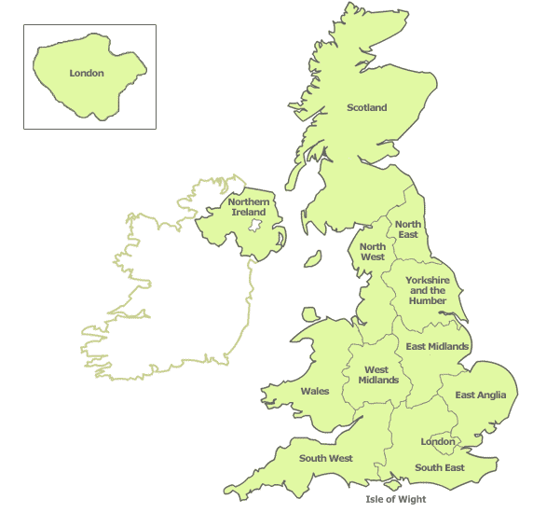
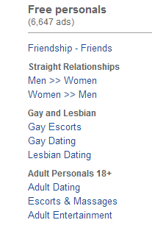
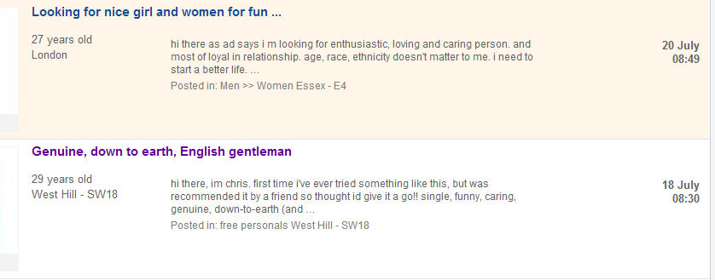

Slide 16
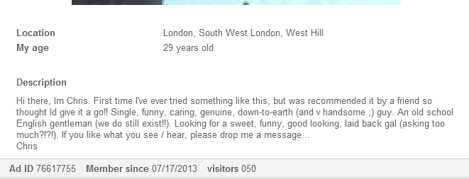
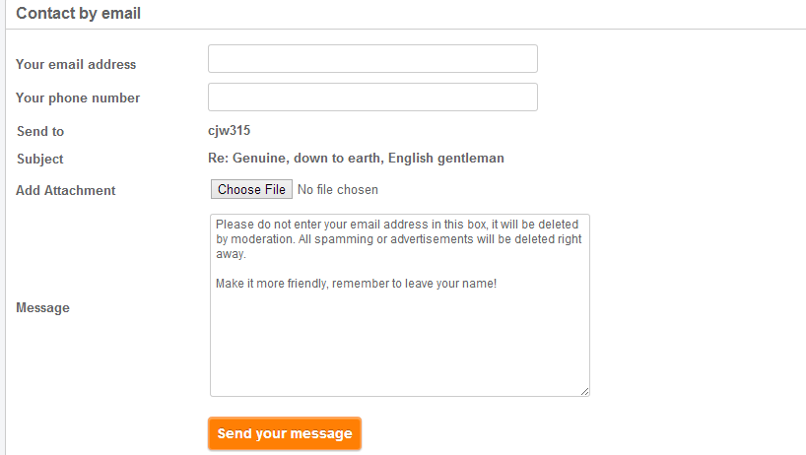
Notes:
category of the personal ad; postcode (region and city name in the Mexican version); ad title; description (where the main body of the personal ad is written); age; a link to post a photo (optional); email (which remains private in the classified ad); a password; and an optional phone number, which would be displayed if it is provided. It is on the individual ad’s page that the reader can view the full description that the advertiser posted. If he/she is interested then the reader has the option to click on a button titled Send a message. This link will lead the reader to a webpage in which he/she enters his/her email address, phone number, an optional attachment and a message before clicking send. This message is then sent to the advertiser who has the option to contact the reader. Additionally, if the original advertiser entered his/her phone number, the reader has the option to click on a link that will reveal the number and he/she can consequently directly contact the advertiser. Thus, the two websites are essentially identical, which makes it possible to allocate differences between the two languages to the two languages and not to medium-specific characteristics or requirements, adhering to the main principles of Computer-Mediated Discourse Analysis and contrastive pragmatics.

Slide 17
Dependent variable
I am looking to meet an attractive, intelligent, honest person who likes to have a good time and is fun to be around. (LN.MBM.1)
MY DREAM MAN MUST BE A CHRISTIAN, 35-55YEARS, BETWEEN 5"8-6"4 TALL, NO KIDS BUT WILL LIKE TO HAVE KIDS. (LN.MBH.3)
Wanted, a good, decent, kind man in his late 40s to mid 50s. (LN.MBH.8)
I would like to meet a man who is similar to myself... (LN.MBH.9)

Slide 18
Coding of actional level
Type:
Preposition
Want/desire/hope/wish/prefer
Looking/seeking
Like (verbs like gustar)
Must be/imperative
If you/question
Ellipsis
Other
Verb tense:
Present
Command
Conditional
Number of verbs:
Not applicable
None
1
2
3

Slide 19
Independent Variables
Sex and orientation
Male looking for male
Male looking for female
Female looking for female
Female looking for male
Age
18-30
31-50
51+

Slide 20
Data collection & analysis
Exclusions
Repetitions
Other types of ads
One ad seeking a partner for an alien
Collected in March 2013
Coded for dependent and independent variables and analyzed in GoldvarbX in order to see which groups used which variants more.

Slide 21
Totals
 | London British English | Mexico City Spanish | Total
Men seeking men | 100 | 100 | 200
Men seeking women | 100 | 100 | 200
Women seeking men | 20 | 56 | 76
Women seeking women | 100 | 74 | 174
Total | 320 | 330 | 650

Slide 22
Results
Mexico City Data

Slide 23
Results: DF data→ Type
254/330= 77%
Sex/orienta- tion a significant predictor of selection of buscar v. all others
Age a significant predictor of querer v. all others
No significant predictors of gustar or lack of speech act
 | Querer/desear/etc. (verbs of want) 11.4%) | Buscar (is looking for) (55.9%) | Verbos como gustar (to like) (16.9%) | Speech act not present (15.7%)
Men → men | 11.4% | 60.8* | 12.7 | 15.2
Men → women | 18.6% | 48.6* | 17.1 | 15.7
Women → men | 4.7% | 72.1* | 16.3 | 7.0
Women → Women | 8.1% | 46.8* | 22.6 | 22.6
18-30 | 11.4* | 60.8 | 12.7 | 15.2
31-50 | 18.6* | 48.6 | 17.1 | 15.7
51+ | 4.7* | 72.1 | 16.3 | 7.0
Buscar > gustar > no request > querer/desear

Slide 24
Results: DF data→ Tense
 | Present (85.4%) | Conditional (14.6%)
Men → men | 88.4 | 11.6
Men → women | 85.9 | 14.1
Women → men | 88.1 | 11.9
Women → women | 78.4 | 21.6
18-30 | 85.3 | 14.7
31-50 | 86.3 | 13.7
51+ | 78.6 | 21.4
 | Present | Conditional
Men → men | 88.4 | 11.6
Men → women | 85.9 | 14.1
Women → men | 88.1 | 11.9
Women → women | 78.4 | 21.6
18-30 | 85.3 | 14.7
31-50 | 86.3 | 13.7
51+ | 78.6 | 21.4
233/330= 70.6%
The differences between groups and ages with regard to verb tense are not statistically significant.

Slide 25
Results
London data

Slide 26
Results: LN data→ Type
236/320= 73.8%
Want/wish/desire; and like → not statistically significant.
Gender/orientation statistically predicts use of look/seek v. all others
Age significantly predicts absences v. presence of speech act.
 | Want/wish/desire (8.9%) | Look/seek (64.8%) | Like (10.6%) | Not present (15.7%)
Men → men | 7.8 | 54.7* | 10.9 | 26.6
Men → women | 5.8 | 77.9* | 10.5 | 5.8
Women → men | 13.3 | 53.3* | 26.7 | 6.7
Women → Women | 12.7 | 60.6* | 7.0 | 19.7
18-30 | 11.3 | 60.9 | 7.8 | 20.0*
31-50 | 5.7 | 69.5 | 11.4 | 13.3*
51+ | 12.5 | 62.5 | 25.0 | 0.0*
Looking for> no request > like > want/wish

Slide 27
Results: LN data→ Tense
 | Present (89.7%) | Command (1.5%) | Conditional (8.8%)
Men → men | 89.1 | 5.5 | 5.5
Men → women | 89.0 | 0.0 | 11.0
Women → men | 68.8 | 0.0 | 31.2
Women → women | 89.7 | 1.5 | 8.8
18-30 | 92.0 | 0.0 | 8.0
31-50 | 85.5 | 3.6 | 10.9
51+ | 80.0 | 0.0 | 20.0
230/320= 71.9%
Variation is not statistically significantly conditioned by either social factor.
Possibly due to small numbers.

Slide 28
Results
Both varieties

Slide 29
Compared varieties
 | Buscar v. all other variants | Look/seek v. all other variants
Men → men | 60.8* | 54.7*
Men → women | 48.6* | 77.9*
Women → men | 72.1* | 53.3*
Women → Women | 46.8* | 60.6*
18-30 | 60.8 | 60.9
31-50 | 48.6 | 69.5
51+ | 72.1 | 62.5

Slide 30
Compared varieties
 | Conditional Mexico | Conditional London
Men → men | 11.6 | 5.5
Men → women | 14.1 | 11.0
Women → men | 11.9 | 31.2
Women → women | 21.6 | 8.8
18-30 | 14.7 | 8.0
31-50 | 13.7 | 10.9
51+ | 21.4 | 20.0

Slide 31
Summary of results
Same four variants constitute the majority of the data for both varieties (77% vs. 73.8%): buscar/looking for, no request, gustar/to like, desear/to want or wish.
Buscar/looking for is the most frequent for both; desear/to want is the least frequent for both.
Gender/sexual orientation statistically significantly conditions the use of buscar/look/seek vs. all other variations in both languages
Women addressing men favor buscar in the DF data, while men addressing women favor seek/look for in the LN data.

Slide 32
Summary of results
Age plays a role in DF: middle aged speakers use querer more.
Age also plays a role in LN: Younger speakers are more likely to omit the speech act.
Tense not socially conditionned in either language. Conditional more frequent in DF data while LN has less conditional and some present of commands.
Verb number didn’t show any effect in the two varieties

Slide 33
Conclusions

Slide 34
What does this all mean?
Online personal ads are highly conventionalized, despite no length limits.
Same four variables are majority in both languages.
Universality of personal ads? (Fraser, 1985)
However, while the options are the same between the two languages, speaker choices are different.
Sociolinguistic patterning is different between the two cultures
Culture-specificity? (Wierzbicka, 1985)
Notes:
Sensitivity for the importance of contextual variables

Slide 35
Questions for future research
Are pragmalinguistic variations of a speech act universal if they are not used in the same way by the same speakers in two varieties or languages?

Slide 36
¡Gracias!
szahler@indiana.edu
References on next page

Slide 37
References
Androutsopoulos, J. (2006). Introduction: Sociolinguistics and computer-mediated communication. Journal of Sociolinguistics, 10(4), 419-438. Retrieved February 10, 2013, from http://www.blackwellsynergy.com/doi/abs/10.1111/j.1467_9841.2006.00286.x
Beebe, L., & Waring, H. (2005). Pragmatic development in responding to rudeness. In J. Frodesen, & C. Holten (Eds.), The power of context in language teaching and learning (pp. 67-80). Boston, MA: Heinle & Heinle/Thomson Learning.
Beebe, L., & Yakashi, T. (1989). Do you have a bag?: Social status and pattern variation in second language acquisition. In S. Gass, C. Madden, D. Preston, & L. Selinker (Eds.), Variation in second language acquisition: Discourse, pragmatics, and communication. (pp. 103-125). Clevedon, UK: Multilingual Matters.
Blum-Kulka, S. (1982). Learning how to say what you mean in a second language: A study of the speech act performance of learners of Hebrew as a second language. Applied Linguistics, 3, 29-39.

Slide 38
References
Blum-Kulka, S. (1983). Interpreting and performing speech acts in a second language: A cross-cultural study of Hebrew and English. In N. Wolfson & E. Judd (Eds.), Sociolinguistics and language acquisition (pp. 36-55). Rowley, MA: Newbury House.
Blum-Kulka, Shoshana, Juliane House, and Gabriele Kasper. (eds.) (1989). Cross-cultural pragmatics: Requests and apologies. Norwood: Ablex Publishing.
Boxer, D. (2002). Nagging: the familial conflict area. Journal of Pragmatics(34), 49-61.
Cherny, L. (1999). Conversation and Community: Chat in a Virtual World. Stanford, CA: Center for the Study of Language and Information.
Cicerello, A. a. (1995). Personal advertisements: A content analysis. Journal of Social Behavior and Personality, 10, 751-756.
Coupland, J. (1996). Dating advertisements: Discourses of the commodified self. Discourse and Society, 7(2), 187-207.
Cruz García, Laura; Adams, Heather (2006). Advertising Discourse: A Contrastive Analysis of Computer Adverts in English and Spanish. LFE, Revista de Lenguas para Fines Específicos, 11-12, 113-132.

Slide 39
References
Deaux, K. a. (1984). Courtship in the personals column: The influence of gender and sexual orientation. Sex roles, 11, 363-375.
Ellison, N., Heino, R., & Gibbs, J. (2006). Managing imipressions online: self-presentation processes in the online dating environment. Journal of Computer-Mediated Communication, 11(2). Retrieved March 05, 2013, from http://jcmc.indiana.edu/vol11/issue2/
Epel, E., Spanakos, A., Kasl-Godley, J., & Brownell, K. (1996). Body shape ideals across gender, sexual orientation, socioeconomic status, race and age in personal advertisement. International Journal of Eating Disorders, 19, 265-273.
Fraser, B. (1985). On the universality of speech act strategies. In S. George (Ed.), From the linguistic to the social context (pp. 43-49). Bologna, Italy: CLUEB.
Grice, H. P. (1975). Logic and Conversation. In P. Cole & J.L. Morgan (Eds.), Speech Acts (pp. 41-58). New York: Academic Press.
Groom, C. J., & Pennebaker, J. W. (2005). The language of love: sex, sexual orientation, and language use in online personal advertisements. Sex roles, 52, 447-461.

Slide 40
References
Gudelunas, D. (2005). Online personal ads: community and sex, virtually. Journal of Homosexuality, 49, 1-33.
Hancock, J., Toma, C., & Ellison, N. (2007). The truth about lying in online dating profiles. Proceedings of the ACM Conference on Human Factors in Computing Systems (CHI2007) (pp. 449-452). New York, NY: Associate for Computing Machinery.
Hardey, M. (2004). Mediated relationships: authenticity and the possibility of romance. Information, Communication and Society, 7, 207-222.
Hatala, M., & Prehodka, J. (1996). Content analysis of gay male and lesbian personal advertisements. Psychological Reports, 78, 371-374.
Herring, S. (2004). Computer-mediated discourse analysis: An approach to researching online behavior. In S. Barab, R. Kling, & J. Gray (Eds.), Designing for Virtual Communities in the Service of Learning (pp. 338-376). New York, NY: Cambridge University Press.
Holden, T., & Tsuruki, T. (2003). Deai-kei: Japan's new culture of encounter. In N. Gottlieb, & M. McLelland (Eds.), Japanese cybercultures (pp. 34-49). New York, NY: Routledge.
Kiesler, S., Siegel, J., & McGuire, T. (1984). Social psychological aspects of computer-mediated communication. American Psychologist, 39, 1123-1134.

Slide 41
References
Levenston, E. (1968). Principles of pragmatics. London and New York: Longman.
Locher, M. (2010). Introduction: Politeness and impoliteness in computer-mediated communication. Journal of Politeness Research, 6, 1-5.
Marley, C. (2002). Popping the question: questions and modality in written dating advertisements. Discourse Studies, 4(1), 75-98.
Montero-Fleta, B., Montesinos-López, A., Pérez-Sabater, C., Turney, E. (2009). Computer mediated communication and informalization of discourse: the influence of culture and subject matter. Journal of Pragmatics, 41, 770-779.
Montini, T., & Ovrebro, B. (1990). Personal relationship ads: An informal balancing act. Sociological Perspectives, 33, 327-339.
Nair, R. (1993). Gender, genre, and generative grammar: Deconstructing the matrimonial column. In M. Toolan (Ed.), Language, text and context: Essays in stylistics (pp. 227-254). London: Routledge.
Pérez-Sabater, C., Turney, E., Montero-Fleta, B. ( 2008). A spoken genre gets written: online football commentaries in English, French and Spanish. Written Communication 25 (2), 235–261.

Slide 42
References
Qadir, A., & Riloff, E. (2011). Classifying sentences as speech acts in message board posts. Proceedings of the Conference on Empirical Methods in Natural Language Processing (pp. 748-758). Stroudsburg, PA: Association for Computational Linguistics.
Rojas-Sosa. (n.d.). "Tú que te mereces un príncipe, un dentista": The use of metaphors of love, desire, and gender in personal ads on the Internet to perform heterosexuality. Creating and supporting ideologies of heteronormativity and sexuality in Spanish. Doctoral dissertation, University of Minnesota.
Ruiz, J.H. (2006). The role of metaphor, metonymy and conceptual blending in understanding advertisements: the case of drug-prevention ads. Revista Alicantina de Estudios Ingleses 19, 169-190.
Schneider, K. P. (2010). Variational Pragmatics. Amsterdam/Philadelphia: Benjamins.
Schneider, K., & Barron, A. (2008). Where pragmatics and dialectology meet: introducing variational pragmatics. In K. Schneider, & A. Barron (Eds.), Variational pragmatics: a focus on regional varieties in pluricentric languages (pp. 1-32). Amsterdam/Philadelphia: Benjamins.

Slide 43
References
Searle, J. (1976). A classification of illocutionary acts. Language in Society, 5(1), 1-23.
Shalom, C. (1997). That great supermarket of desire: attributes of the desired other in personal advertisements. In K. Harvey, & C. Shalom (Eds.), Language and desire: Encoding sex, romance and intimacy (pp. 186-203). New York: Routledge.
Smith, C. A., & Stillman, S. (2002). What do women want? The effects of gender and sexual orientation on the desirability of physical attributes of personal ads of women. Sex Roles, 46, 337-342.
Swales, J. (1990). Genre Analysis. Cambridge: Cambridge University Press.
Tannen, D. (1981). Indirectness in discourse: Ethnicity as conversational style. Discourse Processes, 3(4), 221-238.
Terkourafi, M. (2012). Between pragmatics and sociolinguistics: Where does pragmatic variation fit in? In J. Félix-Brasdefer, & D. Koike (Eds.), Pragmatic Variation in First and Second Language Contexts: Methodological Issues (pp. 295-318). Amsterdam: John Benjamins.
Thorne, A., & Coupland, J. (1998). Articulations of same sex desire: lesbian and gay male dating advertisements. Journal of Sociolinguistics, 2(2), 233-257.

Slide 44
References
van Compernolle, R. (2008a). Second-person pronoun use and address strategies in online personal advertisements from Quebec. Journal of Pragmatics, 40(12), 2062-2076.
van Compernolle, R. (2008b). Language variation in online personals ads from Quebec: The case of ne. Language@Internet, 5.
van Compernolle, R. (2008c). Sociopragmatics norms in Québécois online personal advertisements. In M. Koop (Ed.), Le Québec à l'aube du nouveau millénaire: entre tradition et modernité (pp. 1-8). Québec: Presses de l'Université du Québec.
Vlčková, J. (1996). Text typology of personal advertising (Attract. 35 yo. M, profess., with GSOH, WLTM sim.F 4 f/ship.Ldn). BRNO Studies in English, 22, 89-96.
Wierzbicka, A. (1985). Different cultures, different languages, different speech acts. Journal of Pragmatics, 9, 145-178.
Wood, A. F., & Smith, M. J. (2005). Online communication: Linking technology, identity, and culture. Mahwah, NJ: Lawrence Erlbaum.
Yule, George. (1996). Pragmatics. New York: Oxford University Press.
Yurchisin, J., Watchravesringkan, K., & McCabe, D. (2005). An exploration of identity re-creation in the context of Internet dating. Social Behavior and Personality, 33, 735-750

Slide 45
Object of the study
Ø Un hombre profesional que me apoye económicamente.
“A professional man that supports me economically.” (DF.MBM.17)
I am looking for a white gentleman. Someone between 30 and 50 years old who can show me London. (LN.MBH.2)
Wanted, a good, decent, kind man in his late 40s to mid 50s. White man only. None smoker & no criminal record. (LN.MBH.8)

Slide 46
Type
Verbs like gustar: Me agradria encontrar a una persona sincera sin malos rollos limpia,sana. (DF.HBH.91)
“I would like to find a sincere person without any bad habits, clean, healthy.”
Ellipsis: Solo Ø hombres serios que no tengan miedo al compromiso. (DF.MBH.48)
“Only serious men who aren’t afraid of commitment.”
Question: Buscas una mujer en los 40's y te gusta una mujer de complexión grande? Realmente te sientes solo y buscas quien te atienda? (DF.MBH.43)
“Are you looking for a woman in her 40’s and you like a woman with a big personality? Do you truly feel alone and want someone to take care of you?

Slide 47
Verb tense
Present tense: I prefer Asian guys. (LN.HBH.70)
Conditional: Age and looks not important, but wouldnt mind a young fit guy (lets face it, who wouldnt). (LN.HBH.28)
Imperative/must: You must be a good-looking lad, slim, clean and under 35. (LN.HBH.7)

Slide 48
Number of verbs
Two verb: I am looking to meet an attractive, intelligent, honest person who likes to have a good time and is fun to be around someone who is very goal-oriented in his personal life and his career. (LN.MBH.1)
One verb: Looking for a serious man, educated, caring, understanding ... like me, who are feeling alone and desire to start a family. (LN.MBH.16)

