Slide 1
Second Language Learners and Working Memory: Production of gender agreement in advanced Spanish
Sara Zahler and Marina Bonilla Conejo
University at Albany, SUNY
Hispanic Linguistics Symposium
October 26^{th,} 2019

Slide 2
Introduction

Slide 3
Gender in Spanish and English
Spanish
English
Gendered language
All nouns are assigned gender
Most modifiers are overtly marked for gender
El padre/la madre
El gato/la gata
El/la estudiante
El carro
La mesa
El puente/la clase
El tema/la mano
Non-gendered language
Nouns are not assigned gender
Modifiers are not marked for gender
Only a few noun pairs that have inherent biological gender
The mother/father
The duke/duchess

Slide 4
Acquisition of gender in second language (L2) Spanish
Acquired late
Learners more accurate with…
Gender assignment/recognition v. gender production
Masculine nouns v. feminine nouns
Biological/animate v. non-biological/inanimate
Canonical v. not marked v. deceptive noun morphology
Shorter distances between modifier and noun v. longer distances between modifier and noun
Frequent nouns v. infrequent nouns
As proficiency increases
(Alarcón, 2009, 2011; Bruhn de Garavito & White, 2002; Fernández-García, 1999; Montrul, Foote & Perpiñan, 2008; Sagarra & Herschensohn, 2010; White, Valenzuela, Kozlowska-MacGregor & Leung, 2004)

Slide 5
If learners show higher accuracy in gender assignment and show knowledge of noun gender, why do they continue to make errors in production even at very advanced levels?
Our hypothesis: Working Memory (WM)
WM limits production planning and retrieval of knowledge from long-term memory during production leading to more errors in language production
(Klaus, Mädebach, Oppermann & Jescheniak, 2016; Unsworth, Brewer & Spillers, 2013)

Slide 6
Working memory (WM)
Limited capacity attentional resource
Temporarily stores and manipulates information available for processing during complex tasks
Information is subject to decay over time
Inverse relationship between storage and processing
Thought to allow for the faster learning of grammatical rules in language
(e.g. Baddeley, 2000; Baddeley, 2007; Baddeley & Hitch, 1974; Miller, 1956)

Slide 7
WM and L2 abilities
Documented correlations between WM and…
Grammatical associations in artificial languages
Reading comprehension
Sensitivity to grammatical cues/errors
Grammatical accuracy
General second language proficiency
(e.g. Ando et al., 1992; Harrington & Sawyer, 1992; Hartsuiker & Barkhuysen, 2007; Keating, 2010; Martin & Ellis, 2012; Miyake & Friedman, 1998; Robinson, 2002; Sagarra & Herschensohn, 2011; Sunderman & Kroll, 2009)

Slide 8
WM and L2 gender
Learners with higher WM are more sensitive to gender disagreement in comprehension/processing tasks than learners with lower WM (Keating, 2010; Sagarra & Herschensohn, 2009)
WM does not affect accuracy in a grammaticality judgement task, but does affect accuracy in gender production in novice learners (Denhovska & Serratrice, 2017)
The effects of distance, frequency and overtness of gender marking may indicate that gender accuracy in production is lower when processing demands are higher

Slide 9
Research Question
Does working memory affect production accuracy of gender in advanced learners?
Advanced learners with higher WM will demonstrate more accurate gender marking during production
Better production planning abilities
Better able to retrieve and integrate gender information from long-term memory
Documented correlations between WM and production accuracy for other grammatical structures and for gender in other L2s

Slide 10
Method

Slide 11
Participants
30 undergraduate students enrolled in 4th year Spanish courses at a large public university in the United States
L1 English
Spanish majors and minors
16 women and 14 men
 | WM ( /75) | PSTM (/144) | IQ (/160) | Years of Study | Overall Proficiency (-30 to 80)
Mean | 59.73 | 89.5 | 109.43 | 10.4 | 29.23
SD | 11.79 | 19.69 | 9.17 | 2.72 | 10.11
Range | 28-75 | 53-126 | 91-127 | 6-15 | 10-54

Slide 12
Tasks
[Part of a larger corpus of tasks designed to elicit free response speech and examining cognitive individual differences]
Operation span task (Measure of WM)
Oral response task
IQ test
DELE grammar task
Lex-tale vocabulary task
Background questionnaire
Serial non-word recognition task (measure of phonological short-term memory)
Written contextualized tasks (WCT)

Slide 13
Operation span task
Operation span task from the Psychology Experiment Building Language (PEBL) (Meuller & Piper, 2014)
Perform simple math operations while memorizing letters for later recall
 | Working memory | Weighted IQ | PSTM | Overall Proficiency | Years of Study
Working memory | 1 | .282 | .242 | -.014 | .249
Weighted IQ | .282 | 1 | .111 | .435* | -.076
PSTM | .242 | .111 | 1 | .202 | -.171
Overall Proficiency | -.014 | .435* | .202 | 1 | .000
Years of Study | .249 | -.076 | -.171 | .000 | 1

Slide 14
Oral response task
Participants presented with prompts for an oral response (via PowerPoint)
10 prompts, 10-15 minutes total
Topics designed to promote a range of discourse types (hypothetical, narrative, description)
Responses recorded with a TASCAM DR-40 4-Track portable digital recorder with a Shure WH20XLR dynamic headset microphone
“Cuéntame tus planes para este fin de semana.’

Slide 15
Analysis (1)
All tokens of determiners and adjectives that modified a noun and could be marked overtly for gender
Las personas más amistosas
Exclusions
Variable in native Spanish (N=5)
El/la mar
Modifiers of a non-native noun (N=10)
Pela larga (pelo largo - long hair)
Overtly marked for gender in the task prompt (N=699)
Este semestre
Cases where distance could not be calculated (N=69)
Pearson correlations between learner accuracy and WM scores
 | Number
Raw total | 3823
Exclusions | 783
Final total | 3055

Slide 16
Analysis (2)
Variable | Subcategories
Modifier Type | Determiner Adjective
Type of gender marking | Canonical (o/a) Not marked (-e, -s, -n, etc.) Predictive (e.g. –ción, -dad) Deceptive (a/o)
Animacy | Animate Inanimate
Noun gender | Feminine Masculine
Corpus frequency | Continuous
Distance | Continuous (number of words)
Working memory | Continuous
Proficiency | Continuous
Dependent variable
Yes
No
Corrected
Independent variables
Modifier type
Type of gender marking
Animacy
Noun gender
Corpus frequency
Distance
Working memory
Proficiency
Random effects
Participant

Slide 17
Results

Slide 18
Participant | Accuracy (%y/y+n+c) | Participant | Accuracy (%y/y+n+c)
5 | 70.3 | 20 | 88.2
9 | 77.5 | 13 | 89.8
17 | 78.4 | 3 | 89.9
16 | 81.2 | 25 | 91.3
23 | 81.6 | 31 | 91.3
14 | 82.4 | 6 | 91.8
1 | 82.6 | 11 | 91.9
4 | 82.6 | 28 | 92.4
10 | 85.4 | 29 | 93.2
30 | 85.9 | 22 | 94.6
19 | 86.5 | 7 | 94.6
18 | 86.6 | 21 | 95.5
2 | 86.8 | 15 | 95.9
12 | 87.0 | 26 | 96.0
8 | 87.8 | 24 | 97.2
Mean = 87.9 ; SD = 6.3 ; Range = 70.3% - 97.2%

Slide 19
R = -.014
p = .942
N= 30
Notes:
All 30 participants. No significant correlation, but rather

Slide 20
R = .586
p = .002
N= 26

Slide 21
Factor | Significant?
Noun gender | X***
Type of gender marking | X***
Modifier type | X***
Corpus frequency | X**
Distance | X*
Animacy | X*
More accurate with…
Masculine > feminine nouns
Canonical > predictive > not marked > deceptive gender marking
Determiners > adjectives
As word frequency increases
At shorter distances
Animate > inanimate nouns
X*** = p < .001, X** = p < .01, X* = p < .05
Proficiency and WM were not significant constraints on accuracy
Binominal regression analysis of all 30 participants; Total N = 3055

Slide 22
Factor | Significant?
Noun gender | X***
Type of gender marking | X***
Working memory | X***
Modifier type | X***
Corpus frequency | X**
Animacy | X*
Distance | X*
More accurate with…
Masculine > feminine nouns
Canonical > predictive > not marked > deceptive gender marking
As WM increases
Determiners > adjectives
As word frequency increases
Animate > inanimate nouns
At shorter distances
X*** = p < .001, X** = p < .01, X* = p < .05
Proficiency was not a significant constraint on accuracy
Binominal regression analysis of 26 participants; Total N = 2688

Slide 23
Discussion

Slide 24
Research questions revisited
Does working memory affect production accuracy of gender in advanced learners?
Advanced learners with higher WM will demonstrate more accurate gender marking during production
Yes and no
For most learners (26/30), there was a strong correlation between WM and accuracy in gender marking
WM also significant in regression analysis
However, four learners did not follow the general pattern

Slide 25
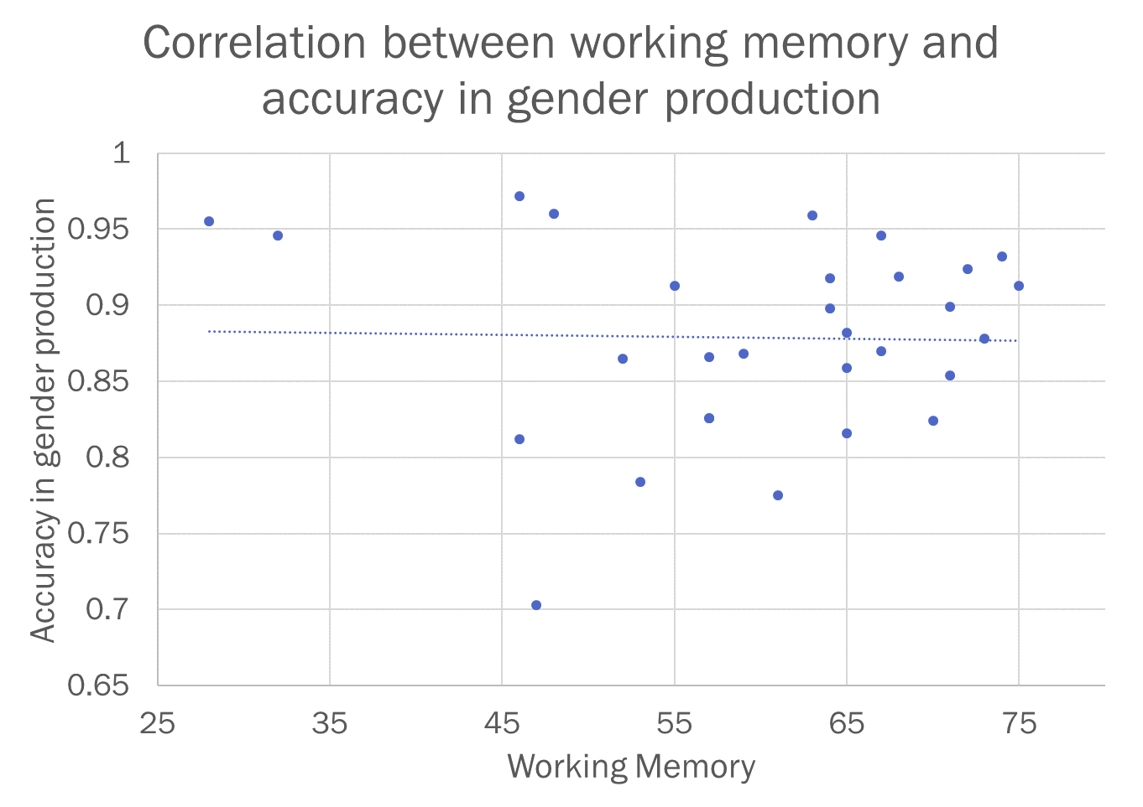
Why these four learners?
Proficiency approached significance in regression (p = .06) with all 30 participants
Two learners had particularly high proficiency
The other two had average proficiency, but had the lowest speech rate of the 30 participants
No other clear differences for PSTM, IQ, years of study, study abroad, participant sex
Although there appears to be a role for WM, other factors are at play
WM, proficiency and other individual differences may combine to affect learners’ accuracy in gender production

Slide 26
Connection with previous literature
Regarding linguistic constraints, our findings are in line with previous research
(Alarcón, 2009, 2011; Bruhn de Garavito & White, 2002; Fernández-García, 1999; Montrul, Foote & Perpiñan, 2008; Sagarra & Herschensohn, 2010; White, Valenzuela, Kozlowska-MacGregor & Leung, 2004)
Proficiency was not significant in the regression (p<.06), but our learners were all from one class level
Significant in previous studies (Gudmestad, Edmonds & Metzger, 2019)

Slide 27
Future steps
Collect more data and do cluster analysis to group into proficiency groups
Examine the role of speech rate in grammatical accuracy during production
Continue studying the role of WM in grammatical accuracy during production
Seems to play a role
But other individual differences also seem to be important

Slide 28
Thank you!
szahler@albany.edu
mbonillaconejo@albany.edu

Slide 29
Additional slides

Slide 30
Factor | N | %Accurate | Factor weight/ Log odds
Noun gender (p < .001)
Masculine | 1437 | 90.5% | 0.62
Feminine | 1618 | 82.4% | 0.38
Type of gender marking (p < .001)
Canonical | 2012 | 89.0% | 0.66
Predictive | 456 | 80.3% | 0.56
Not marked | 496 | 82.7% | 0.47
Deceptive | 91 | 74.7% | 0.31
Word type (p < .001)
Determiner | 2356 | 86.9% | 0.56
Adjective | 699 | 84.0% | 0.44
Corpus frequency (p = .007) |  |  | 0.005
Distance (p = 0.021) |  |  | -0.055
Animacy (p = 0.024)
Animate | 704 | 89.6% | 0.55
Inanimate | 2351 | 85.2% | 0.45

Slide 32
Factor | N | %Accurate | Factor weight/ Log odds
Noun gender (p < .001)
Masculine | 1280 | 90.0% | 0.63
Feminine | 1408 | 80.5% | 0.37
Type of gender marking (p < .001)
Canonical | 1763 | 88.1% | 0.66
Predictive | 395 | 77.7% | 0.56
Not marked | 446 | 81.8% | 0.48
Deceptive | 84 | 72.6% | 0.31
Working memory (p < .001) |  |  | 0.041
Word type (p = .001)
Determiner | 2082 | 85.6% | 0.56
Adjective | 606 | 83.0% | 0.44
Corpus frequency (p = .004) |  |  | 0.006
Animacy (p = 0.024)
Animate | 628 | 89.2% | 0.55
Inanimate | 2060 | 83.8% | 0.45
Distance (p = 0.037) |  |  | -0.051

