Slide 1
The future is in the past: A diachronic analysis of variable future-in-the-past expression in Spanish
Danielle Daidone
Sara Zahler
Indiana University

Slide 2
Introduction
Future-in-the-past (FP): events in a subordinate clause that are subsequent to the event in the main clause
1. Les dió licencia y esperanzas de que presto iría a Judea. (CORDE, 1580-1630)
‘He gave them permission and hope that soon he would go to Judea’
2. Mañana hemos dicho que íbamos a ir a la Sierra. (CREA, 1980-2004)
‘Tomorrow we said that we are going to go to the mountains’
3. Aconsejaron al mismo capitán Perálvarez que se fuese a ver con él, pues que iba tan cerca. (CORDE, 1580-1630)
‘They advised Captain Perálvarez that he face him, since he was to be so close by.’
Notes:
This study began with our personal interest in sentences such as

Slide 3
Introduction
Observed by several researchers and is claimed to be similar to the variation between forms expressing the canonical future (CF) (Abusch, 1988; Hadlick, 1971; Lozano, 1988; Ohigara, 1986; Poplack & Malvar, 2007; Radanova-Kusceva & Kitova-Vasileva, 1985; Reichenback, 1947; Stockwell, Bowen, & Martin, 1965; Tagliamonte, 2012).
Hablaría = hablaré
Iba a hablar = voy a hablar
Hablaba = habla
Spanish grammars:
20th century: discuss variation between future-in-the-past forms in terms of canonical future (CF) forms
The future-in-the-past variation shares its “particularities” with future variation (Alarcos Llorach, 1973)

Slide 4
Introduction
Nevertheless, the FP has rarely been studied
Studies on distribution (Radanova-Kusceva & Kitova-Vasileva, 1985; Sarrazin & Azzopardi, 2012)
However, CF forms have been shown to be constrained by numerous linguistic factors in Romance varieties
The effects of these factors change across time
Indicate change in grammaticalizing forms (Aaron [2006]; Malvar [2004]; Poplack & Dion [2009]; Poplack & Malvar [2007])

Slide 5
Proposed study
To examine the effect of numerous linguistic factors on the use of FP forms across time
Characterize variation in FP contexts across time (diachronically)
Compare said variation with diachronic studies on the CF.
Goal
To determine whether the same constraints govern variation for both contexts

Slide 6
Previous research

Slide 7
Previous research on FP
Radanova-Kusceva & Kitova-Vasileva (1985):
Literary texts
354 cases of FP
67% conditional
23% imperfect go-periphrasis
4% imperfect indicative
6% other forms such as the imperfect subjunctive and the periphrastic conditional
Sarrazin & Azzopardi (2012):
Oral data in CREA from 1995-2004
251 cases of FP
76% imperfect go-periphrasis
24% conditional

Slide 8
Diachronic studies of canonical future
Notes:
Aaron looked at 1605-1635
1789-1834
1987-2003 written
Late 20th century

Slide 9
Diachronic studies of canonical future

Slide 10
Diachronic studies of variation in CF forms in Romance
Several factors have been found to constrain variation in diachronic variationist research on the canonical future
Adverbial modification
Temporal proximity
Polarity
Sentence modality
Verb class
Aaron (2006); Malvar (2004); Poplack & Dion (2009); Poplack & Malvar (2007)

Slide 11
Diachronic studies of variation in CF forms in Romance
Factor | Effects | Languages | Studies
Adverbial modification | At first, PF disfavored by all adverbial modification, then a distinction between specific and non-specific adverbials arose. | Spanish | Aaron (2006)
Temporal proximity | Distal events → SF Proximal events → PF Switches in 20th century. Small effect. | Canadian French* | Poplack & Dion (2009)
Polarity | 1. At first negative disfavors PF 2. Period of non-significance 3. Negative favors PF | Spanish | Aaron (2006)
Sentence modality | Interrogatives favor PF Effect becomes stronger across time | Spanish | Aaron (2006)
Verb class | Statives → SF Dynamic non-motion; motion → PF Effect size decreases over time | Spanish | Aaron (2006)
Aaron (2006); Malvar (2004); Poplack & Dion (2009); Poplack & Malvar (2007)
Notes:
Aaron (2006): also looked at 20th century spoken
Didn’t compare Malvar (2004) or Poplack & Malvar (2007) since they considered four forms, one of which is not found in Spanish, the haver + infinitive periphrasis, which accounts for at least a 1/3 of the tokens until the 20th century.
Poplack & Dion (2009): The synthetic future is very restricted to negative clauses. Almost categorically synthetic future in negative contexts.
Also disfavored in negative in Malvar (2004) and Poplack & Malvar (2007).
With BP: when it comes into the system, favored by proximal and no adverbial. Adverbial and proximal both decrease over time.
No effect of verb type when enters system. By 20th century motion disfavors

Slide 12
The Current Study
Methods

Slide 13
Research questions
What linguistic factors affect variation between the imperfect, conditional, and periphrastic form when expressing FP across three time periods (1580-1630, 1780-1830, and 1980-2004)?
Is the variation between periphrastic and synthetic forms in the FP context analogous to that of CF diachronically?

Slide 14
Corpora
Corpus Diacrónico del Español (CORDE)
Data from the beginnings of the language until 1975
Theater and narrative
Corpus de Referencia del Español Actual (CREA)
Data from 1975 to 2004
Oral and narrative
3 time installments in order to capture discernable differences between periods (Aaron, 2006)
1580-1630, 1780-1830, 1980-2004

Slide 15
Variables
Dependent variable
Original goal
Hablaría
Iba a hablar
Hablaba
BUT imperfect with future-in-the-past interpretation extremely infrequent
Only 1/198 tokens of imperfect actually expressed future-in-the-past
Sarrazin and Azzopardi (2012): imperfect – 4%
Tokens only in subordinate clauses considered (Tagliamonte, 2012)
Aaron (2006)
Notes:
Future-in-the-past is a phenomenon primarily constrained to subordinate clauses (Tagliamonte, 2012)

Slide 16
Extraction and Coding
 | High frequency | Low frequency
Motion | Ir Llegar | Correr Caer
Dynamic non-motion | Hacer Dar | Sacar Recibir
Psychological | Querer Saber | Entender Recordar
Stative | Ser Estar | Resultar Corresponder
Frequency was determined using Davies’ (2006) A frequency dictionary of Spanish: Core vocabulary for learners.

Slide 17
Extraction and Coding
All grammatical person/number combinations were considered
All tokens which referred to future-in-the-past events were extracted and coded according to various linguistic variables
Tokens with meanings apart from future-in-the-past were disregarded
epistemic use of conditional: Pensando que sería cierto (CORDE, 1580-1630)
purely allative uses of the go-periphrasis: Se la había contado un día que los dos iban a un monte a hacer leña (CORDE, 1580-1630)

Slide 18
Independent variables
Adverbial modification
Temporal proximity
Polarity
Sentence modality
Verb class (subordinate)
Grammatical person
Semantics of the matrix clause
Frequency
Specific subordinate verb

Slide 19
Independent variables
Variables | Categories
1. Adverbial modification | None Specific Non-specific
2. Temporal proximity | Same day A year or more away Within a week Indeterminate Within a month Proximate Within a year Unknown
3. Polarity | Affirmative Negative
4. Sentence modality | Declarative Interrogative
5. Verb class | Motion Dynamic non-motion Psychological Stative

Slide 20
Analysis
Separate binary logistic regressions were run for the time periods 1580-1630 and 1980-2004 in Rbrul (Johnson, 2009)
1780-1830 did not have enough tokens. Raw % reported

Slide 21
Results

Slide 22
172/347
49.3%
13/113
11.5%
35/473
7.4%

Slide 23
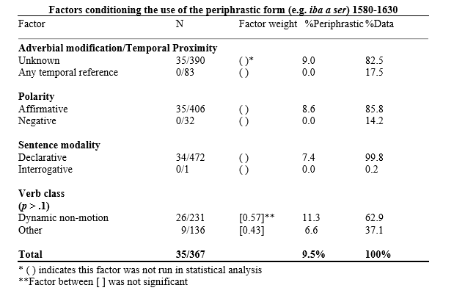
1580-
1630

Slide 24
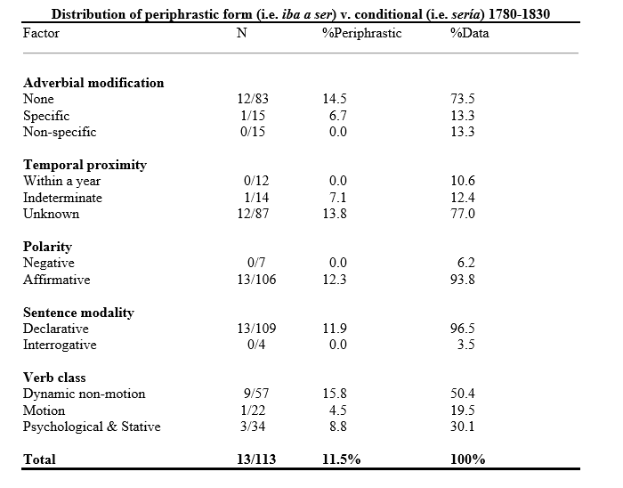
1780-
1830

Slide 25
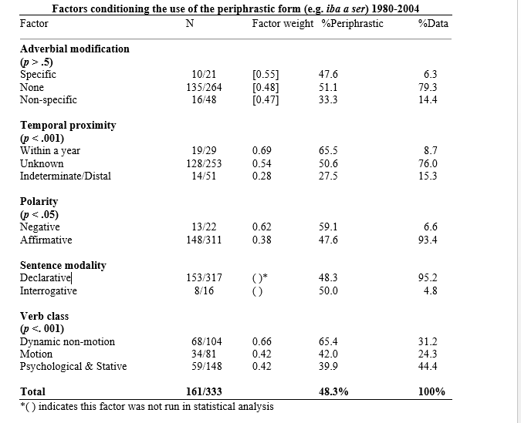
1980-
2004
14 cases excluded due to their distribution within factors not analyzed here

Slide 26
Adverbial modification
Future in the past
Periphrastic form does not occur with any adverbial modification
First appearance of periphrastic form with adverbial modification, occurs with a specific adverbial
Periphrastic form allowed in all contexts with adverbial modification, more common with specific adverbials
1580-1630
1780-1830
1980-2004
Patterns similarly, but our third time period is like the 19th century for canonical future
Canonical future
Aaron (2006)
Periphrastic form highly disfavored by any adverbial modification
Effect of adverbial modification not significant
Periphrastic form disfavored by specific adverbials, even more so by non-specific
Same trend as written data
17th century
19th century
20th century written
20th century spoken

Slide 27
Temporal proximity
Future in the past
Periphrastic form does not occur with any temporal reference
Periphrastic form occurs when temporal proximity is not specified
Periphrastic form favored with events occurring within a year; synthetic favored in indeterminate/distal
1580-1630
1780-1830
1980-2004
Patterns similarly, but our third time period is like the 19th century for canonical future
Canonical future
Poplack & Dion (2009)
Distal favors synthetic form
Distal disfavors synthetic form (range of 3)
19th century
20th century spoken

Slide 28
Polarity
Future in the past
Periphrastic form does not occur in negative contexts
Periphrastic form does not occur in negative contexts
Periphrastic form favored in negative contexts; disfavored in affirmative
1580-1630
1780-1830
1980-2004
Patterns similarly, and at the same rate
Canonical future
Aaron (2006)
Periphrastic form disfavored by negative contexts
Effect of polarity not significant
Effect of polarity not significant
Periphrastic form favored in negative contexts
17th century
19th century
20th century written
20th century spoken

Slide 29
Sentence modality
Future in the past
Periphrastic form does not occur with interrogatives (only 1 interrogative)
Periphrastic form does not occur with interrogatives (only 4 interrogatives)
Periphrastic and synthetic forms evenly distributed
1580-1630
1780-1830
1980-2004
Behaves more like the 17-19th century canonical future forms
Canonical future
Aaron (2006)
Effect of sentence modality not significant
Effect of sentence modality not significant
Periphrastic form favored in interrogatives
Periphrastic form favored in interrogatives
17th century
19th century
20th century written
20th century spoken

Slide 30
Verb class
Future in the past
Effect of verb class not significant; periphrastic form occurs more with dynamic non-motion verbs
Periphrastic form more common with dynamic non-motion verbs
Periphrastic form favored by dynamic non-motion verbs; disfavored by psychological, stative, and motion verbs
1580-1630
1780-1830
1980-2004
Same distribution for future-in-the-past and canonical future. Consistent across time.
Motion verbs behave differently.
Canonical future
Aaron (2006)
Periphrastic form favored by dynamic non-motion and motion verbs; disfavored by stative, perceptual, & psychological
Periphrastic form favored by dynamic non-motion and motion verbs; disfavored by stative, perceptual, & psychological
Periphrastic form favored by dynamic non-motion and motion verbs; disfavored by stative, perceptual, & psychological
Periphrastic form favored by dynamic non-motion and motion verbs; disfavored by stative, perceptual, & psychological
17th century
19th century
20th century written
20th century spoken

Slide 31
Discussion

Slide 32
Discussion: Research question 1
What linguistic factors affect variation between the imperfect, conditional, and periphrastic form when expressing future-in-the-past across three time periods (1580-1630, 1780-1830, and 1980-2004)?
More restricted at first then started showing a distinction between
Specific and non-specific for adverbial modification
Within a year (proximate) and more than a year (distal)
Polarity
At first negative disfavored periphrastic form, but switched direction of effect
Sentence modality
No periphrastic form with interrogatives, but in 3rd time period, no effect
Verb type: does not change across time
Dynamic non-motion favors periphrastic; Stative disfavor it

Slide 33
Research question 2
Is the variation between periphrastic and synthetic forms in the future-in-the-past context analogous to that of canonical future diachronically?
Yes
Jump in periphrastic use, decrease of synthetic form in late 19th century/early 20th century (Aaron, 2006; Malvar, 2004)
Verb type and polarity follow similar paths for research on the future (Aaron, 2006) and our results
Similar effects of adverbial specification, proximity, and sentence modality but slower rate
The changes over time for future-in-the-past seem to be slower for these factors, which behave in the 20th century for future-in-the-past as canonical future in the 19th century

Slide 34
Comparison with diachronic studies

Slide 35
Research question 2a
Has the imperfect go-periphrasis followed the same grammaticalization path as the present go-periphrasis?
Yes
Increase in late 19th/early 20th century
At first not allowed with temporal reference, but moved into all temporal reference by 20th century
Favored by “within a year”; difference between specific and nonspecific
Does not occur with negatives at first, but is favored by this context by 20th century
Favored by dynamic non-motion

Slide 36
Research question 2b
Has the use of the conditional form followed the same grammaticalization path as the use of the future form?
Yes
Decreases across time
Less frequent in the 20th century
Not constricted by temporal specificity or adverbial modification at first
Relegated to nonspecific contexts and distal events by 20th century
Becomes constrained by polarity
Favored in affirmatives, disfavored in negatives
Favored by stative verbs

Slide 37
Conclusion

Slide 38
Conclusion
Same lexico-semantic origin for future variants and future-in-the-past variants
This causes the pathway of grammaticalization for both variable contexts to be remarkably similar
Highlights the interconnectedness of the entire tense, mood and aspect system in Spanish, and in Romance
Specifically, changes in grammaticalizing forms may be explained by, or are analogous to, changes in other parts of the whole tense and aspect system

Slide 39
Future research
Look at written 20th century for future-in-the-past
Compare to canonical future in subordinate clauses with the same 16 verbs, so that results are more comparable
Examine tokens of conditional, and imperfect go-periphrasis that do not have future-in-the-past meaning
With forms that perform a particular function, examining their other functions outside of the variable context has been shown to inform their behavior within the variable context (Aaron, 2010)

Slide 40
Thanks!
Danielle Daidone ddaidone@indiana.edu
Sara Zahler szahler@indiana.edu

Slide 41
References
Aaron, J. E. (2006). Variation and change in Spanish future temporal expression: Rates, constraints, and grammaticization. Unpublished doctoral dissertation. University of New Mexico, Albuquerque.
Abusch, D. (1988). Sequence of tense, intensionality and scope. In Proceedings of WCCFL (Vol. 7, pp. 1-14).
Alarcos Llorach, E. (1973). Gramática de la lengua española. Madrid: Espasa Calpe.
Bello, A. (1847). Gramática de la lengua castellana destinada al uso de los americanos. Bogotá: Reimpresa Echeverría
Blas Arroyo, J. L. (2008). The variable expression of future tense in Peninsular Spanish: The present (and future) of inflectional forms in the Spanish spoken in a bilingual region. Language Variation and Change, 20(01), 85-126.
Bybee, J. L., & Pagliuca, W. (1987). The evolution of future meaning. In Papers from the 7th International Conference on Historical Linguistics (pp. 109-122). Amsterdam: John Benjamins.
Bybee, J. (2000). The phonology of the lexicon: Evidence from lexical diffusion. In M. Barlow & S. Kemmer (Eds.) Usage-based models of language, 65-85. Stanford: CSLI.
Bybee, J., & Thompson, S. (2000). Three frequency effects in syntax. In Proceedings of the Annual Meeting of the Berkeley Linguistics Society (Vol. 23, No. 1).
Bybee, J. (2006). From usage to grammar: The mind's response to repetition. Language, 711-733.
Bybee, J., Perkins, R., & Pagliuca, W. (1994). The evolution of grammar: Tense, aspect, and modality in the languages of the world. Chicago: University of Chicago Press.
Claes, J., & Ortiz Lopez, L. A. (2011). Restricciones pragmáticas y sociales en la expresión de futuridad en el español de Puerto Rico. Spanish in context, 8(1), 50-72.
Davies, M. (2013). A frequency dictionary of Spanish: Core vocabulary for learners. New York: Routledge.
del Corro, A. (1988 [1586]). Reglas gramaticales para aprender la lengua Española y Francesa. Study and edition by Lidio Nieto. Madrid: Arcos/Libros.
Díaz-Peralta, M., & Almeida, M. (2000). Sociolinguistic factors in grammatical change: the expression of the future in Canarian Spanish. Studia Neophilologica, 72(2), 217-228.
Durán Urrea, E., & Gradoville, M. (2006). Variation in the future tense of New Mexican Spanish. In SALSA, Symposium About Language and Society. Austin, TX.
Gili Gaya, S. (1966). Resumen práctico de gramática española. Barcelona: Biblograf
Gudmestad, A., & Geeslin, K. L. (2011). Assessing the Use of Multiple Forms in Variable Contexts: The Relationship between Linguistic Factors and Future-Time Reference in Spanish. Studies in Hispanic & Lusophone Linguistics, 4(1).
Hadlich, R. (1971). A Transformational Grammar of Spanish. Englewood Cliffs, New Jersey: Prentice-Hall.
Harris, A. C., & Campbell, L. (1995). Historical syntax in cross-linguistic perspective (Vol. 74). Cambridge, UK: Cambridge University Press.

Slide 42
References
Hopper, P. & Traugott, E. (1993). Grammaticalization. Cambridge, UK: Cambridge University Press.
Johnson, D. E. (2009). Getting off the GoldVarb standard: Introducing Rbrul for mixed effects variable rule analysis. Language and Linguistics Compass, 3, 359-383.
Lastra, Y., & Butragueño, P. (2010). Futuro perifrástico y futuro morfológico en el corpus sociolingüístico de la ciudad de México. Oralia, 13.
Lozano, A. G. (1988). The Semantics of the Spanish Conditional in Discourse. Hispania 71, pp. 675-680.
Malvar, E. (2003). Future temporal reference in Brazilian Portuguese: Past and present. Unpublished doctoral dissertation). University of Ottawa, Ottawa.
Martínez Amador, E. (1966). Diccionario gramatical y de dudas del idioma.
Méndez Vallejo, D. C. (2008). Periphrastic and morphological future forms in Bogotá Spanish: A preliminary sociolinguistic study of upper class speakers. IULC Working Papers Online, VIII (3), 1-22.
Orozco, R., & Guy, G. (2008). El uso variable de los pronombres sujetos:¿ qué pasa en la costa Caribe colombiana. In Selected proceedings of the 4th workshop on Spanish sociolinguistics (pp. 70-80).
Poplack, S., & Dion, N. (2009). Prescription vs. praxis: The evolution of future temporal reference in French. Language, 85(3), 557-587.
Poplack, S., & Malvar, E. (2007). Elucidating the transition period in linguistic change: The expression of the future in Brazilian Portuguese. Probus, 19, pp. 121-169.
Radanova-Kusceva, N., & Kitova-Vasileva, M. (1985). Forme esprimenti un’azione futura rispetto a un momento di riferimento al passato nell’italiano e nello spagnolo contemporaneo. Rassegna italiana di lingüística applicata 17, pp. 1-31.
Real Academia Española (1973). Esbozo de una nueva gramática de la lengua española. Madrid: Espasa-Calpe
Real Academia Española. Banco de datos (CORDE) [online]. Corpus diacrónico del español. <http://www.rae.es> [March 20, 2014]
Real Academia Española. Banco de datos (CREA) [online]. Corpus de referencia del español actual. <http://www.rae.es> [March 20, 2014]
Sarrazin, S., & Azzopardi, S. (2012). L'alternance du conditionnel et de la périphrase itive à l'imparfait dans des corpus oraux espagnols et français. Studia Universitatis Babes-Bolyai-Philologia, (3), 57-68.
Schwenter, S. A., & Cacoullos, R. T. (2008). Defaults and indeterminacy in temporal grammaticalization: the ‘perfect’road to perfective. Language Variation and Change, 20(01), 1-39.
Squartini, M., & Bertinetto, P. M. (2000). The simple and compound past in Romance languages. In Ö. Dahl (Ed.), Tense and Aspect in the Languages of Europe (403-439). Berlin: Mouton de Gruyter.
Stockwell, R.P.J., Bowen, D., & Martin, J.W. (1965). The Grammatical Structure of English and Spanish. Chicago: University of Chicago Press.
Tagliamonte, Sali. 2012. Variationist sociolinguistic, change, observation and interpretation. Oxford: Wiley-Blackwell.
Travis, C. E. (2007). Genre effects on subject expression in Spanish: Priming in narrative and conversation. Language variation and change, 19(02), 101-135.

Slide 43
Grammaticalization
The process by which lexical items or constructions come to serve grammatical functions or by which grammatical items develop new grammatical functions (Hopper & Traugott, 1993, pp. 1-2)
Considered to be one of the main driving forces behind language change
How does this happen? (Bybee, Perkins, & Pagliuca, 1994)
Reanalysis
Inference
Analogy/extension
Retention in grammaticalization (Schwenter & Torres Cacoullos 2008: 11; cf. Bybee &Pagliuca 1987)
As a form grammaticalizes from one meaning to another, it retains its prior uses
Insights from grammaticalization are relevant for the conditional/synthetic future and the go-periphrasis
Notes:
When the underlying structure of the system is reanalyzed

Slide 44
Go-periphrasis
Physical movement towards a goal implies intention of completing that action
I am/was going [to talk to the king]
Reanalysis of intention as future
I [am/was going to] talk to the king.
Generalized to more contexts
I [am/was going to] be a king.
Relevant linguistic factors for analysis:
Animacy → originally with animate subjects
Verb type → originally not compatible with verbs of motion or statives

Slide 45
Synthetic future and the conditional
Originally periphrastic constructions (Bybee, 2000; Harris & Campbell, 1995; Hopper & Traugott, 1993)
[infinitive] + [conjugated habere ´to have´ in the present/imperfect]
Frequent use → reanalysis as a single unit
[infinitive + conjugated habere]
habere analyzed as the auxilary and the infinitive as the main verb
Phonological reduction to modern forms → hablaré, hablarás, etc.
Semantic shift due to inference
obligation > intention > future > modality
Highly grammaticalized (Bybee, Perkins & Pagliuca, 1994)
Relevant linguistic factor for analysis:
Animacy → since it is highly grammaticalized, it should be favored more with impersonal, abstract and inanimate subjects than the go-periphrasis

Slide 46
The grammatical tradition

Slide 47
Grammatical tradition
The treatment of different structures in grammars can provide valuable insights into the evolution of forms in variation (Poplack & Dion, 2009; Poplack & Malvar, 2007)
Spanish grammars from 16th century to 21st century were examined for references to future-in-the-past expression
No mention in 16th, 17th, and 18th centuries
19th century: majority talk about the future-in-the-past use of the conditional, draw parallel to canonical synthetic future, don’t mention other forms (e.g. Bello, 1869)
20th & 21st centuries: the periphrastic form begins to be mentioned, and the existence of variation is discussed (e.g. RAE, 2009)
Certainty (periphrastic) versus uncertainty (synthetic)
The future-in-the-past variation shares its “particularities” with future variation (Alarcos Lllorach, 1973)

Slide 48
Canonical future
Due to parallel drawn between FP and CF expression, we looked at their discussion of CF temporal reference
Throughout the centuries futurate present and synthetic future mentioned
Present said to describe an action that is will be realized immediately after the moment of speaking (Alcina Franch & Blecua, 1982; Alarcos Llorach, 1999)
Beginning in the 20th century the periphrastic future is mentioned
The periphrastic future linked to close or imminent actions or processes, the synthetic future is described as the preferred variant for distant time contexts (Gili Gaya, 1966; RAE, 1973)

Slide 49
Resulting hypotheses
The information from the grammars yields the following hypotheses:
The go-periphrasis will emerge later than the other forms
Possible that the imperfect and the imperfect go-periphrases are used when the future-in-the-past action occurs shortly after the action of the main verb
Futurate present and the periphrastic future are said to be used when an action will happen soon after the moment of speaking
The conditional should occur with uncertain events, while the periphrastic variant should occur with certain predicates
Factors
Proximity of future event
Certainty

Slide 50
Synchronic studies of variation in future forms in Spanish
Adverbial modification
No adverbial generally favors PF
With adverbial favors present
Results not so clear for SF, tendency is adverbials favor SF
Temporal proximity
Distal events favor SF
Proximate and indefinite frequently favor the PF
Proximate favors the present
Polarity
Negative favors PF, affirmative favors SF
Sentence modality
Interrogatives favor PF
Verb type
Results are not consistent across studies; verb categories are classified differently

Slide 51
Synchronic studies of variation in future forms in Spanish
Subject plurality
Inconsistent results
Subject animacy
Non-human favors SF; human favors PF
Grammatical person/number
1st person PF; 3rd person SF
Certainty
Uncertainty favors SF
Certainty favors PF
Blas Arroyo, 2008; Claes & Ortíz-López, 2011; Díaz-Peralta & Almeida, 2000; Durán Urrea & Gradoville, 2008; Gudmestad & Geeslin, 2010; Lastra-Butragueño, 2010; Méndez-Vallejo, 2008; Orozco, 2005
Notes:
Not surprising that some of these constraints don’t behave the same in different varieties of Spanish since it has been shown that different dialects can be at varying stages of grammaticalization of a particular form (Schwenter & Torres Cacoullos, 2008).

