Slide 1
A Variationist Account of Trill /r/ Usage in the Spanish of Málaga
Sara Zahler
Danielle Daidone

Slide 2
Introduction
Spanish has two rhotics, the tap /ɾ/ and the trill /r/, ex. pero [pé.ɾo] ‘but’ vs. perro [pé.ro] ‘dog’
/r/ occurs in
Intervocalic position: carro [ká.ro]
Word-initial position: rota [ró.ta]
Post-consonant syllable-initial position: honra [ón.ra]
Prescriptively, /r/ is realized as a voiced alveolar trill with 2-3 occlusions (Hualde, 2005).
The alveolar trill is a difficult sound requiring complex articulation, precise muscle control and a necessary airflow speed in order for the tongue tip to vibrate (Ladefoged, 1982).
Notes:
The only position where the trill contrasts with the tap is in intervocalic position. In all other positions, the tap and the trill have a complementary distribution. The trill occurs in word-initial position, and in word-internal, syllable-initial position following a consonant.
Prescriptively /r/ is realized as a voiced alveolar trill with 2-3 occlusions.

Slide 3
However…
Previous studies have found that the production of the trill varies considerably across dialects:
Velar variants in Puerto Rico (Lipski, 1990)
Pre-breathy voiced variants in Dominican Republic (Willis, 2006)
An assibilated variant in the highlands of Latin America (e.g. Canfield, 1962; Matus-Mendoza, 2004)
Categorically assibilated in the Central Valley of Costa Rica (Adams, 2002)
A range of variants from fricatives to approximants in Argentina (Colantoni, 2006)
A tap realization in various dialects (e.g. Díaz-Campos, 2008; Willis, 2006)

Slide 4
Within dialects:
Seven variants found in Santo Domingo Dominican Spanish (c.f. Willis, 2006, p. 124)
IPA | % | Description
[ɦ] | 9 | Voiced glottal fricative
[ʃ] | 10 | Voiceless alveo-palatal fricative
[ɦɾ] | 30 | Pre-breathy voice followed by a single tap
[ɦr] | 21 | Pre-breathy voice followed by multiple closures (trill)
[ɾ] | 9 | Single tap
[r] | 16 | Multiple closures without preceding breathy voice (trill)
Misc. | 4 | Post-tap frication (typically)

Slide 5
Within individuals:
Out of the individual data presented for 10 speakers in Willis (2006), not a single speaker used exclusively one variant, i.e. all speakers presented variation
Speaker | [ɦ] | [ʃ] | [ɦɾ] | [ɦr] | [ɾ] | [r] | misc.
ME | 0 | 2 | 6 | 27 | 1 | 9 | 0
MG | 7 | 0 | 7 | 6 | 7 | 5 | 2
RC | 5 | 0 | 18 | 4 | 2 | 2 | 0
PB | 1 | 1 | 0 | 3 | 7 | 1 | 0
Examples taken from Willis (2006, p. 128)

Slide 6
What conditions this variation?
Trill variation has been found to be conditioned by both linguistic and extralinguistic factors
Linguistic factors
Position within the word (Díaz-Campos, 2008; Diez Canseco, 1998; Henriksen & Willis, 2010; Willis, 2006)
Phonetic context (Diez Canseco, 1998; Lewis, 2004; Recasens & Pallarès, 1999; Solé, 2002; Vásquez-Carranza, 2006)
Syllable length of word (Díaz-Campos, 2008)
Grammatical category (Díaz-Campos, 2008)
Syllable stress (Henriksen & Willis, 2010)

Slide 7
What conditions this variation?
Trill variation has been found to be conditioned by both linguistic and extralinguistic factors
Extralinguistic factors
Age (Díaz-Campos, 2008; Henriksen & Willis, 2010; Lastra & Butragueño, 2006)
Education level (Lastra & Butragueño, 2006)
Gender (Díaz-Campos, 2008; Diez Canseco, 1998; Henriksen & Willis, 2010; Lastra & Butragueño, 2006; Willis, 2006)
Social class (Díaz-Campos, 2008; Diez Canseco, 1998; Lastra & Butragueño, 2006)
Social network density (Diez Canseco, 1998)

Slide 8
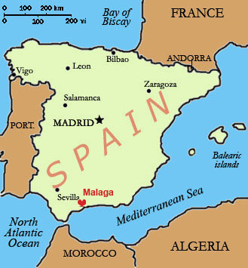
The current study
This study investigates trill variation in Málaga, Spain
Peninsular Spanish is one of the least studied varieties for trill variation (Hammond, 2000)
Most studies done on Spanish of northern Spain (Almeida & Dorta, 1993; Blecua Falgueras, 2001; Lewis, 2004; Quilis, 1993)
One study showed that there is variation in the Jerezano variety of Andalusian Spanish (Henriksen & Willis, 2010)
Position within the word
Stress
Age
Gender
http://2.bp.blogspot.com/-EHN40K7iQXY/UDaF8vmkm_I/AAAAAAAABPM/vOBduuL7u38/s1600/spain.jpg
Notes:
One study showed that there is variation in the jerezano variety of Andalusian Spanish. They considered word position, stress, age and gender and found some level of variation in all four factors. (move to next slide)

Slide 9
The current study
We aim to:
Widen the number of factors examined
Determine which factors favor the production of the canonical trill using a variationist analysis
Analyze the role of frequency in trill production
Expand these analyses to a previously unstudied variety of Andalusian Spanish in terms of trill production
Notes:
Consequently, the aim of this study is to widen the number of factors examined as influencing trill variation in Andalusian Spanish, determine which favor the canonical trill, analyze the role of frequency in trill production and at the same time expand these analyses to a previously understudied variety of Andalusian Spanish in terms of trill production, that is we will examine Malaga Spanish.

Slide 10
Methods

Slide 11
Method
Corpus
Corpus de Málaga (Múñoz, Manuel, Lasarte & Villena, 2008)
12 sociolinguistic interviews with native Spanish speakers from Málaga
6 men and 6 women from 3 different age groups, all high level of education
 | Men | Women
20-34 | 2 | 2
35-54 | 2 | 2
55+ | 2 | 2

Slide 12
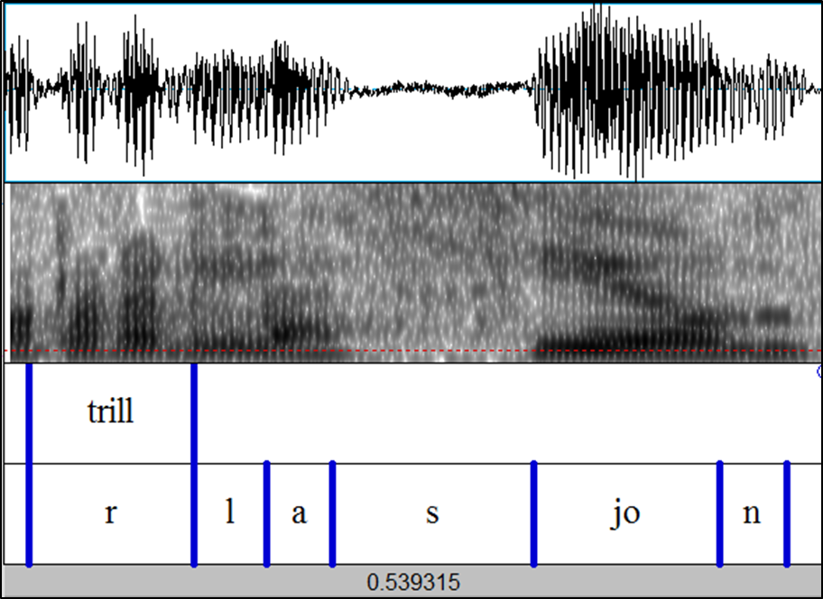
Method
963 tokens of /r/ were analyzed acoustically with Praat and classified as either canonical trill (2 or more occlusions) or other (all other realizations.

Slide 13
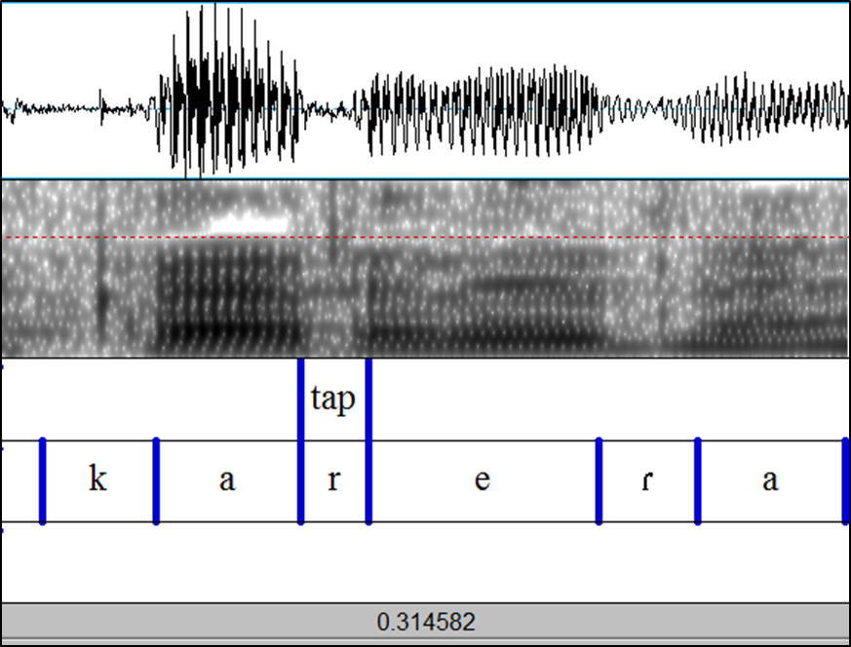

Slide 14
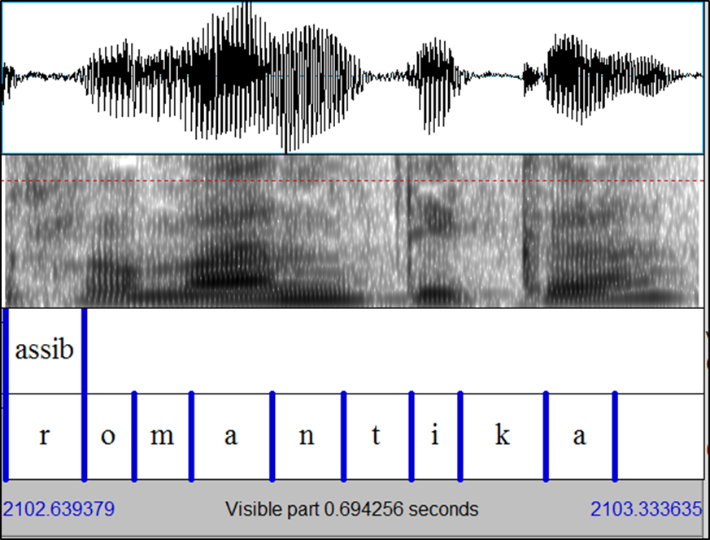

Slide 15
Method
These tokens were then coded according to the following linguistic factors:
Following context (point of articulation)
Following context (manner of articulation)
Preceding context (point of articulation)
Preceding context (manner of articulation)
Position of /r/ within the word
Grammatical category of the word
Number of syllables in the word
Syllable stress
Corpus frequency of the word
ESPAL token count frequency
ESPAL number of phonological neighbors
ESPAL number of higher frequency phonological neighbors
ESPAL average frequency of phonological neighbors
Preceding context manner of articulation | Stop Affricate Fricative Nasal Lateral Vibrant High vowel Mid vowel Low vowel Pause
Preceding segment point of articulation | Bilabial Labiodental Dental Alveolar Palatal Velar Pause Front vowel Central vowel Back vowel
Position in word | Word initial, post-pause Word initial, post-consonant Word-initial, post-vowel Intervocalic –rr- Word medial, after -s, -l, o -n
Grammatical category | Noun Proper noun Adjective Adverb Verb Pronoun Conjunction
Following segment point | Front vowel Central vowel Back vowel
Following context manner of articulation | High vowel Mid vowel Low vowel
Syllable stress | Stressed Unstressed N/A
Number of syllables | Monosyllabic 2-3 syllables 4+ syllables
A database for information about word properties based off written data and subtitles.
Phonological neighbors: words that differ by one phoneme with either addition, deletion or substitution.

Slide 16
Method
Factor | P-value
Following segment-manner | 0.0207
Following segment-point | 0.00957
Preceding segment-manner | .992
Preceding segment-point | 0.135
Position within word | 0.0021
Corpus frequency of the word | 0.000343
ESPAL corpus frequency | 0.101
ESPAL # phonological neighbors (PN) | 0.0338
ESPAL # high frequency PN | 0.171
ESPAL avg. frequency PN | 0.314

Slide 17
Method
Final factors considered:
Following context (point of articulation)
Position of /r/ within the word
Grammatical category of the word
Number of syllables in the word
Syllable stress
Corpus frequency of the Word
ESPAL number of phonological neighbors

Slide 18
Method
These tokens were then coded according to the following extralinguistic factors:
Age
Sex
A multivariate analysis was run on the data using Rbrul (Johnson, 2009)

Slide 19
Statistical analysis

Slide 20
Exclusions
963 original tokens.
918 used in final analysis:
8 word-internal after –s, -l, or –n
2 monosyllabic
3 prepositions
32 no ESPAL frequency/phonological neighbor count available
Proper names of nearby landmarks, etc. that are not in the database: Alpujarra

Slide 21
Significant factors
Factor | logodds | Token # | %Trill | weight
Syllable stress (p=2.29e-05)
Stressed | 0.265 | 270 | 44.8% | 0.57
Unstressed | -0.265 | 648 | 30.1% | 0.43
Age (p=0.00186)
35-54 | 0.302 | 283 | 39.2% | 0.58
55+ | 0.133 | 435 | 35.6% | 0.53
20-34 | -0.434 | 200 | 25.0% | 0.39
Position (p=0.0281)
Word-initial post-consonant | 0.335 | 93 | 44.1% | 0.58
Intervocalic –rr- | 0.210 | 298 | 40.6% | 0.55
Word-initial post-vowel | -0.190 | 501 | 29.3% | 0.45
Word-initial post-pause | -0.354 | 26 | 26.9% | 0.41
Total tokens |  | 918 | 34.4%
Notes:
Here is the best model predicted by Rbrul, with lexical accent, age and position in word resulting significant.
Here we see that lexical accent is the most significant factor with the trill co-occurring more with stressed words.

Slide 22
Non-significant factors
Factor | Token # | %Trill
Following sound point
Back vowel | 112 | 42.9%
Central vowel | 119 | 42.9%
Front vowel | 687 | 31.5%
Number of syllables
2-3 syllables | 640 | 44.8%
4+ | 279 | 30.0%
Grammatical category
Adjective/adverb | 163 | 41.7%
Verb | 235 | 34.0%
Noun | 466 | 32.4%
Proper noun | 54 | 31.5%
Gender
Male | 542 | 36.3%
Female | 376 | 31.6%
Total | 918 | 34.4%
Notes:
Here are the non-significant factors. Explain them.
Frequency is not among either the significant nor the non-significant ones. Why not? Because it interacted with several of the factors… switch to next slide

Slide 23
Correlations between all linguistic factors and corpus frequency
Factor | P-value
Following segment – point | 5.88e-08
Position in word | 0.000373
Syllable stress | 0.143
# of syllables | 2.37e-09
Grammatical category | 1.18e-16
Factor | logodds
Corpus frequency (p=0.000175) | -0.008
ESPAL # phonological neighbors (p=0.0207) | 0.017
Notes:
As we see here, Corpus frequency is strongly correlated to four of the five factors, while it is not statistically correlated to lexical accent. This would then skew the data if it were included.
Thus corpus frequency and number of phonological neighbors were considered separately and a multi-variate analysis was conducted on just these two factors. Results show that both factors are statistically significant. Higher corpus frequency favors non-trill productions whereas more phonological neighbors favor trill productions.

Slide 24
Factor | logodds | Token # | %Trill | weight
Lexical accent (p=2.29e-05)
Stressed | 0.265 | 270 | 44.8% | 0.57
Unstressed | -0.265 | 648 | 30.1% | 0.43
Age (p=0.00186)
35-54 | 0.302 | 283 | 39.2% | 0.58
55+ | 0.133 | 435 | 35.6% | 0.53
20-34 | -0.434 | 200 | 25.0% | 0.39
Position (p=0.0281)
Word-initial post-consonant | 0.335 | 93 | 44.1% | 0.58
Intervocalic –rr- | 0.210 | 298 | 40.6% | 0.55
Word-initial post-vowel | -0.190 | 501 | 29.3% | 0.45
Word-initial post-pause | -0.354 | 26 | 26.9% | 0.41
Total tokens |  | 918 | 34.4%
Factor | P-value
Lexical accent | 2.29e-05
Corpus frequency | 0.000301
Age | 0.00334
Position in word | 0.00167
# of phonological neighbors | 0.0338
Following segment | 0.0406
# syllables | 0.0474
Gender | 0.14
Grammatical category | 0.186
Factor | logodds
Corpus frequency (p=0.000175) | -0.008
ESPAL # phonological neighbors (p=0.0207) | 0.017
Notes:
So then the question becomes, how do you merge the two models? Since they were run separately, would frequency still be significant if included in the model.
Well, if you correlate each factor individually with trill production, then you get the following hierarchy. The factors with the lowest p-values were also significant in the separate runs, indicating the similarity between when these factors are considered individually and together. The next question that arises is whether frequency, since it correlates with almost all the other factors, is causing factors to be significant when they would otherwise not be, or vice-versa.

Slide 25
Correlations between all linguistic factors and corpus frequency
Factor | logodds | Token # | %Trill | weight
Corpus frequency (p=0.000133) | -0.0009
Position in word (p=0.00081)
Word-initial post-consonant | 0.333 | 93 | 44.1% | 0.583
Intervocalic –rr- | 0.309 | 298 | 40.6% | 0.577
Word-initial post-vowel | -0.256 | 501 | 29.3% | 0.436
Word-initial post-pause | -0.387 | 26 | 26.9% | 0.405
Notes:
So if we return to the correlations between all the factors and frequency, we see that lexical accent is not statistically significant related to frequency. This factor had the most significant p-value in the multivariate analysis and thus, one could argue that this effect is not an effect of frequency.
However, position in the word is statistically correlated to frequency. Thus, it is hard to tease apart whether position in word or frequency are both constraining variation or are skewed one because of the other. As such, we ran a statistical analysis with only these two factors and they both were still extremely significant. This suggests that both position in word and corpus frequency would be included in an ideal model of trill variation.

Slide 26
Discussion

Slide 27
How does this compare to previous research?
Lexical accent
Stress not significant in some previous studies (Lewis, 2004; Díaz-Campos, 2008)
Unstressed words correlate with more occlusions (trill) (Henriksen & Willis, 2010)
THIS STUDY: Stressed syllables favor trill variant.
Age
Older speakers favor trill (Díaz-Campos, 2008)
Younger speakers use more trill (Lastra & Butragueño, 2006; Henriksen & Willis, 2010)
THIS STUDY: Middle and older speakers favor trill, while younger speakers disfavor it.

Slide 28
How does this compare to previous research?
Word position
Word medial correlates to higher trill use/higher number of occlusions (Henriksen & Willis, 2010; Lastra & Butragueño, 2006)
Word initial correlates to higher trill use (Díaz-Campos, 2008; Diez Canseco, 1998).
IN THIS STUDY: Picture not quite so clear →
Word-medial generally favors but when word-initial is divided according to the sound that precedes it, post-consonant trills pattern differently than other word initial trills.
Position (p=0.0281) | logodds | #tokens | %trill | weight
Word-initial post-consonant | 0.335 | 93 | 44.1% | 0.58
Intervocalic –rr- | 0.210 | 298 | 40.6% | 0.55
Word-initial post-vowel | -0.190 | 501 | 29.3% | 0.45
Word-initial post-pause | -0.354 | 26 | 26.9% | 0.41

Slide 29
How does this compare to previous research?
Following sound
Trills in [i]_[i] context are shorter, have fewer contacts, and have a higher rate of fricatives/approximant realizations than [a]_[a] context (Solé, 2002)
THIS STUDY: Following back and central vowels occur more with trill variants than following front vowels.
Number of syllables
Words with 1-3 syllables significantly favor non-trill variants; words with 4+ syllables favor trill variants (Díaz-Campos, 2008).
THIS STUDY: Not significant but the opposite trend.
Notes:
Add more to following sound.

Slide 30
How does this compare to previous research?
Grammatical category
Adjectives > verbs > nouns > adverbs (Díaz-Campos, 2008)
THIS STUDY: Similar trend: Adjectives/adverbs > verb > noun > proper noun
Sex
Male > female (Willis, 2006)
Female > male (Díaz-Campos, 2008; Henriksen & Willis, 2010)
Not significant (Lastra & Butragueño, 2006)
THIS STUDY: Not significant, but males used the trill slightly more.
Notes:
Add more to following sound.

Slide 31
Frequency
Corpus Frequency
No previous variationist research on frequency effects in trill production.
Following Bybee (2001, 2002) → high frequency tokens will tend to show more reduction.
THIS STUDY: Corpus frequency was extremely significant → higher frequency disfavors trill production.
Number of phonological neighbors
No previous variationist research on phonological neighborhood effects in trill production.
Words that have more phonological neighbors may require more need to be phonetically distinguished from similar sounding words, thus canonical productions may be more likely to occur in these words (Munson & Solomon, 2004)
THIS STUDY: Number of phonological neighbors was significant → words with more phonological neighbors favored the trill.
Notes:
Munson & Solomon found that vowel space was more expanded with high-density words than low-density words, i.e. vowels were more distant in words with many phonological neighbors

Slide 32
Conclusions

Slide 33
Conclusions
This is the first study to look at trill variation in Málaga.
Significant factors were:
Syllable stress
Age
Position in word
Corpus frequency
# of phonological neighbors
Future research should consider corpus frequency and phonological neighbors.
Future research should also define word position in more detail since this may explain conflicting results from prior studies.
Notes:
Finish this slide

Slide 34
Thank you
Questions? Comments?
Danielle Daidone ddaidone@indiana.edu
Sara Zahler szahler@indiana.edu

Slide 35
References
Adams, C. (2002). Strong assibilation and prestige: a sociolinguistic study in the central valley of Costa Rica. Diss., University of California Davis.
Boersma, P., & Weenink, D. (2012). Praat: doing phonetics by computer (Version 8.4.10). Retrieved from www.praat.org.
Bradley, T. & Willis, E. (2008). Rhotic contrast and neutralization in Veracruz Mexican Spanish. Paper presented at Linguistic Symposium on Romance Languages. Urbana-Champaign, Indiana.
Bradley, T. & Willis, E. (2012). Rhotic variation and contrast in Veracruz Mexican Spanish. Estudios de Fonética Experimental. Forthcoming in vol. 21.
Canfield, D. L. (1962). La pronunciación del español en América. Bogotá: Instituto Caro y Cuervo.
Colantoni, L. (2006). Micro and macro sound variation and change in Argentine Spanish. In Selected Proceedings of the 9th Hispanic Linguistics Symposium (pp. 91-102).
Díaz-Campos, M. (2008). Variable production of the rrill in spontaneous speech: Sociolinguistic implications. In L. Colantoni & J. Steele (Eds.), Selected Proceedings of the 3rd Conference on Laboratory Approaches to Spanish Phonology (pp. 47-58). Somerville, MA: Cascadilla Proceedings Project.
Diez-Canseco, S. (1997). Language variation: the influence of speakers’ attitudes and gender on sociolinguistic variables in the Spanish of Cusco, Peru. Ph.D. Dissertation: University of Pittsburgh.
Hammond, R. (1999). On the non-occurrence of the phone [r̃] in the Spanish sound system. Advances in Hispanic linguistics, ed. by Javier Gutiérrez-Rexach and Fernando Martínez-Gil, 135-151. Somerville, MA: Cascadilla Press.
Hammond, R., (2000). “The multiple vibrant liquid in U.S. Spanish.” In A. Roca’s (ed.) Research on Spanish in the U.S. Somerville, MA: Cascadilla Press, 333-347.

Slide 36
References
Hualde, J.I. (2005). The sounds of Spanish. Cambridge: Cambridge University Press.
Ladefoged, P. (1982). A Course in Phonetics. New York: Harcourt Brace Jovanich.
Lastra, Y.P. & Martín Butragueño, P. (2006). Un posible cambio en curso: el caso de las vibrantes en la ciudad de México. In A.M. Cestero Mancera (Ed.), Estudios sociolingüísticos del español de España y América. Madrid: Arco Libros.
Lipski, J. (1990). “Spanish taps and trills: phonological structure of an isolated opposition.” Folia Linguistica 24, 153-174.
Matus Mendoza, M. (2004). Assibilation of /-r/ and migration among Mexicans. Language. Variation and Change 16. 17-30.
Munson, B. & Solomon, N. (2004). The effect of phonological neighborhood density on vowel articulation. Journal of Speech, Language and Hearing Research, 47(5), 1048.
Múñoz, A., Manuel, A., Lasarte, M., & Villena, J.A. (eds.) (2008). El español hablado en Málaga II. Málaga: Sarriá.
Real Academia Española: Database (CREA) [online]. Corpus de referencia del español actual. <http://www.rae.es> [December 8, 2012]
Sankoff, D., Tagliamonte, S. A., & Smith, E. (2005). "Goldvarb X: A multivariate analysis application." Dept. of Linguistics, Univ. of Toronto. http://individual.utoronto.ca/tagliamonte/Goldvarb/GV_index.htm
Solé, M. (2002). Aerodynamic characteristics of trills and phonological patterning. Journal of Phonetics 30. 655-688.
Willis, E. (2006). Trill variation in Dominican Spanish: an acoustic examination and comparative analysis. In N. Segarra and A. J. Toribio (eds.), Selected proceedings of the 9th Hispanic Linguistic Symposium, 121-131. Somerville, MA: Cascadilla Proceedings Project.
Willis, E. and Bradley, T. (2008). Contrast maintenance of taps and trills in Dominican Spanish: Data and analysis. In Laura Colantoni and Jeffrey Steele (eds.) Selected Proceedings of the 3rd Conference on Laboratory Approaches to Spanish Phonology, 87-100. Somerville, MA: Cascadilla Proceedings Project.

