Slide 1
Documenting instructor input in the Spanish language classroom
Sara Zahler University at Albany, SUNY
Danielle Daidone University of North Carolina Wilmington
CASPSLaP
February 17, 2022

Slide 2
Instructor input
Instructor input, or “teacher talk” often differs from speech outside the classroom
preterit and imperfect (Daidone, 2019)
subject pronouns (Dracos, 2018; Gurzynski-Weiss et al., 2018)
Under a usage-based account, learners build their grammar based on linguistic input (e.g., Bybee, 2008; Ellis, 2013)
Distribution or frequency of forms in student output have been found to mirror instructor input (Hamayan & Tucker, 1980; Trofimovich et al., 2012)
Nevertheless, as a field, we have little research on the input, particularly oral input, to which learners are exposed (Ellis & Collins, 2009)

Slide 3
Spanish instructor input corpus
63 recordings from online synchronous classes
5 instructors teaching across 4 course levels
average of 1 recording per week for a semester
Sociolinguistic interviews with 4 of the instructors
Working on orthographic transcripts in ELAN
Plan to collect more data and make transcriptions and recordings publicly available

Slide 4
Pilot study on trill variation
Production of the trill is highly variable in native speech (e.g., Díaz-Campos, 2008; Henriksen & Willis, 2010; Willis, 2007)
Voiced alveolar multiple occlusion trill is the standard taught in classrooms (Face, 2006; Olsen, 2012)
However, explicit pronunciation instruction is rare in Spanish teaching materials (Arteaga, 2000)
Pronunciation training is often not part of the curriculum
→What do they hear in the input?

Slide 5
Research questions
What trill variants do instructors use in the classroom and at what rate?
Does this differ from the trill variation present in sociolinguistic interviews with the same instructors?

Slide 6
Method
Analyzed all tokens of /r/ in 3 class sessions each for 4 instructors teaching 100 and 200 level courses
Analyzed all tokens of /r/ in interviews for 3 of the instructors
Speaker 1: female from New Jersey (parents from Argentina and DR)(no interview data yet)
Speaker 2: female from Spain (Málaga)
Speaker 3: female from Puerto Rico (Mayagüez)
Speaker 4: female from Spain (Madrid)

Slide 7
Method
Tokens were identified as 1 of 10 variants using Praat:
Assibilated
Elision
Epenthetic vowel + rhotic
Native-like approximant
Non-native approximant
Pre-aspirated trill
Tap
Tap + approximant
Tap + frication
Multiple-occlusion trill

Slide 8
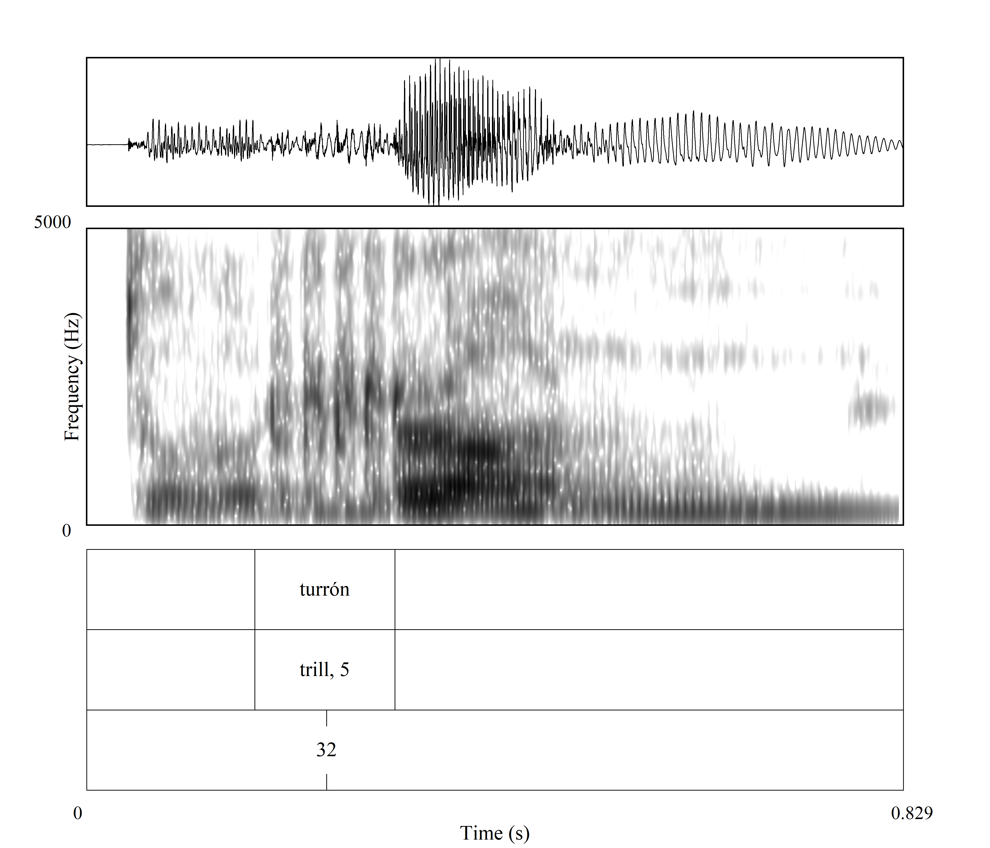
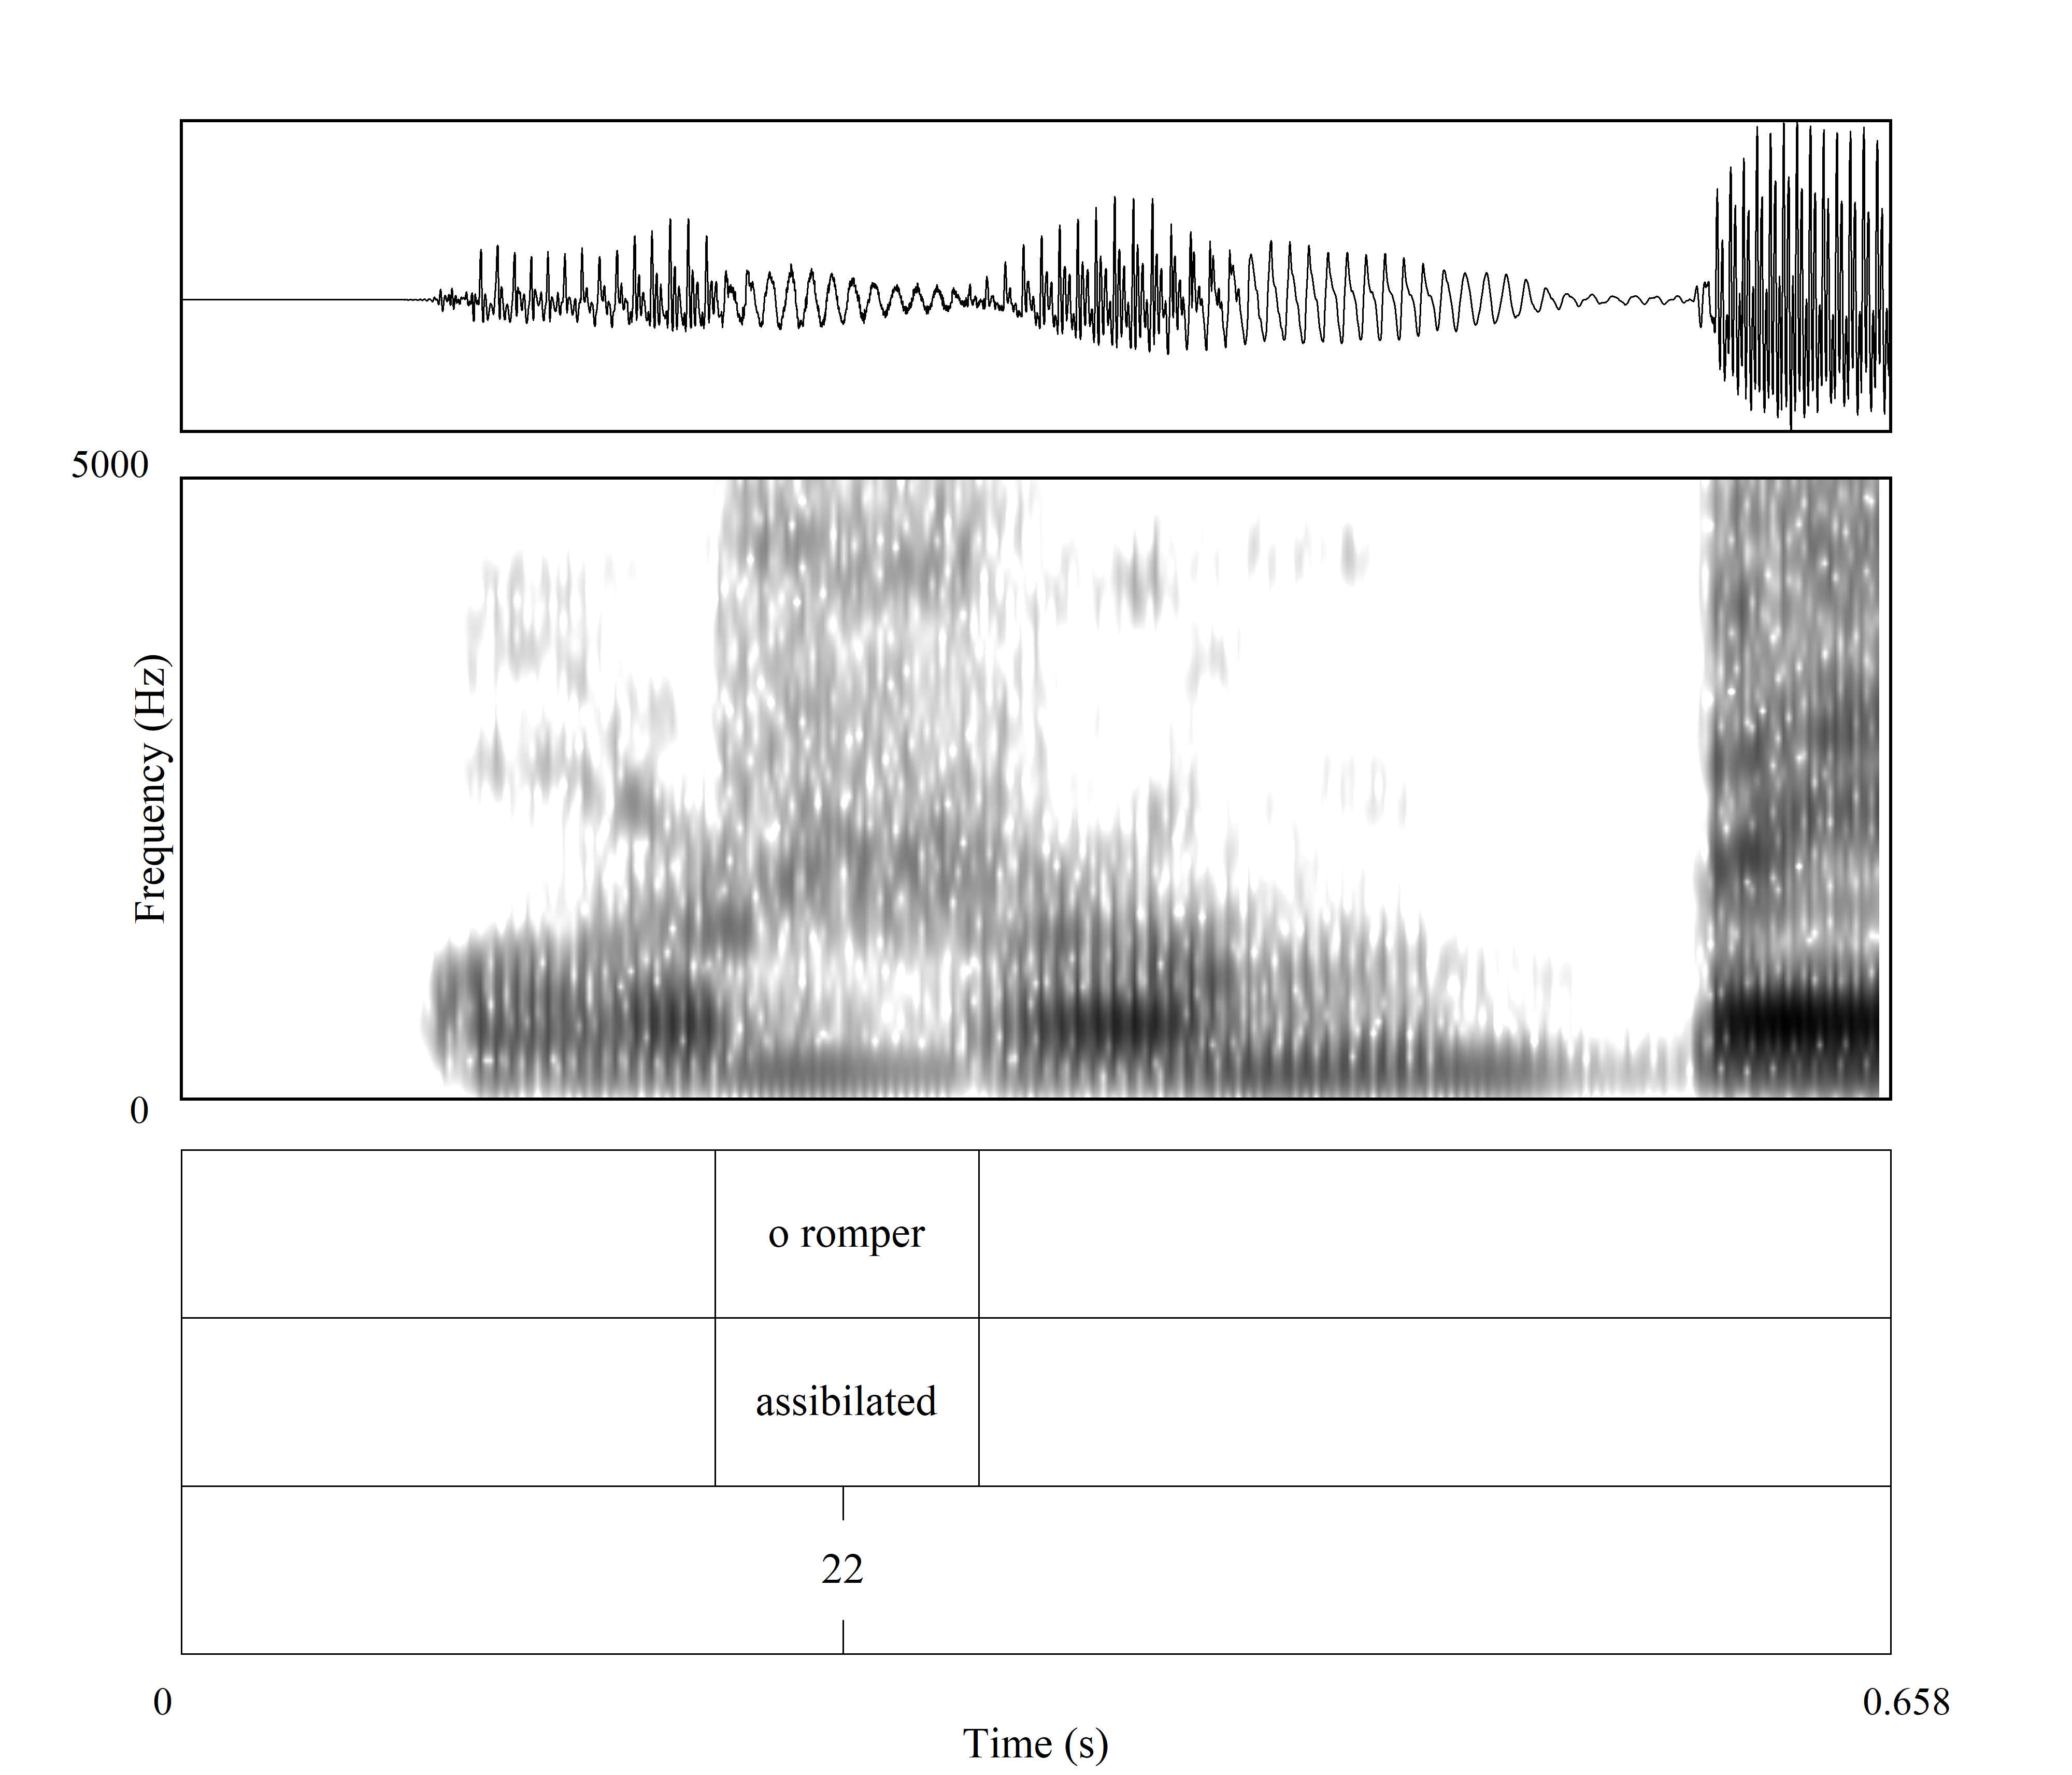
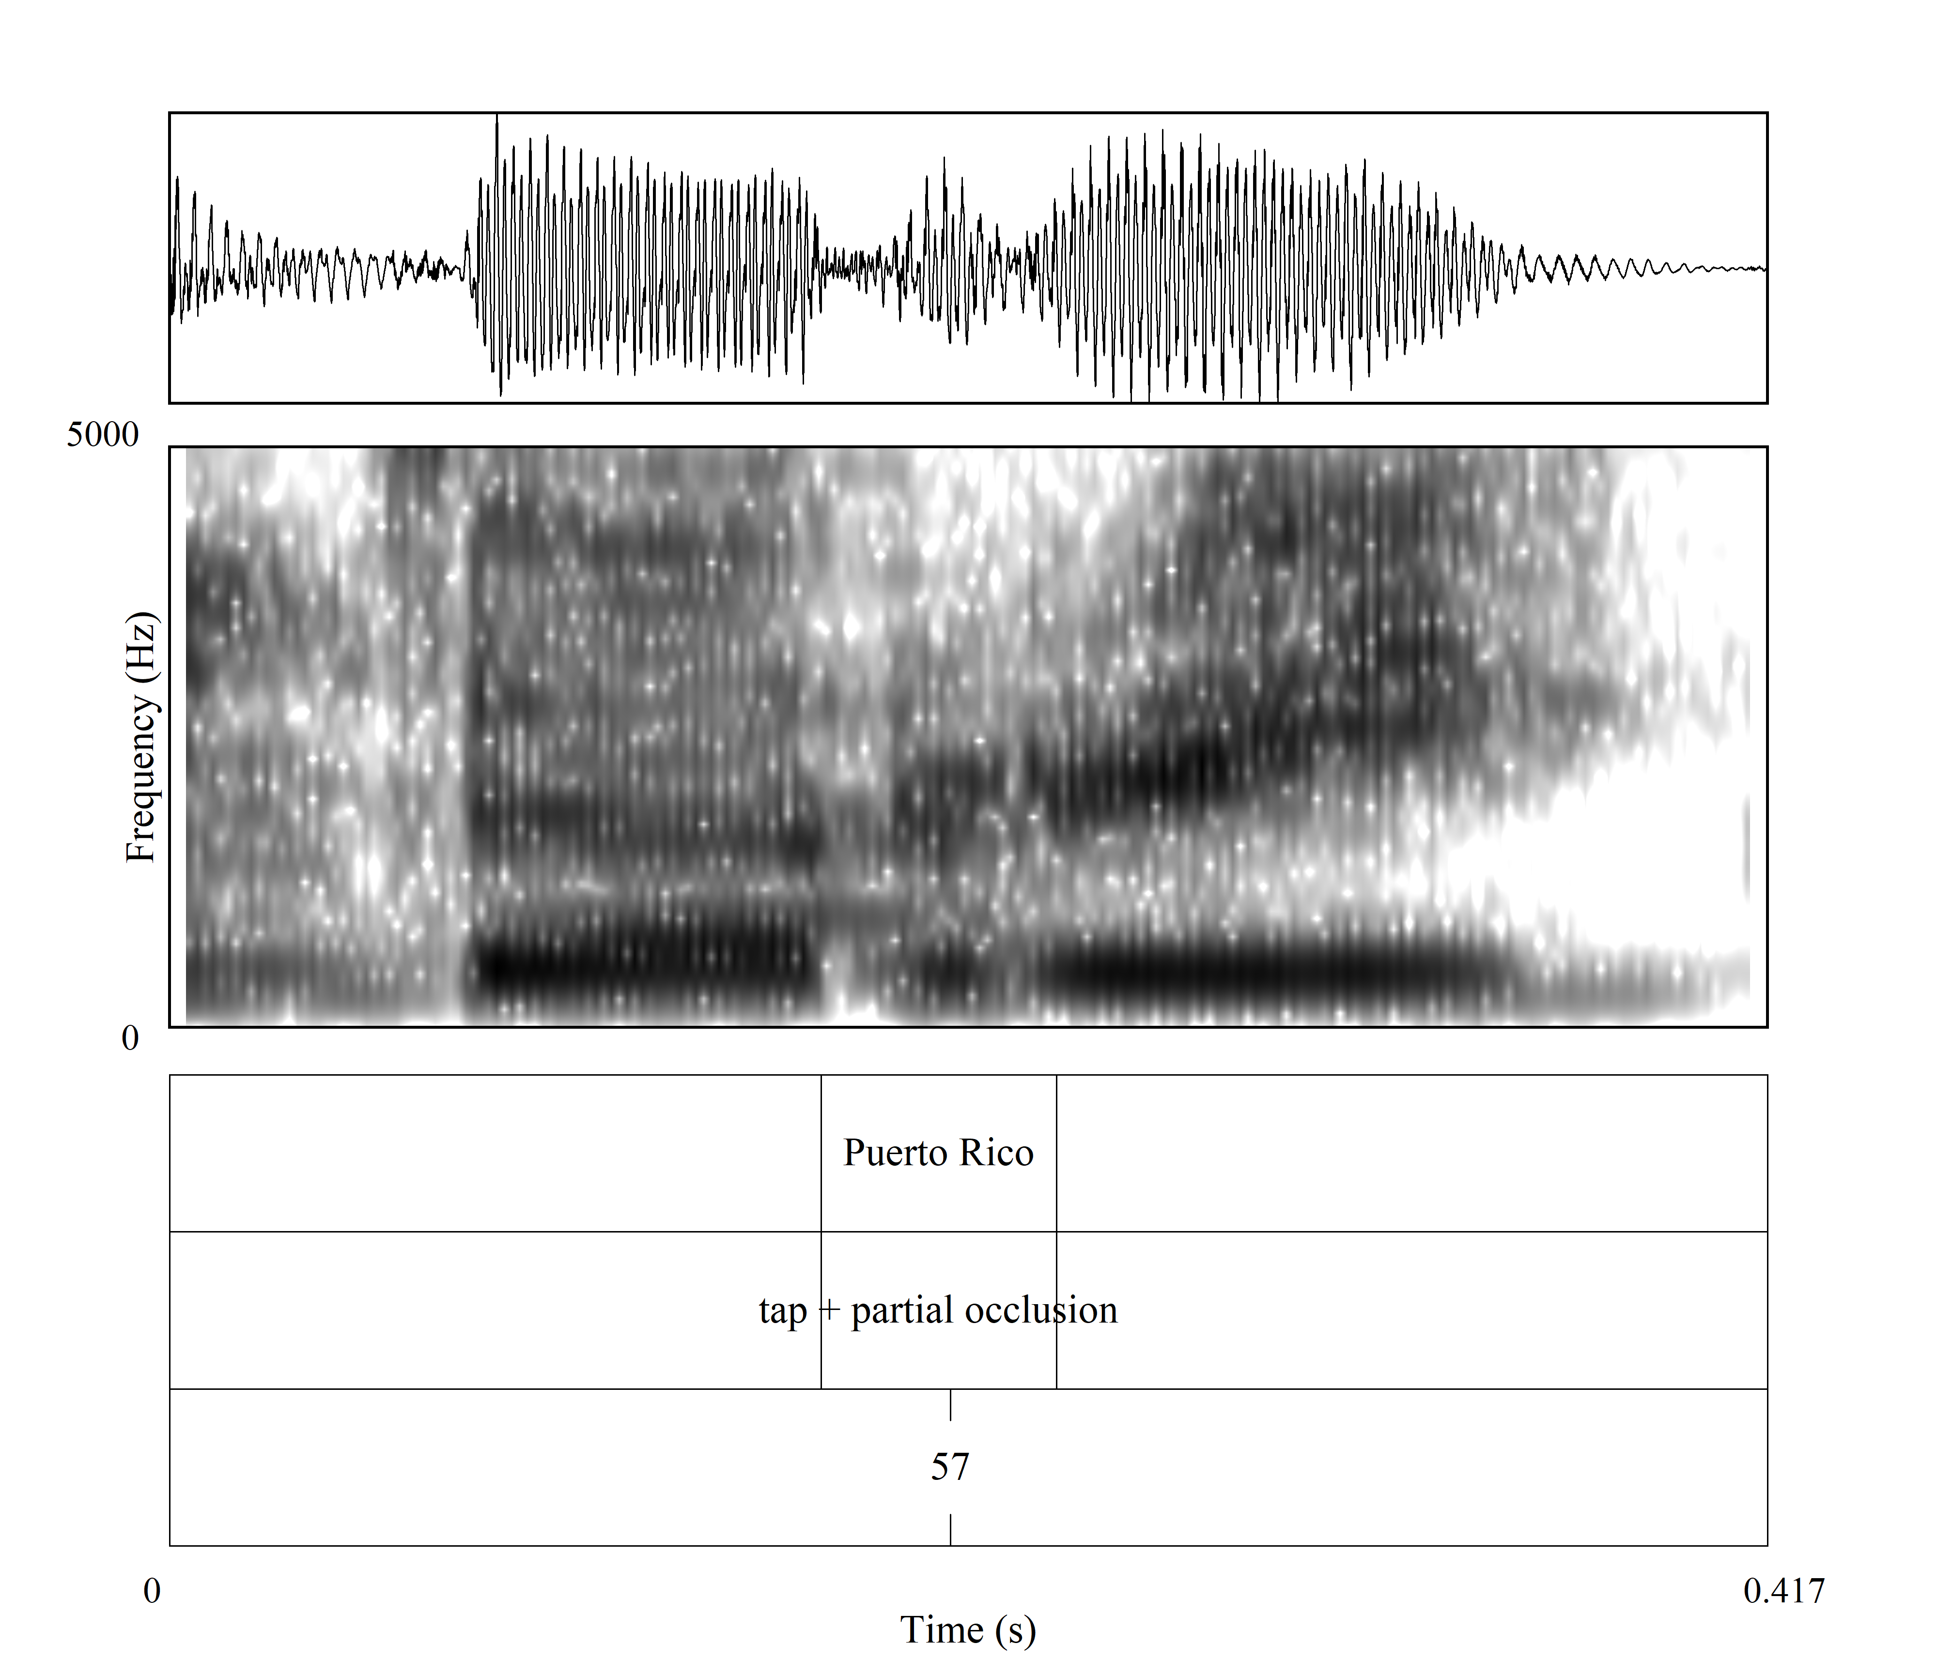

Slide 9
Results

Slide 10
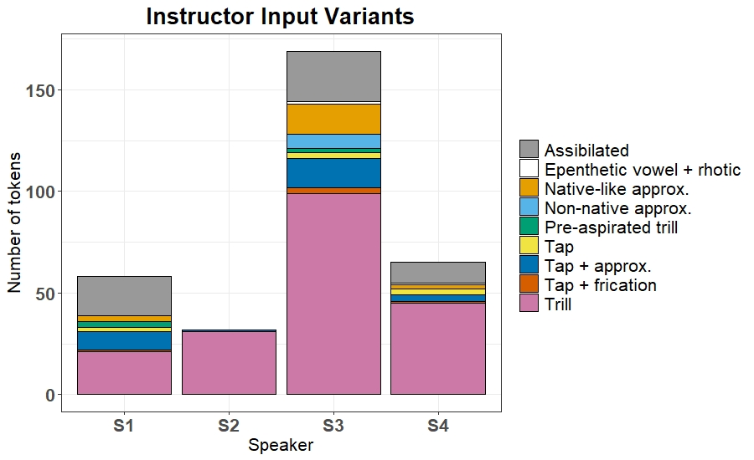
Large variance in amount of trill tokens
Note low # for S2
Trill variation present in the classroom; differs based on speaker

Slide 11
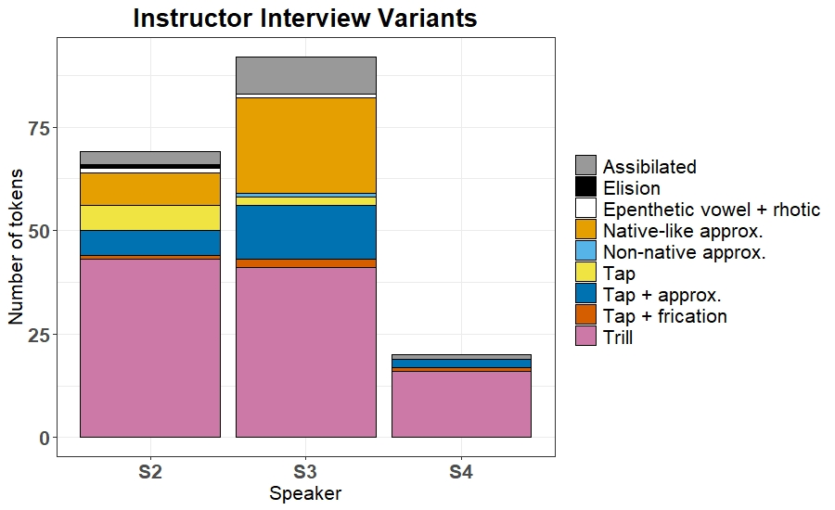
Note low number of tokens for S4

Slide 12
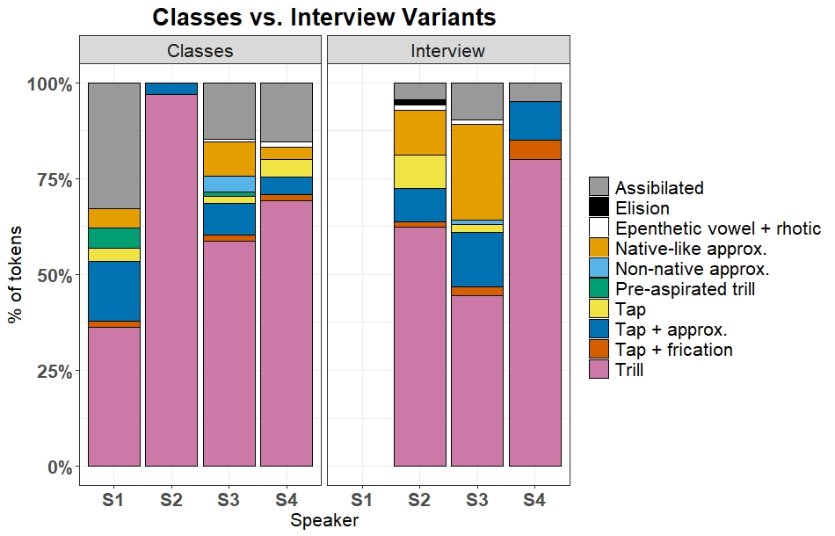
S2 used a lot more standard trills in the classroom (but only 32 tokens)
Average # of occlusions for standard trills
Classroom: 2.7
Interview: 2.2

Slide 13
S3 used somewhat more standard trills in the classroom compared to the interview
Average # of occlusions for standard trills
Classroom: 2.9
Interview: 2.5

Slide 14
S4 used somewhat more standard trills in the interview (but only 20 tokens)
Average # of occlusions for standard trills
Classroom: 3.3
Interview: 2.3

Slide 15
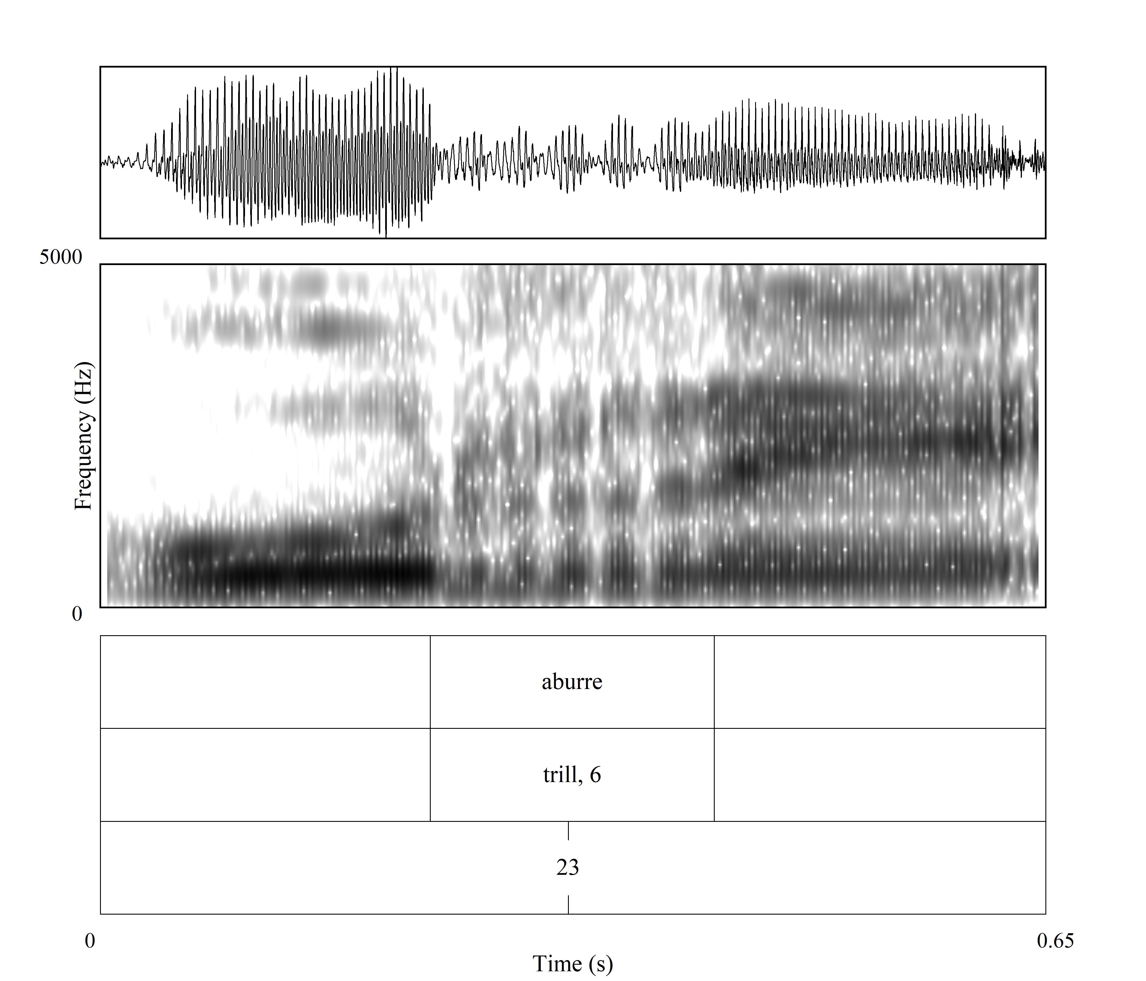
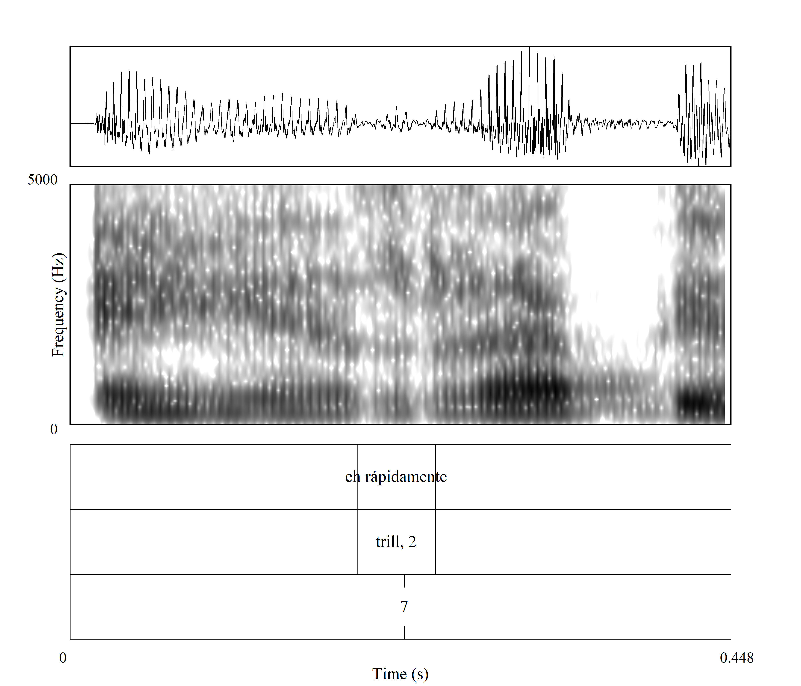
Number of occlusions
Participant 2
Class: 12.9% of the trills contained 4 or more occlusions
Interview: 2.4%
Participant 3
Class: 26.3%
Interview: 7.3%
Participant 4:
Class: 42.2%
Interview: 0%

Slide 16
Discussion
What trill variants do instructors use in the classroom and at what rate?
9 different variants
Standard trill most frequent variant
Assibilated variant and tap + approximant also frequent
Does this differ from the trill variation present in sociolinguistic interviews with the same instructors?
Yes, less standard trill (except for Speaker 4)
Trills with less occlusions
Native-like approximant used more frequently than in class

Slide 17
How does this compare to previous research?
Study | Task | % Standard Trill
Face (2006) | Read short story | 86%
Henriksen (2014) | Narrate a picture story | 70.8%
Rose (2010) | Narrate two picture stories | 65%
Current study | Instructor Classroom speech | 60.5%
Zahler & Daidone (Under review) | Self-guided PPT response prompt task | 38.7%
Díaz-Campos (2008) | Sociolinguistic interviews | 36.2%
Daidone & Zahler (2021) | Various narrative and dialogue tasks | 35.1%
Henriksen & Willis (2010) | Narrate a picture story | 29.8%
Willis (2007) | Narrate a picture story | 4.2%

Slide 18
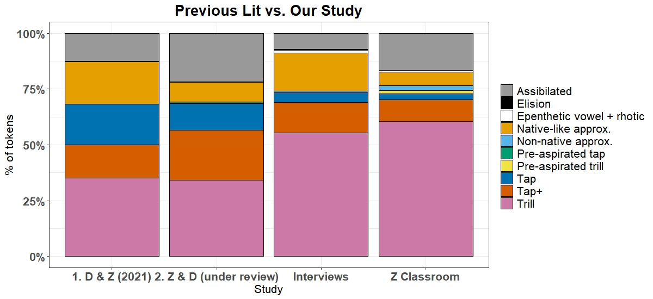
How does this compare to previous research?

Slide 19
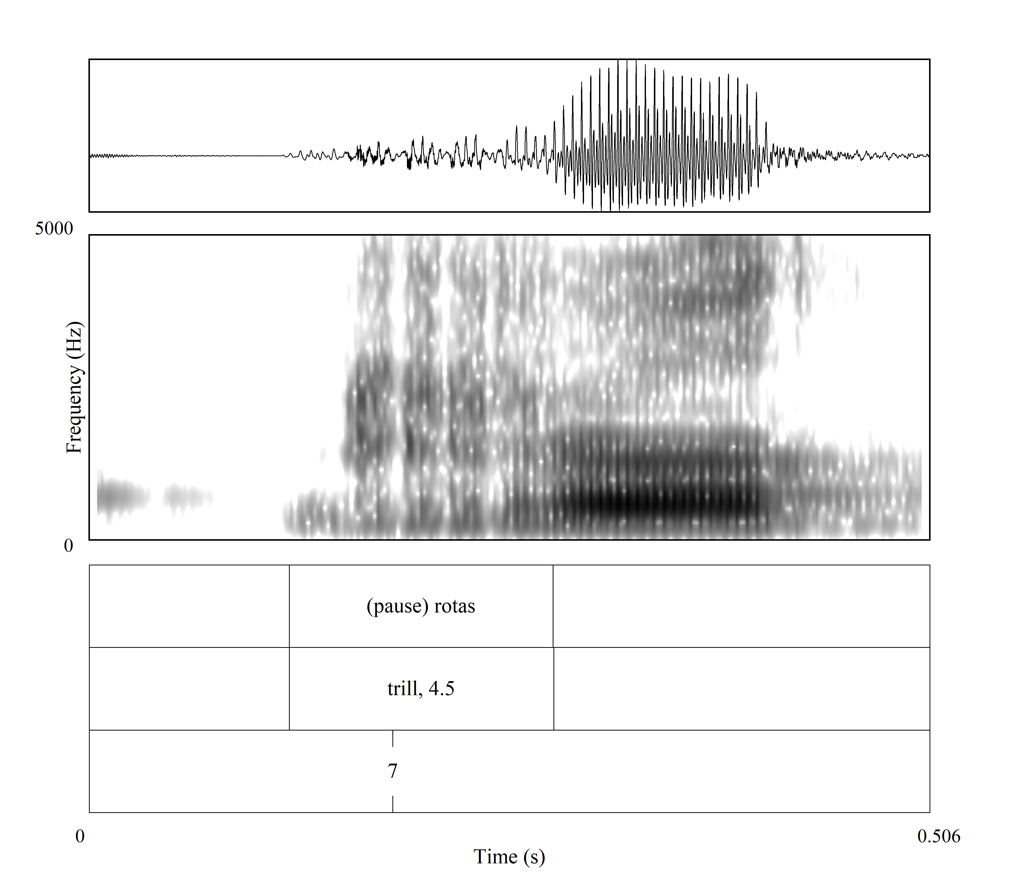
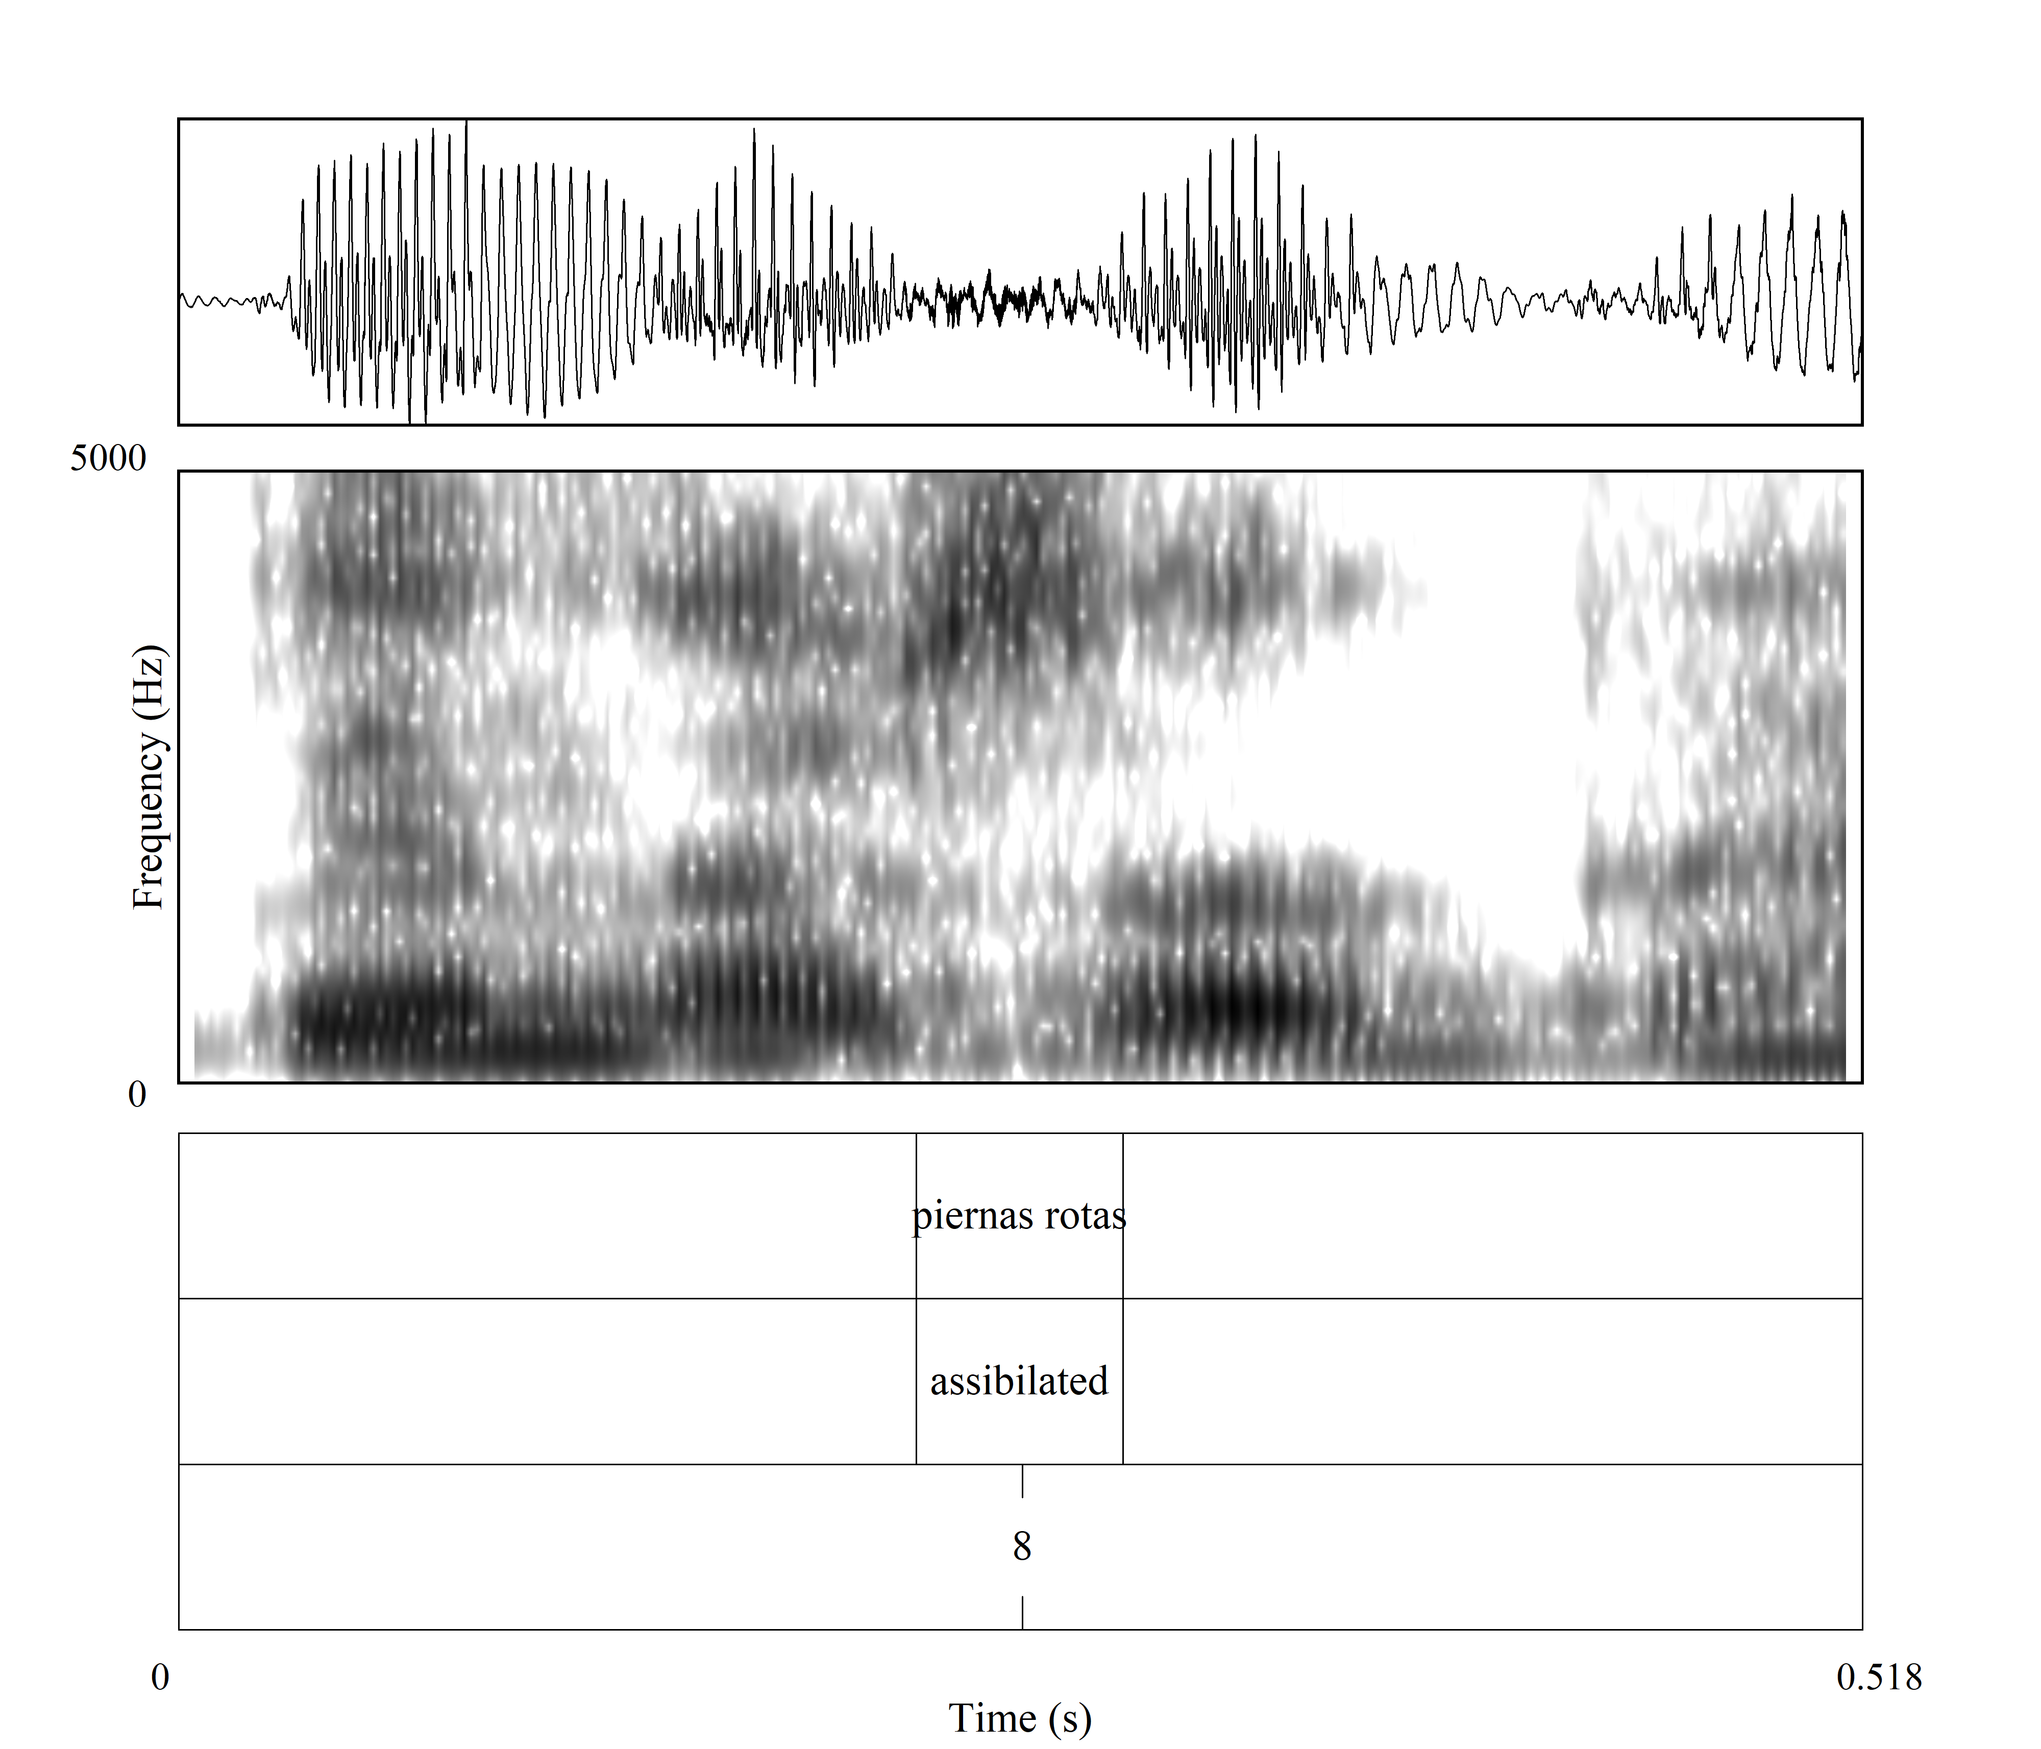
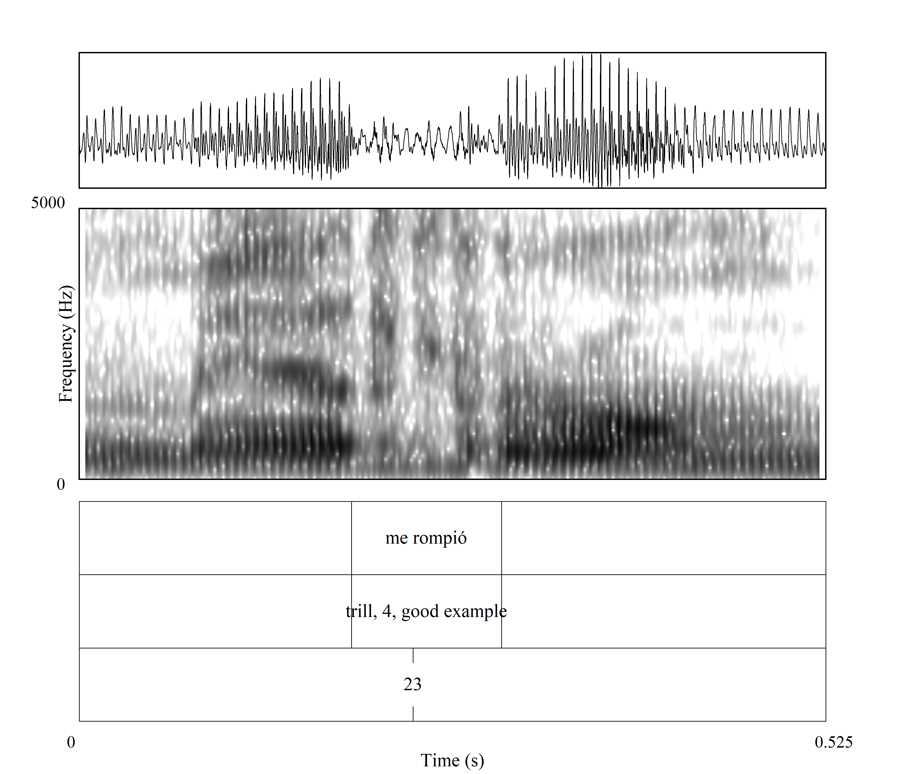
When do these instructors use the standard trill versus other variants?
Piernas, femenino plural, rotas (trill). ¿Sí? ¿Qué le habrá pasado para tener las dos piernas rotas (assibilated)? Vamos a hacer el número dos.
O romper (assibilated). Se me rompió (trill).
60.0% standard trill with first mention of lexical item versus 60.9% with subsequent mentions

Slide 20
When do these instructors use the standard trill versus other variants?
Fast. So, I’m gonna say que el coche azúl es tan rápido (trill)… Rápido (assibilated) is an adverbio. Un adverbio de tiempo…
El surrealismo (trill). Y un pintor importante del surrealismo (tap + approximant)…
El vestido rojo (trill-4) es tan bonito como el marrón (trill-4). So we are comparing el vestido rojo (trill-2), the red dress, with the brown one. So and I w-… What we want to say? That they are both pretty so we are going to say que el vestido rojo (trill-3) es tan bonito… que es un adjetivo… como el marrón (trill-3).

Slide 21
Next steps
More instructors
Add non-native
Continue transcribing
Code the interview data for "type of discourse":
Correction/feedback
Giving examples
Vocabulary presentation
Grammar explanation
Side commentary
More sounds and morphosyntactic structures
Suggestions?

Slide 22
Thank you!
Questions? Suggestions?
Sara Zahler szahler@albany.edu
Danielle Daidone daidoned@uncw.edu

Slide 23
References
Arteaga, D. L. (2000). Articulatory phonetics in the first-year Spanish classroom. The Modern Language Journal, 84(3), 339–354. https://doi.org/10.2307/330565
Bybee, J. (2008). Usage-based grammar and second language acquisition. In P. Robinson & N. C. Ellis (Eds.), Handbook of cognitive linguistics and second language acquisition (pp. 216–236). Routledge.
Daidone, D. (2019). Preterite and imperfect in Spanish instructor oral input and Spanish language corpora. Hispania, 102(1), 45-58.
Daidone, D., & Zahler, S. (2021). A variationist analysis of second language Spanish trill production. Studies in Hispanic and Lusophone Linguistics, 14(1), 1–37. https://doi.org/10.1515/shll-2021-2038
Díaz-Campos, M. (2008). Variable production of the trill in spontaneous speech: Sociolinguistic implications. In L. Colantoni & J. Steele (Eds.), Selected proceedings of the 3rd Conference on Laboratory Approaches to Spanish Phonology (pp. 47–58). Cascadilla Press.
Dracos, M. (2018). Teacher talk and Spanish subject personal pronouns. Journal of Spanish Language Teaching, 5(1), 1-15.
Ellis, N. C. (2013). Frequency-based grammar and the acquisition of tense and aspect in L2 learning. In M. R. Salaberry & L. Comajoan (Eds.), Research design and methodology in studies on L2 tense and aspect (pp. 89–117). Mouton de Gruyter.
Ellis, N. C., & Collins, L. (2009). Input and second language acquisition: The roles of frequency, form, and function. The Modern Language Journal, 93(3), 329–335. https://doi.org/10.1111/j.1540-4781.2009.00893.x
Face, T. L. (2006). Intervocalic rhotic pronunciation by adult learners of Spanish as a second language. In C. A. Klee & T. L. Face (Eds.), Selected proceedings of the 7th Conference on the Acquisition of Spanish and Portuguese as First and Second Languages (pp. 47–58). Cascadilla Proceedings Project.

Slide 24
References
Gurzynski-Weiss, L., Geeslin, K. L., Daidone, D., Linford, B., Long, A. Y., Michalski, I., & Solon, M. (2018). Examining multifaceted sources of input: Variationist and usage-based approaches to understanding the L2 classroom. In A. Tyler, L. Ortega, M. Uno, & L. Park (Eds.), Usage-inspired L2 instruction: Researched pedagogy (pp. 291–311). John Benjamins.
Hamayan, E. V., & Tucker, G. R. (1980). Language input in the bilingual classroom and its relationship to second language achievement. TESOL Quarterly, 14(4), 453-468.
Henriksen, N. (2014). Sociophonetic analysis of phonemic trill variation in two sub-varieties of Peninsular Spanish. Journal of Linguistic Geography, 2(1), 4–24.
Henriksen, N., & Willis, E. W. (2010). Acoustic characterization of phonemic trill production in Jerezano Andalusian Spanish. In M. Ortega-Llebaria (Ed.), Selected proceedings of the Fourth Conference on Laboratory Approaches to Spanish Phonology (pp. 115–127). Cascadilla Proceedings Project.
Olsen, M. K. (2012). The L2 acquisition of Spanish rhotics by L1 English speakers: The effect of L1 articulatory routines and phonetic context for allophonic variation. Hispania, 95(1), 65–82.
Rose, M. (2010). Intervocalic tap and trill production in the acquisition of Spanish as a second language. Studies in Hispanic and Lusophone Linguistics, 3(2), 379–419. https://doi.org/https://doi.org/10.1515/shll-2010-1080
Trofimovich, P., Collins, L., Cardoso, W., White, J., & Horst, M. (2012). A frequency-based approach to L2 phonological learning: Teacher input and student output in an intensive ESL context. TESOL Quarterly, 46(1), 176-187.
Willis, E. W. (2007). An acoustic study of the “pre-aspirated trill” in narrative Cibaeño Dominican Spanish. Journal of the International Phonetic Association, 37(1), 33–49.

